Slide 2
Welcome to Data Week Online 2021
This session is being recorded
Ensure you have read through the JGI Code of Conduct
Mute your microphone, unless stated otherwise by the presenter/speaker
Type any questions you may have for speakers in the chat box
Complete the registration and feedback forms
Introduce yourself in the chat box - name, role, where you're from!

Slide 3
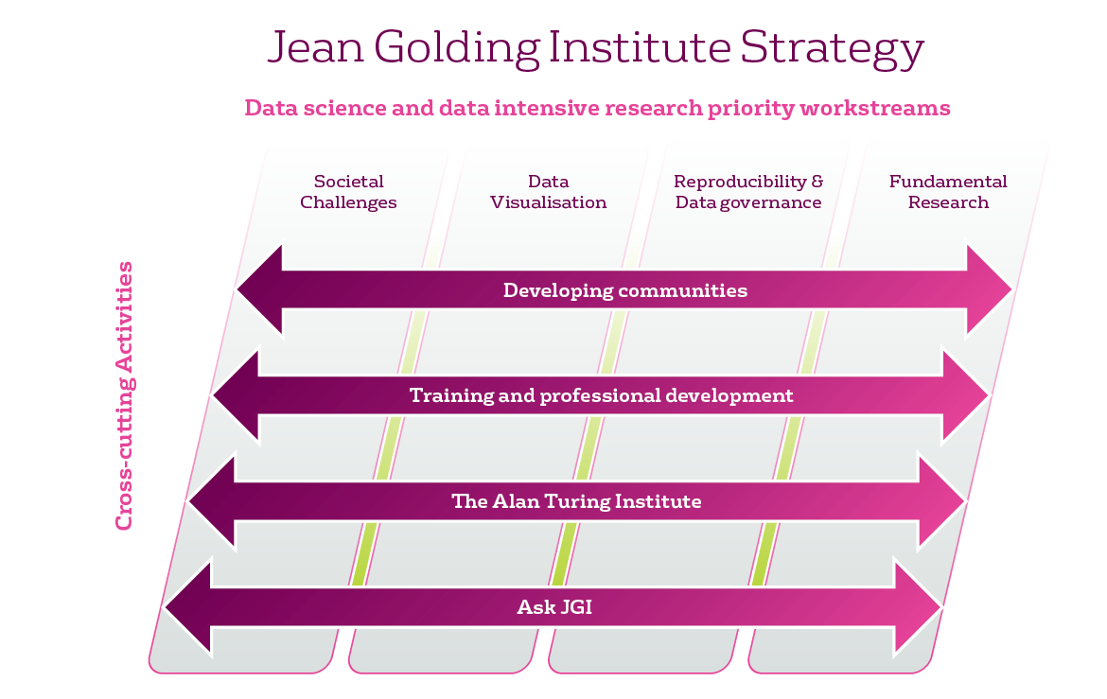
The Jean Golding Institute
A central hub for data science and data-intensive research
One of 5 University of Bristol research institutes
Connect multidisciplinary experts across the University and beyond
Events, training, funding, Ask JGI, The Alan Turing Institute

Slide 4
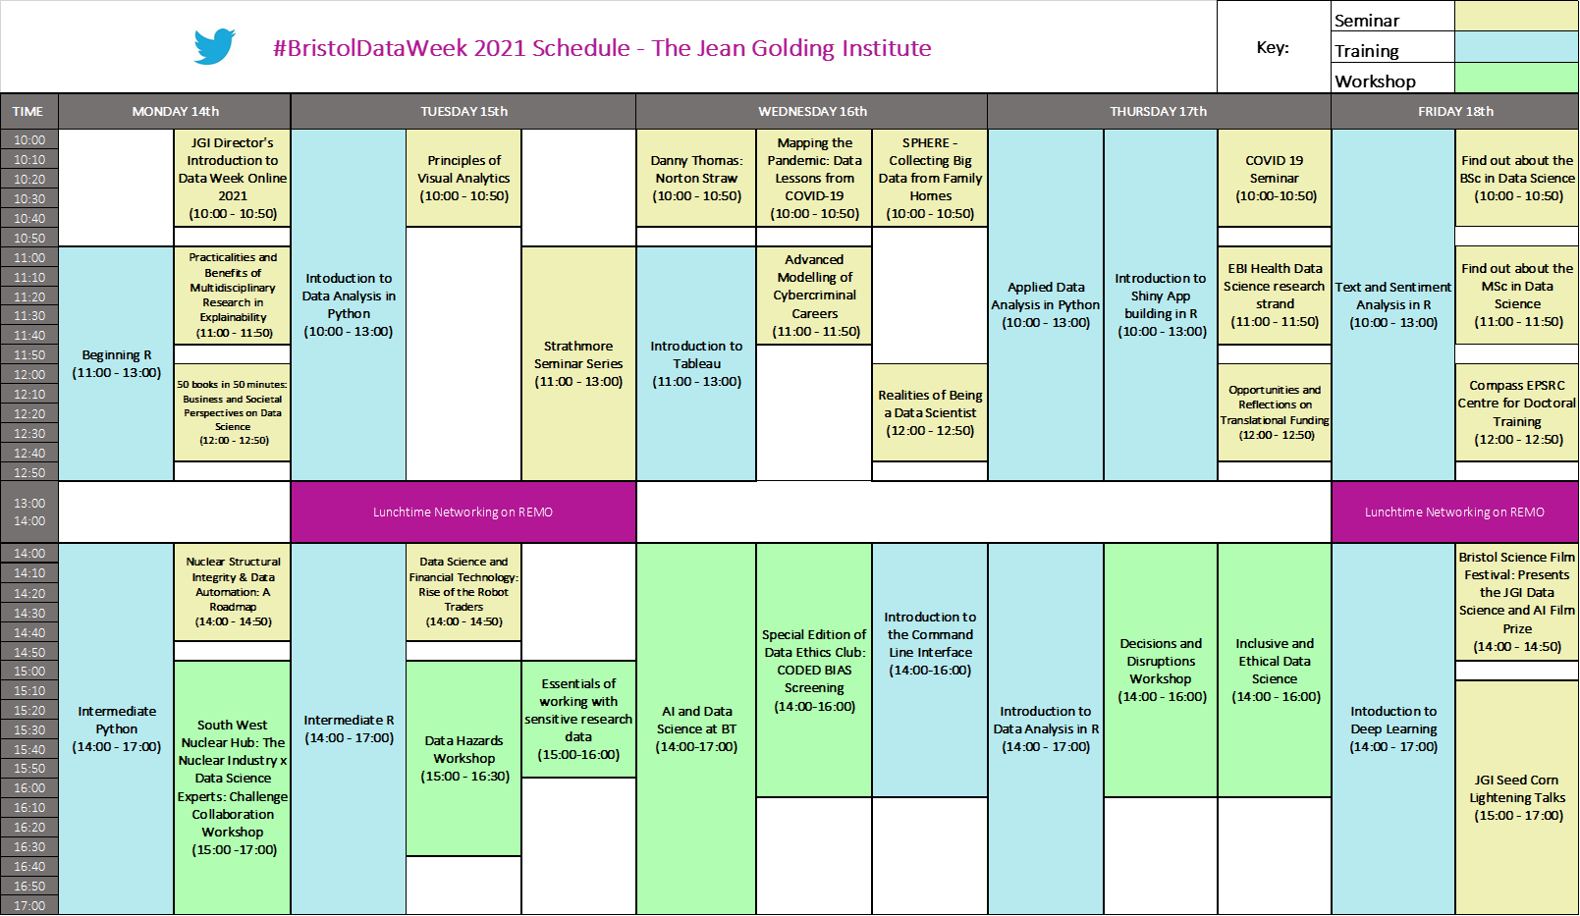

Slide 6
Connect with us & keep in touch!
#BristolDataWeek
@JGIBristol
JGI Website & Blog
Subscribe to our newsletter
Get involved in our Showcase 2022...

Slide 7
Jean Golding Institute Showcase 2022
17th & 18th February 2022 @ M Shed, Bristol
Showcasing the latest interdisciplinary advances in Data Science, Data-intensive research and AI.
Our venue, the M Shed, a flagship museum and iconic building, is set in the heart of Bristol’s historic harborside.
Family-friendly event open to the public
Inspiring speakers, exhibitions, workshops, performances & interactive displays.
Opportunities to connect, network & socialise at our drinks and canapes receptions.

Slide 8
Data integration and Learning
With thanks to: Peter Flach, Raul Santos-Rodriguez, Alessandro Masullo
Miquel Perello-Nieto, Haixia Bi, Emma Tonkin, Taku Yamagata
In This Section
Installation, annotation and training overview
Indoor localisation
Activity recognition
Case study
Other examples

Slide 9
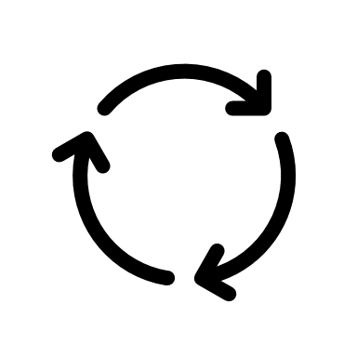
Installation and annotation process
Installation day
...
Removal day
Free living 6-12 months
Annotations
...
Annotations
Estimated indoor locations
...
Estimated activities
Indoor
Localisation
Model
Indoor
Localisation
Model
Estimate
Re-estimate
Train
Retrain
Activity
Model
Activity
Model

Slide 10
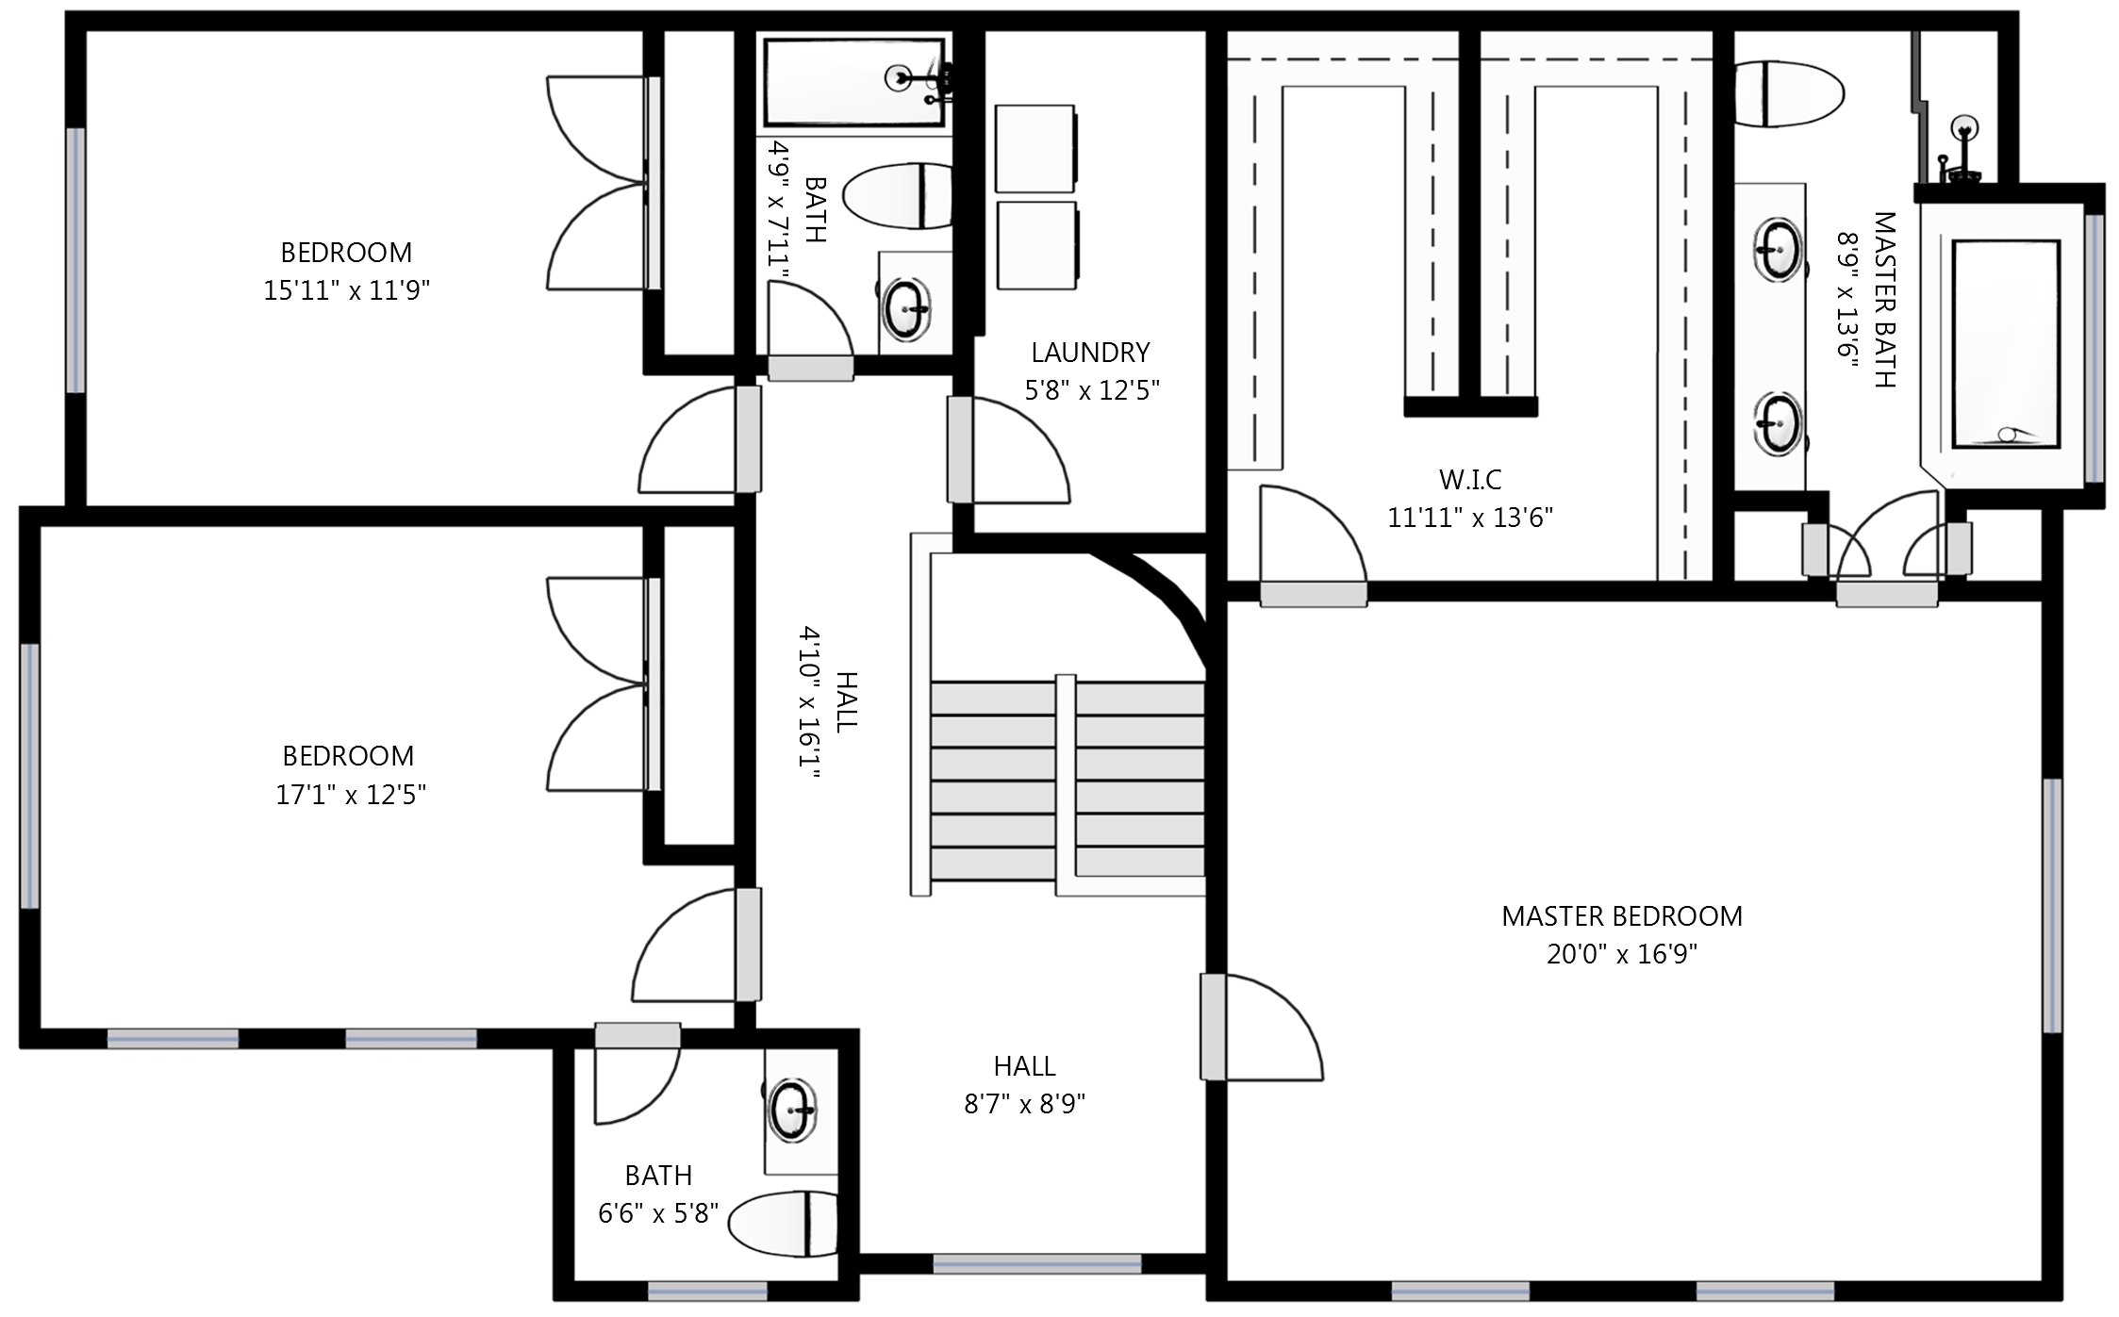
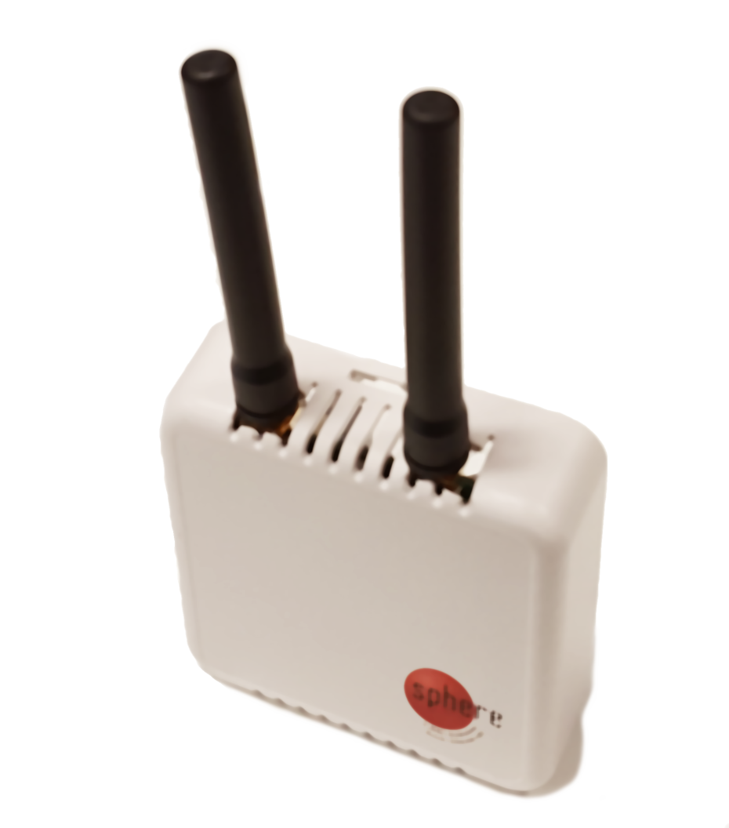
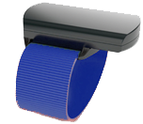
Localisation from Received Signal Strength
-40 dBm
Wristband
-120 dBm
-70 dBm
* dBm: decibel-milliwatts

Slide 11
Example of location annotations
At least 2 experiments per visit
Visit every room and annotate the location
We record the Received Signal Strength Intensity
Train model and use to estimate indoor locations

Slide 12
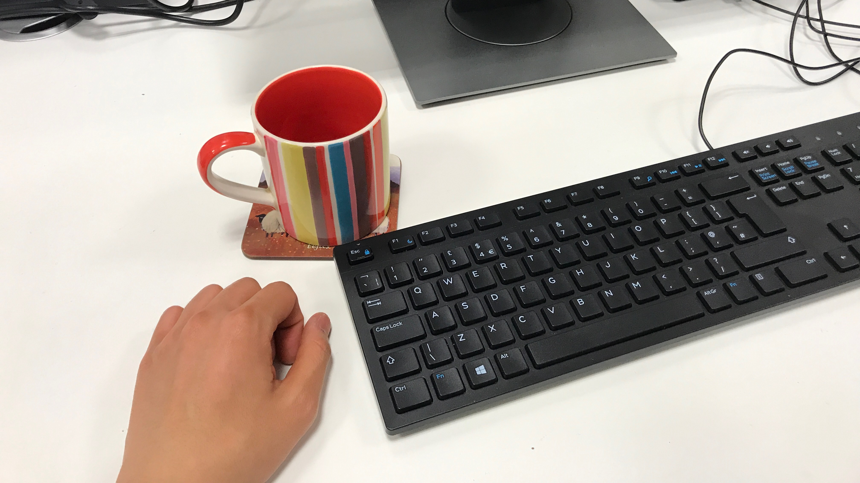
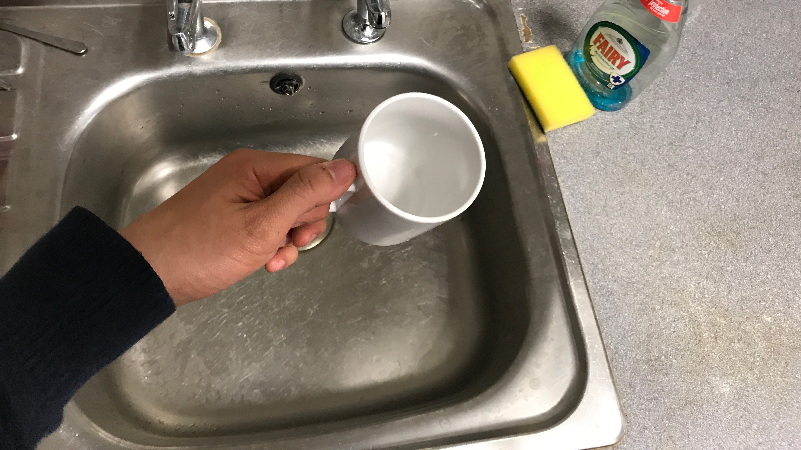
Activity levels and recognition
Z
gravity units
Tri-axial
acceleration
X
Y
Day in fast forward
with a head camera
sit, still
stand, hand activities

Slide 13
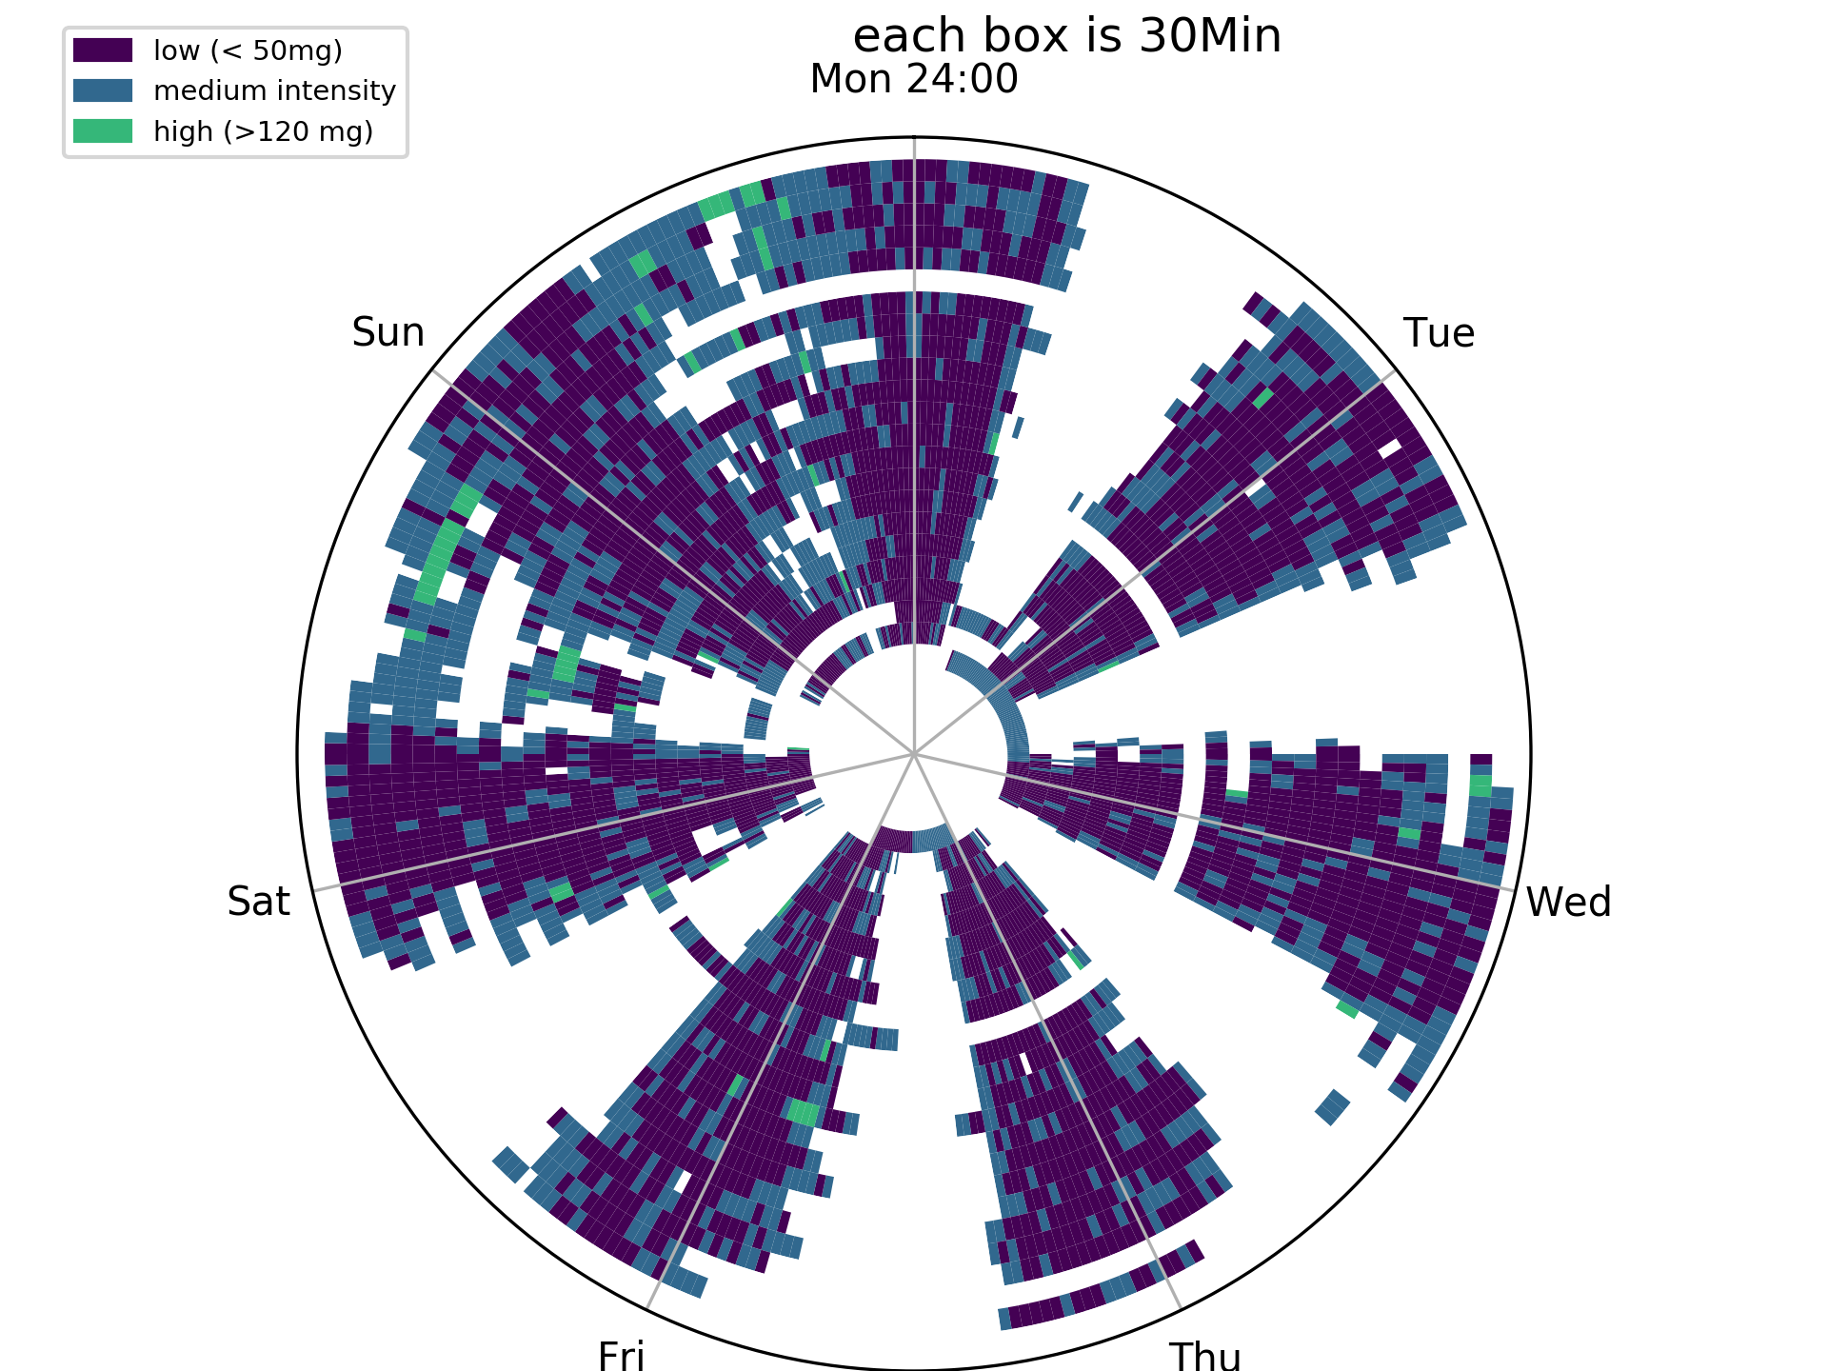
Activity levels for the full period
Outer circle
Last week
Saturdays
daytime
more active
Mon
Sun
Inner
1st
week
Tue
Level of activity
Sat
Wed
Fri
Thu
High
Weekdays
Daytime
Out of home
Medium
Low
Participant A, B, C

Slide 14
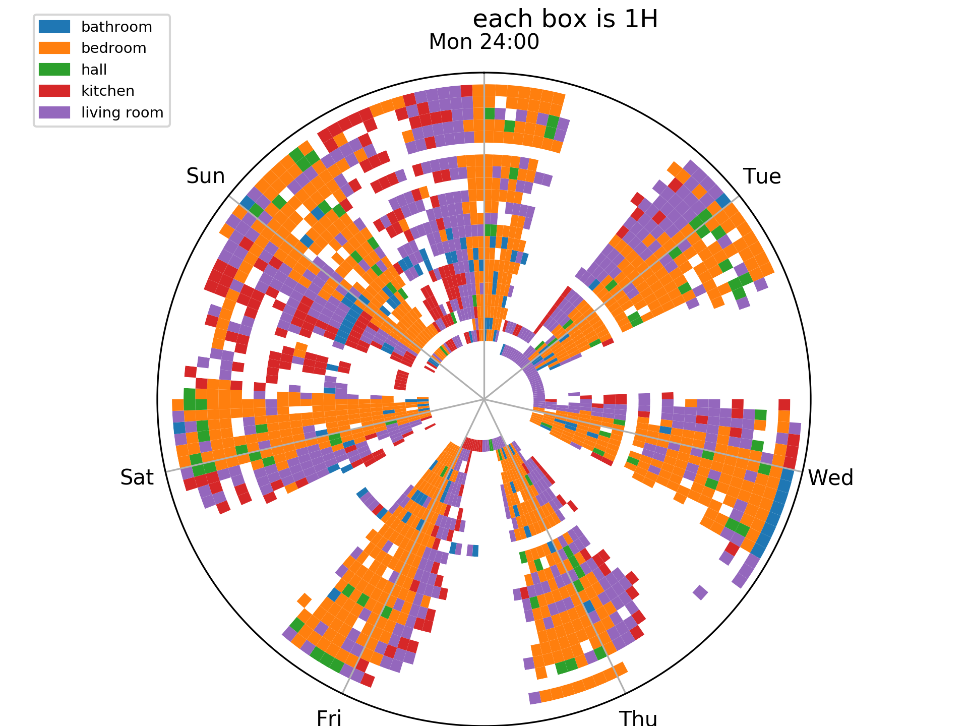
Activity levels and localisation predictions:
Bedroom
Kitchen
Living room
Participant A, B, C

Slide 15
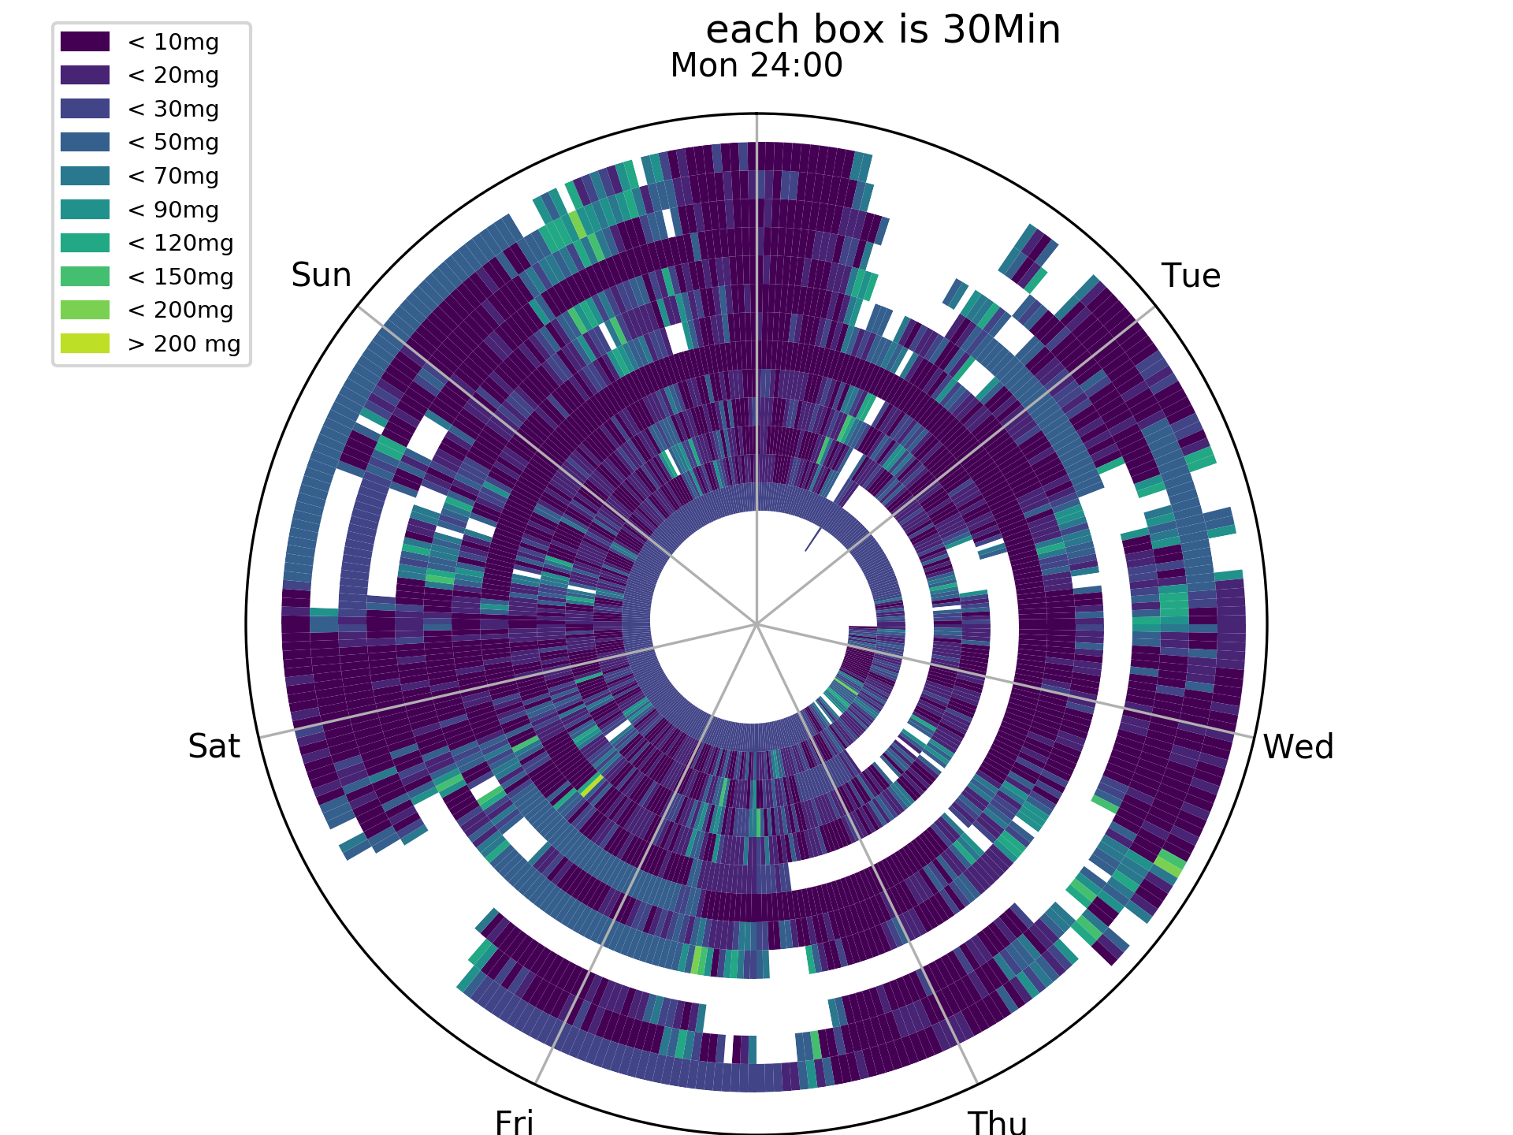
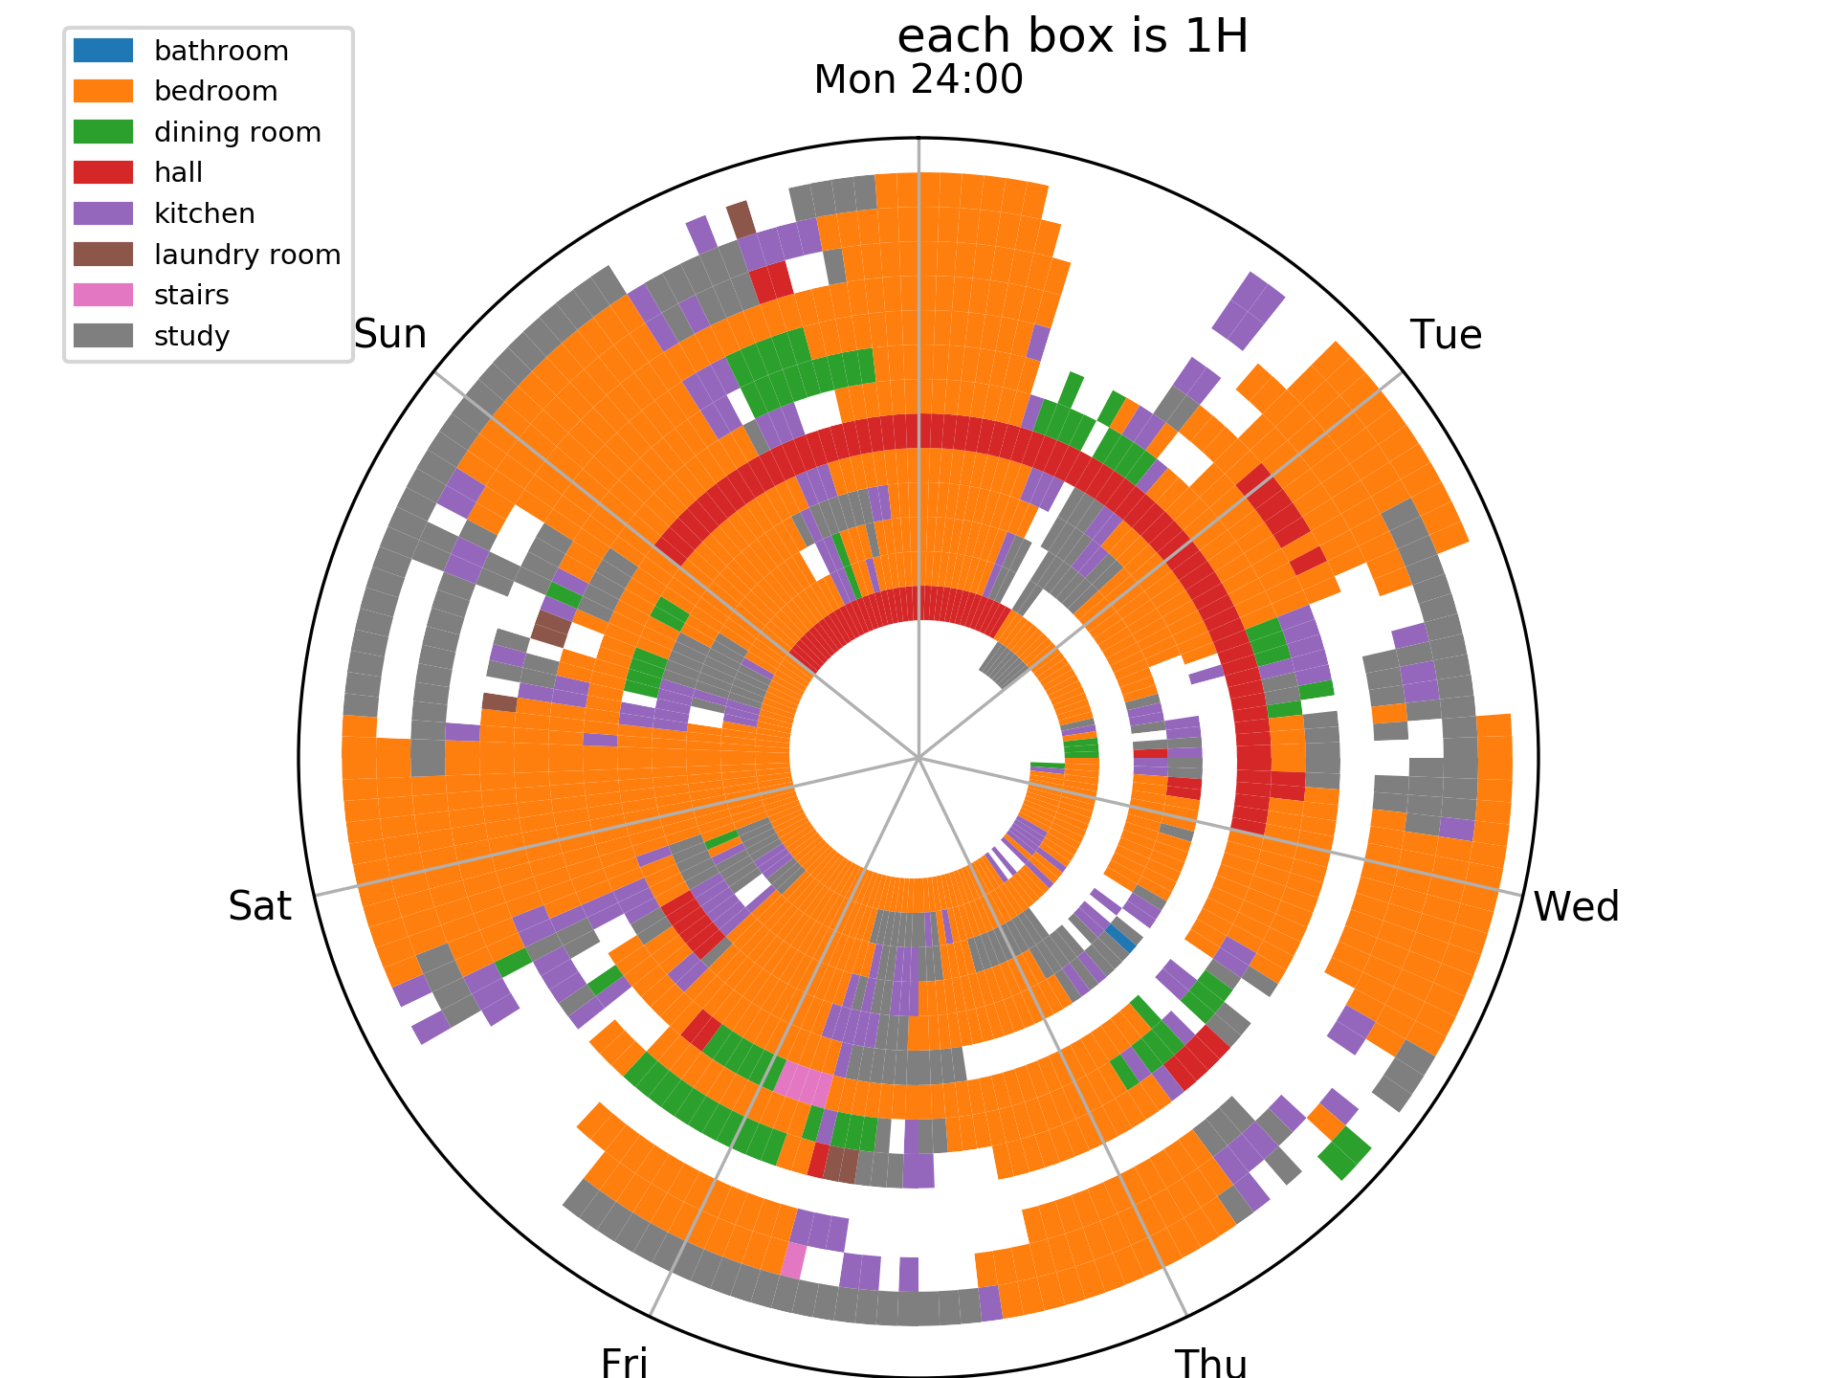
Activity levels and localisation predictions:
Bedroom
Study
Kitchen
First weeks at
home last weeks
out of home
Participant A, B, C

Slide 16
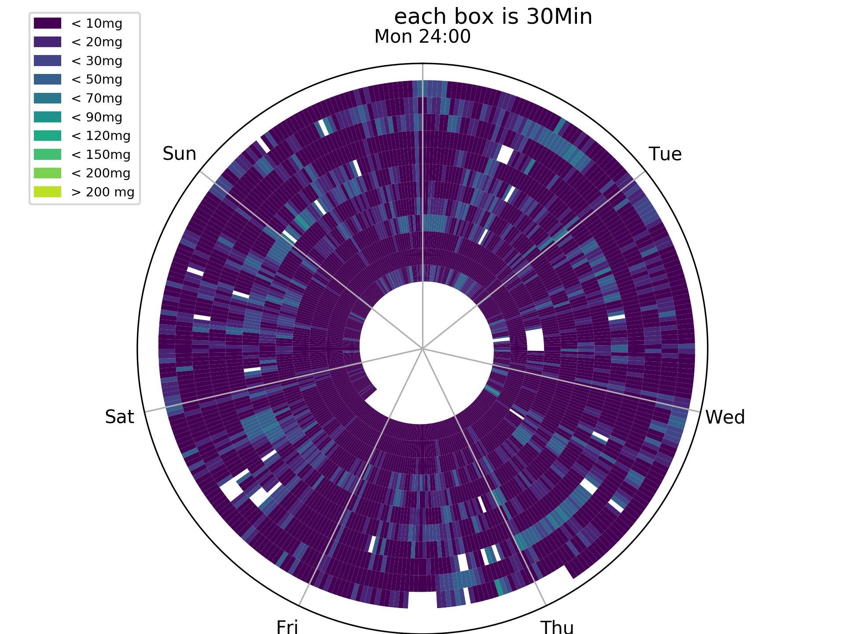
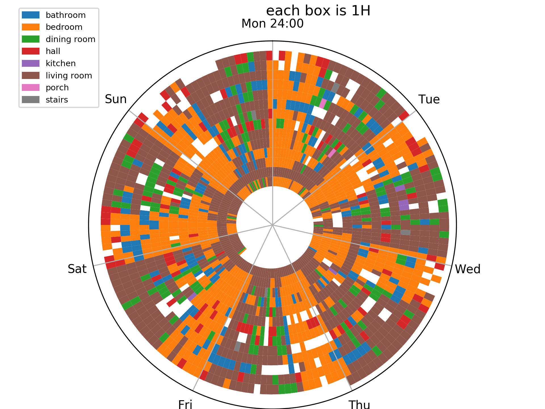
Activity levels and localisation predictions:
Bedroom
Living room
All weeks at home, low level activities
Dinning room
Participant A, B, C

Slide 17
Activity and Locations overview
A
B
C
A is a participant from the control group
B and C are recovering from a hip replacement surgery
B and C spend more time at home, and are generally less active

Slide 18
Sit to Stand as a surrogate of recovery

Slide 19
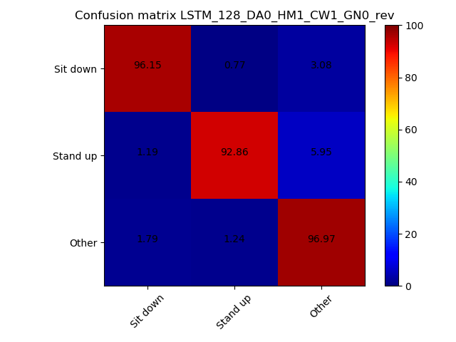
Sit to Stand Detector (Classifier)
Using MuViLab, we have annotated 4 months of video data for STS transitions.
Using a convolutional neural network we were able to achieve >90% accuracy in classifying video sequences:
Examples of 4 seconds video sequences detected as stand up transitions.

Slide 20
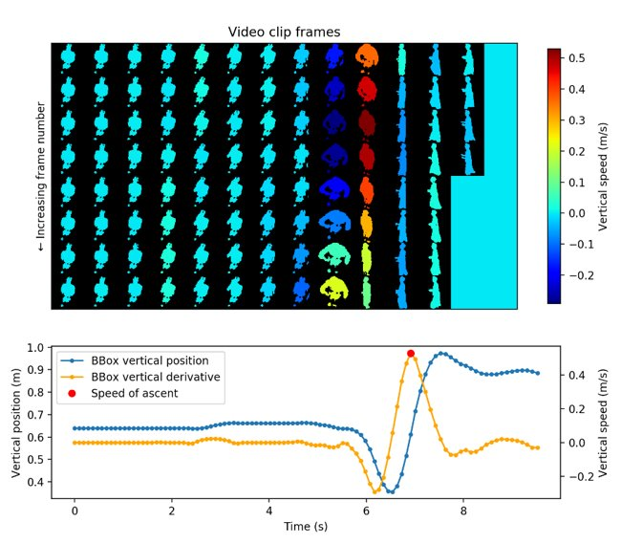
Bounding box peak detection
The figure shows an example of analysis of sit-to-stand transition using silhouettes.
On top are the frames of the video sequence of a person standing up, on the bottom the analysis derived from their movement.
The red dot shows the speed of ascent, i.e. the maximum transfer velocity from sitting to standing position.

Slide 21
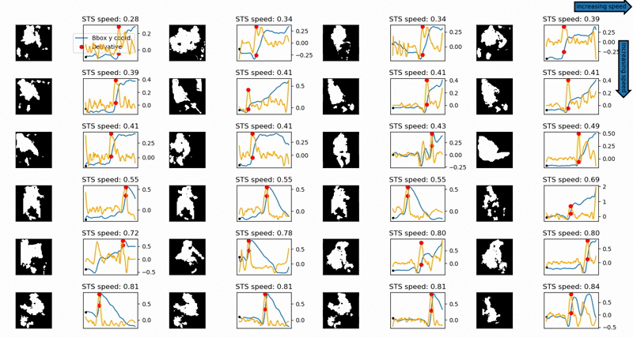
Several Examples of Sit to Stand Speed

Slide 22
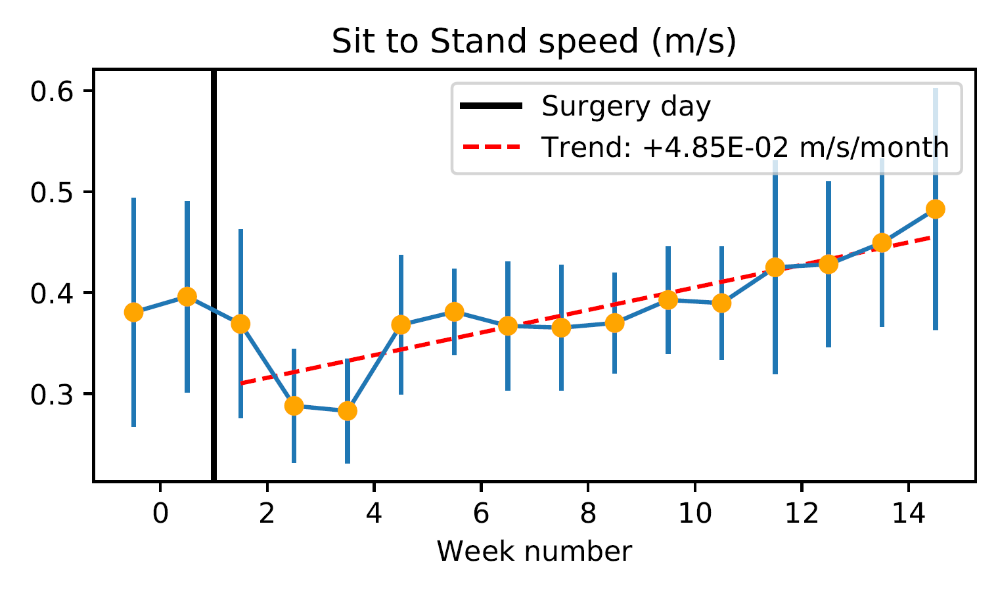
What Does This Look Like for a Patient?
Hip/knee
surgery
Recover from hip/knee replacement
Sit to Stand speed decreases abruptly after surgery
After that, the speed gradually increases

Slide 23
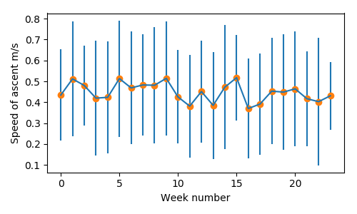
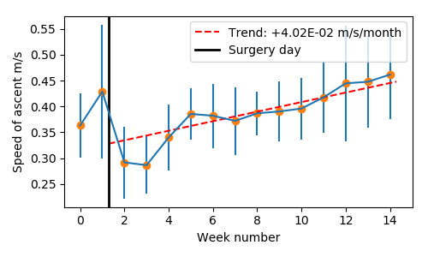
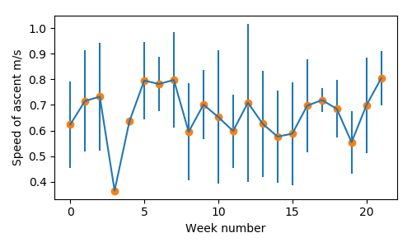
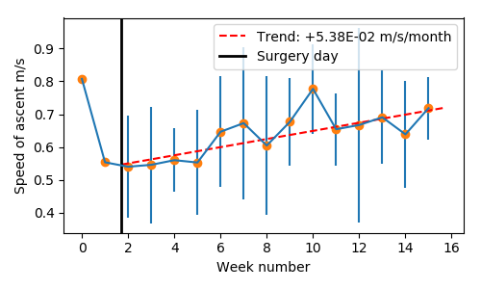
Comparison With Healthy Control
Healthy control
Surgery patients

Slide 24
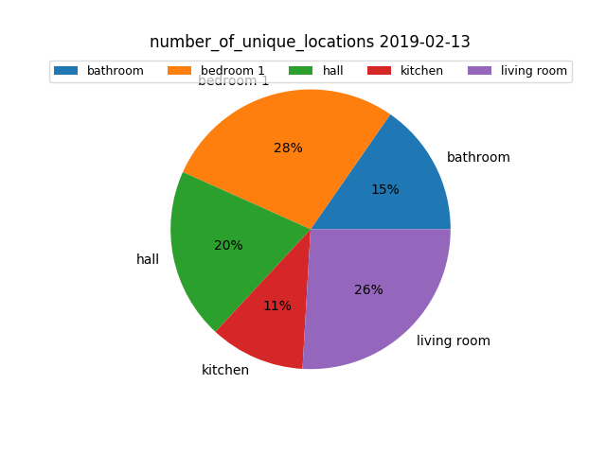
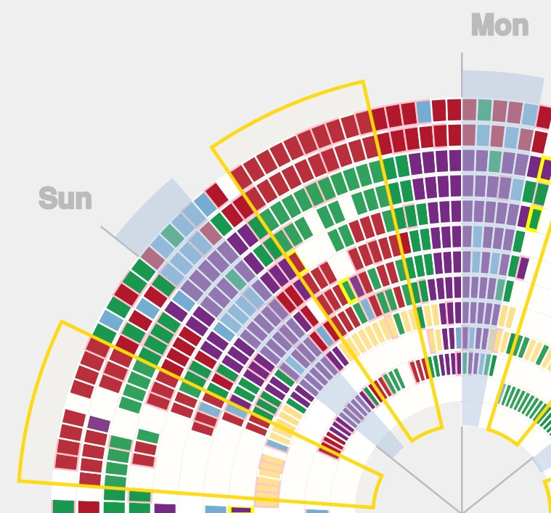
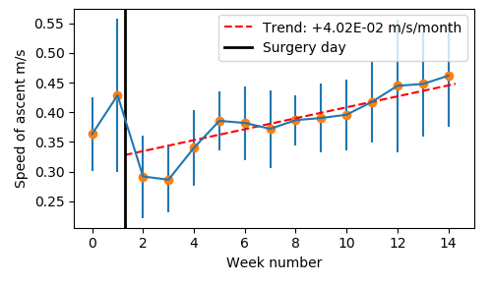
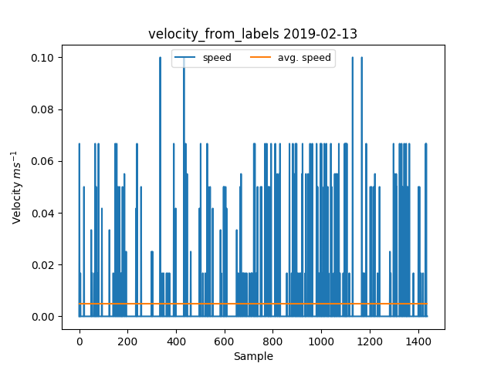
Other examples of available data
- Proportion of time spent in each room in one day (or several)
- Actigraphy for the study of sleep and circadian rhythms. Cut out of a circular plot showing the 10 most active hours (yellow box) and 5 less active (light blue) [2]
- Speed of ascent from sit to stand for a patient recovering from a hip replacement [3]
- Or Number of transitions between rooms
Surrogate of speed computed from room transfers in one day

Slide 25
References
[1] M. Holmes, H. Song, E. Tonkin, M. P. Nieto, S. Grant, and P. Flach, “Analysis of patient domestic activity in recovery from hip or knee replacement surgery: Modelling wrist-worn wearable RSSI and accelerometer data in the wild,” in CEUR Workshop Proceedings, 2018, vol. 2148.
[2] M. Holmes, M. P. Nieto, H. Song, E. Tonkin, S. Grant, and P. Flach, “Modelling Patient Behaviour Using IoT Sensor Data: a Case Study to Evaluate Techniques for Modelling Domestic Behaviour in Recovery from Total Hip Replacement Surgery,” J. Healthc. Informatics Res., vol. 4, no. 3, pp. 238–260, Sep. 2020.
[3] Masullo, Alessandro, et al. "No Need for a Lab: Towards Multi-sensory Fusion for Ambient Assisted Living in Real-world Living Homes." VISIGRAPP (5: VISAPP). 2021.

Slide 26
Connect with us & keep in touch!
#BristolDataWeek
@JGIBristol
JGI Website & Blog
Subscribe to our newsletter
Get involved in our Showcase 2022...

