Slide 1
Are we ready to embrace
Machine Learning in clinical practice?
Part of:
AI and Secure Health Data:
Bridging the Methodological Gap
Presenter: Dr Miquel Perelló Nieto
Wednesday 20th November 2024

Slide 2
About me
Research experience
Research Interests
Machine Learning
Uncertainty quantification
Optimal decision making
Real-world applications
Healthcare

Slide 3
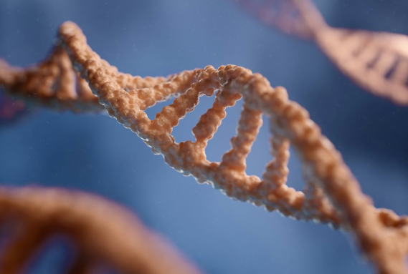
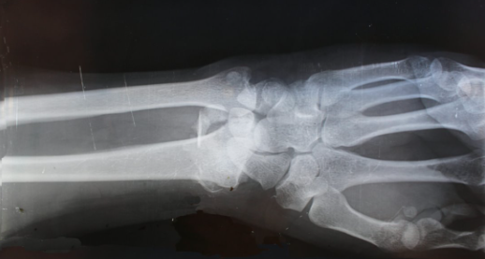
AI vs ML
Artificial Intelligence (AI)
Less data
requirements
Machine Learning (ML)
Deep Learning
More data
Notes:
AI: Multiagent systems, Internet of Things, simulation, digital twins, planning
ML: Human activity recognition, localisation, robotics and automation, predictive maintenance
DL: Personalised medicine, drug discovery and development, medical imaging and diagnostics, chatbots

Slide 4
Healthcare regulations affecting AI
Market (AI Act, Digital Services Act, Digital Markets Act, Cyber Ressillience Act)
Biopharma (European Health Data Space, General Pharmaceutical Legislation, Clinical Trial Regulations)
Data (GDPR, Data Act, Data Governance Act)
Five key principles for regulatory use of AI for medical products
Safety, security and robustness
Transparency and explainability
Fairness
Accountability and governance
Contestability and redress
Research is not affected by some of these regulations.
Policy paper. Impact of AI on the regulation of medical products. Medicines & Healthcare products Regulatory Agency, GOV.UK (Apr. 2024)

Slide 5
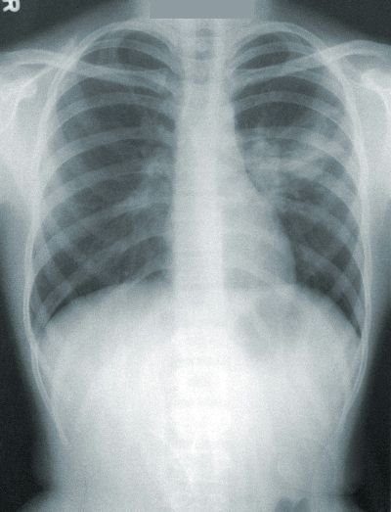
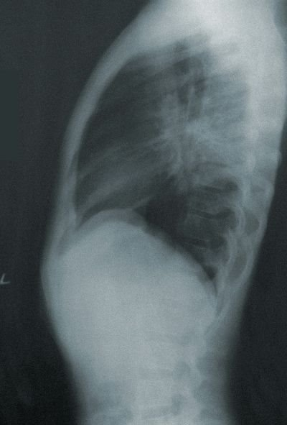
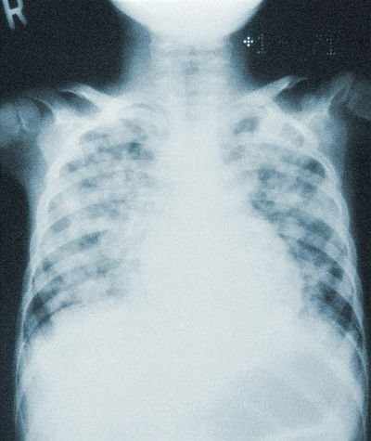
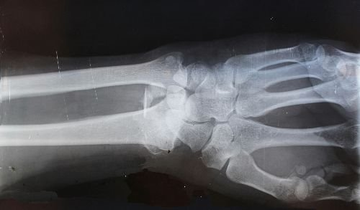
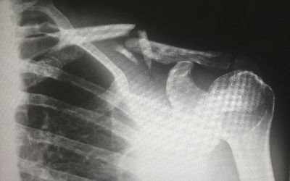
Examples of medical data
Unlabelled data
Annotators
Labelled data
Classification
Detection
Segmentation
Multilabel
Regression
Clustering
Dimensionality Reduction
Generation
Expert
Pneumonia
Reducing costs:
Unsupervised
Semi-supervised
Weak labels
Active learning
Crowdsourcing
Groups
Crowd
Fracture
Notes:
Unsupervised Anomaly detection

Slide 6
Digital health footprint and ML
Health data
Pre-disease
Undetectable
Moderate /
Reversible
Severe /
Irreversible
Disability /
Death
Predisposition?
Epistemic?
Shift from symptom management
to remission and cure
Notes:
Data privacy
Ethical use of collected data
Lack of data standardisation
Scarcity and quality of annotations

Slide 7
Safety and security
Federated learning
Synthetic data
Foundation models
Differential privacy
Synthetic data
Requirements:
Standardisation
Infrastructure
Notes:
Computational infrastructure necessary
Standardisation of the data

Slide 8
Transparency and explainability
Transparent
Pneumonia
Pneumonia
Transparent
Black box
Post-hoc explainability
method
Identify dataset biases, or model problems
Model complexity vs transparency vs performance
Notes:
Dataset biases can be detected with transparency and explainability
Trade-off between predictive performance and model complexity
Model complexity is a common source of lack of transparency

Slide 9
Robustness and fairness
Train
Validate
Test
Deploy
Performance
Training
Validation
Test
Deployment t=1
Deployment t=N
...
Requires constant monitoring
Notes:
active learning, semi-supevised learning, weak labels, one-shot learning
Constant monitoring of
Model performance
Data distribution

Slide 10
Conclusion
Reminder of the key principles
1
Safety, security and robustness
2
Transparency and explainability
3
Fairness
4
Accountability and governance
5
Contestabilityand redress

Slide 11
Sign up to the Hub’s mailing list
Thanks for listening!
Collaborative research
funding in 4 key themes
Ways to get involved
leap-hub.ac.uk
leap-dh-hub@bristol.ac.uk
Programme of short courses for professionals involved in digital health
@LEAP_hub
Funded fellowships, internships, networking and development opportunities
leap-dh-hub

