Slide 1
A focus group to co-design a course on Artificial Intelligence for healthcare professionals
Presenter: Dr Miquel Perelló Nieto
3 December 2024

Slide 2
Schedule
1. (a) Introduction, (b) icebreaker, (c) participants (30 min)
2.a. Demystifying AI (20 min)
2.b. Ethics and regulations of AI (20 min)
2.c. Possible course content (20 min)
3. (a) Learned, (b) missed, (c) feedback (30 min)

Slide 3
1.a., 1.b., 1.c.
Introduction
(10 min)

Slide 4
Dr Miquel Perelló
Nieto
Senior Research Associate
Dr Hanna Isotalus
Deputy Director, Co-Investigator and Skills and Knowledge Programme Director
Tefkros Chimonas
PhD Student
EPSRC CDT in Digital Health and Care
Dr Hans Johnson
PhD Student
EPSRC CDT in Digital
Health and Care

Slide 5
Introduction from participants
Name, company or department

Slide 6
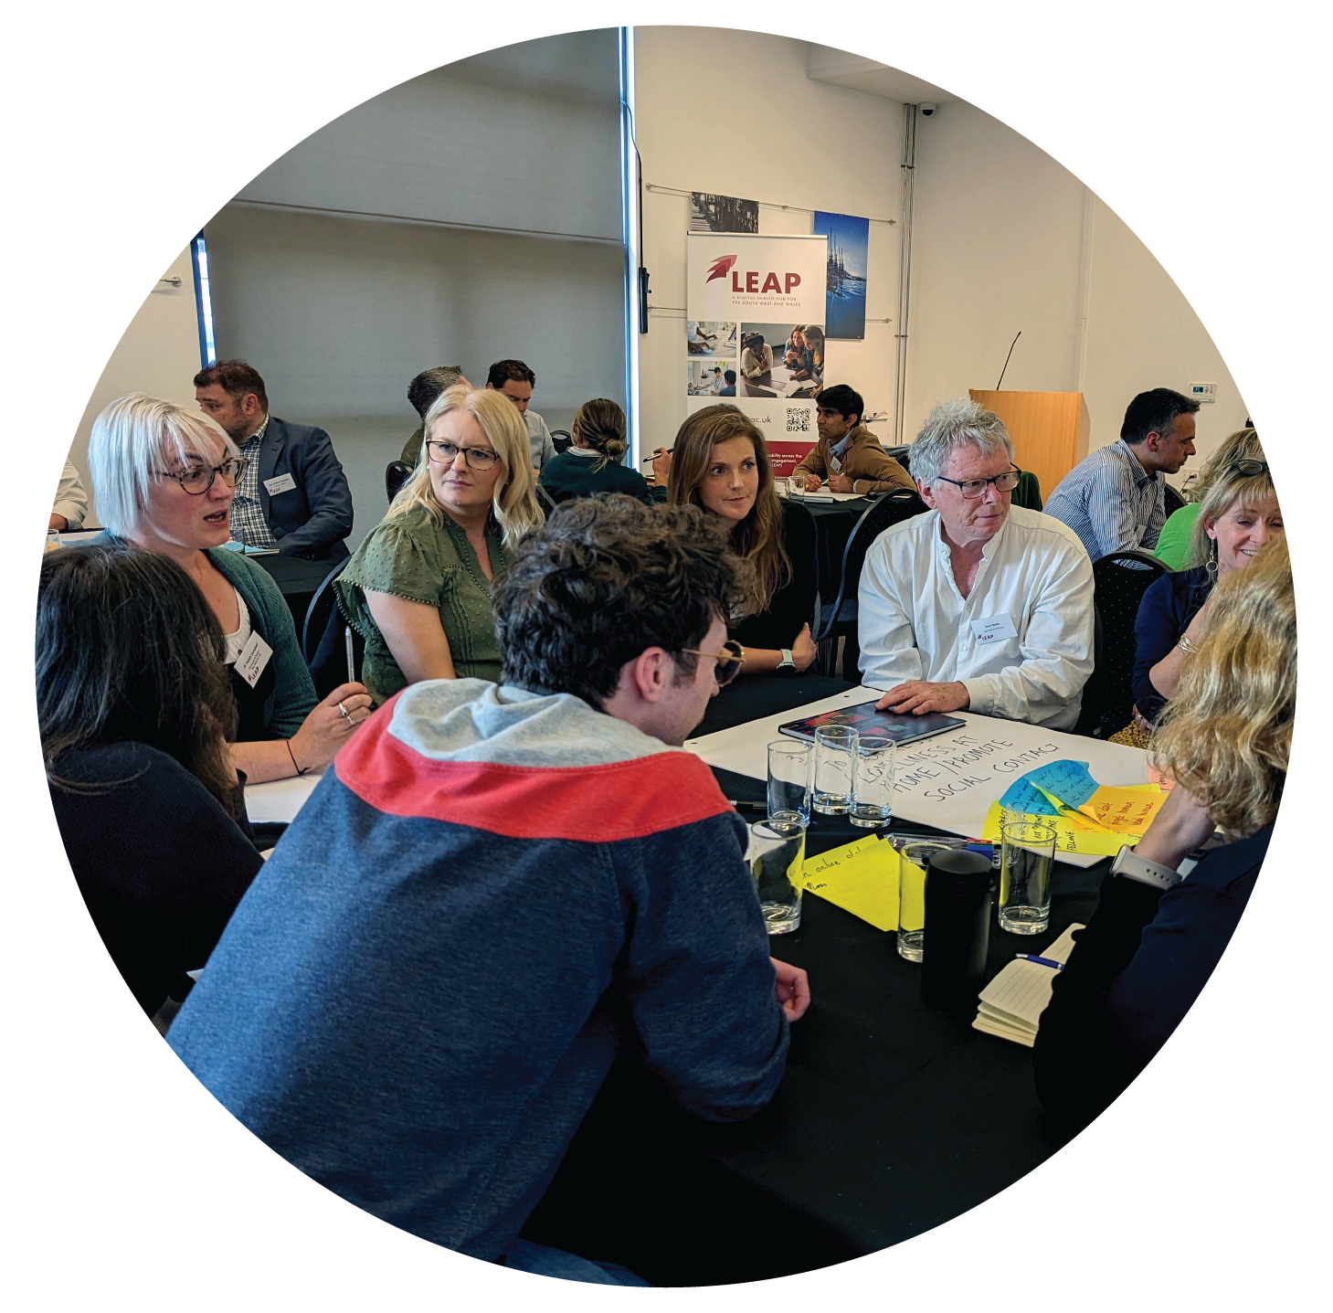
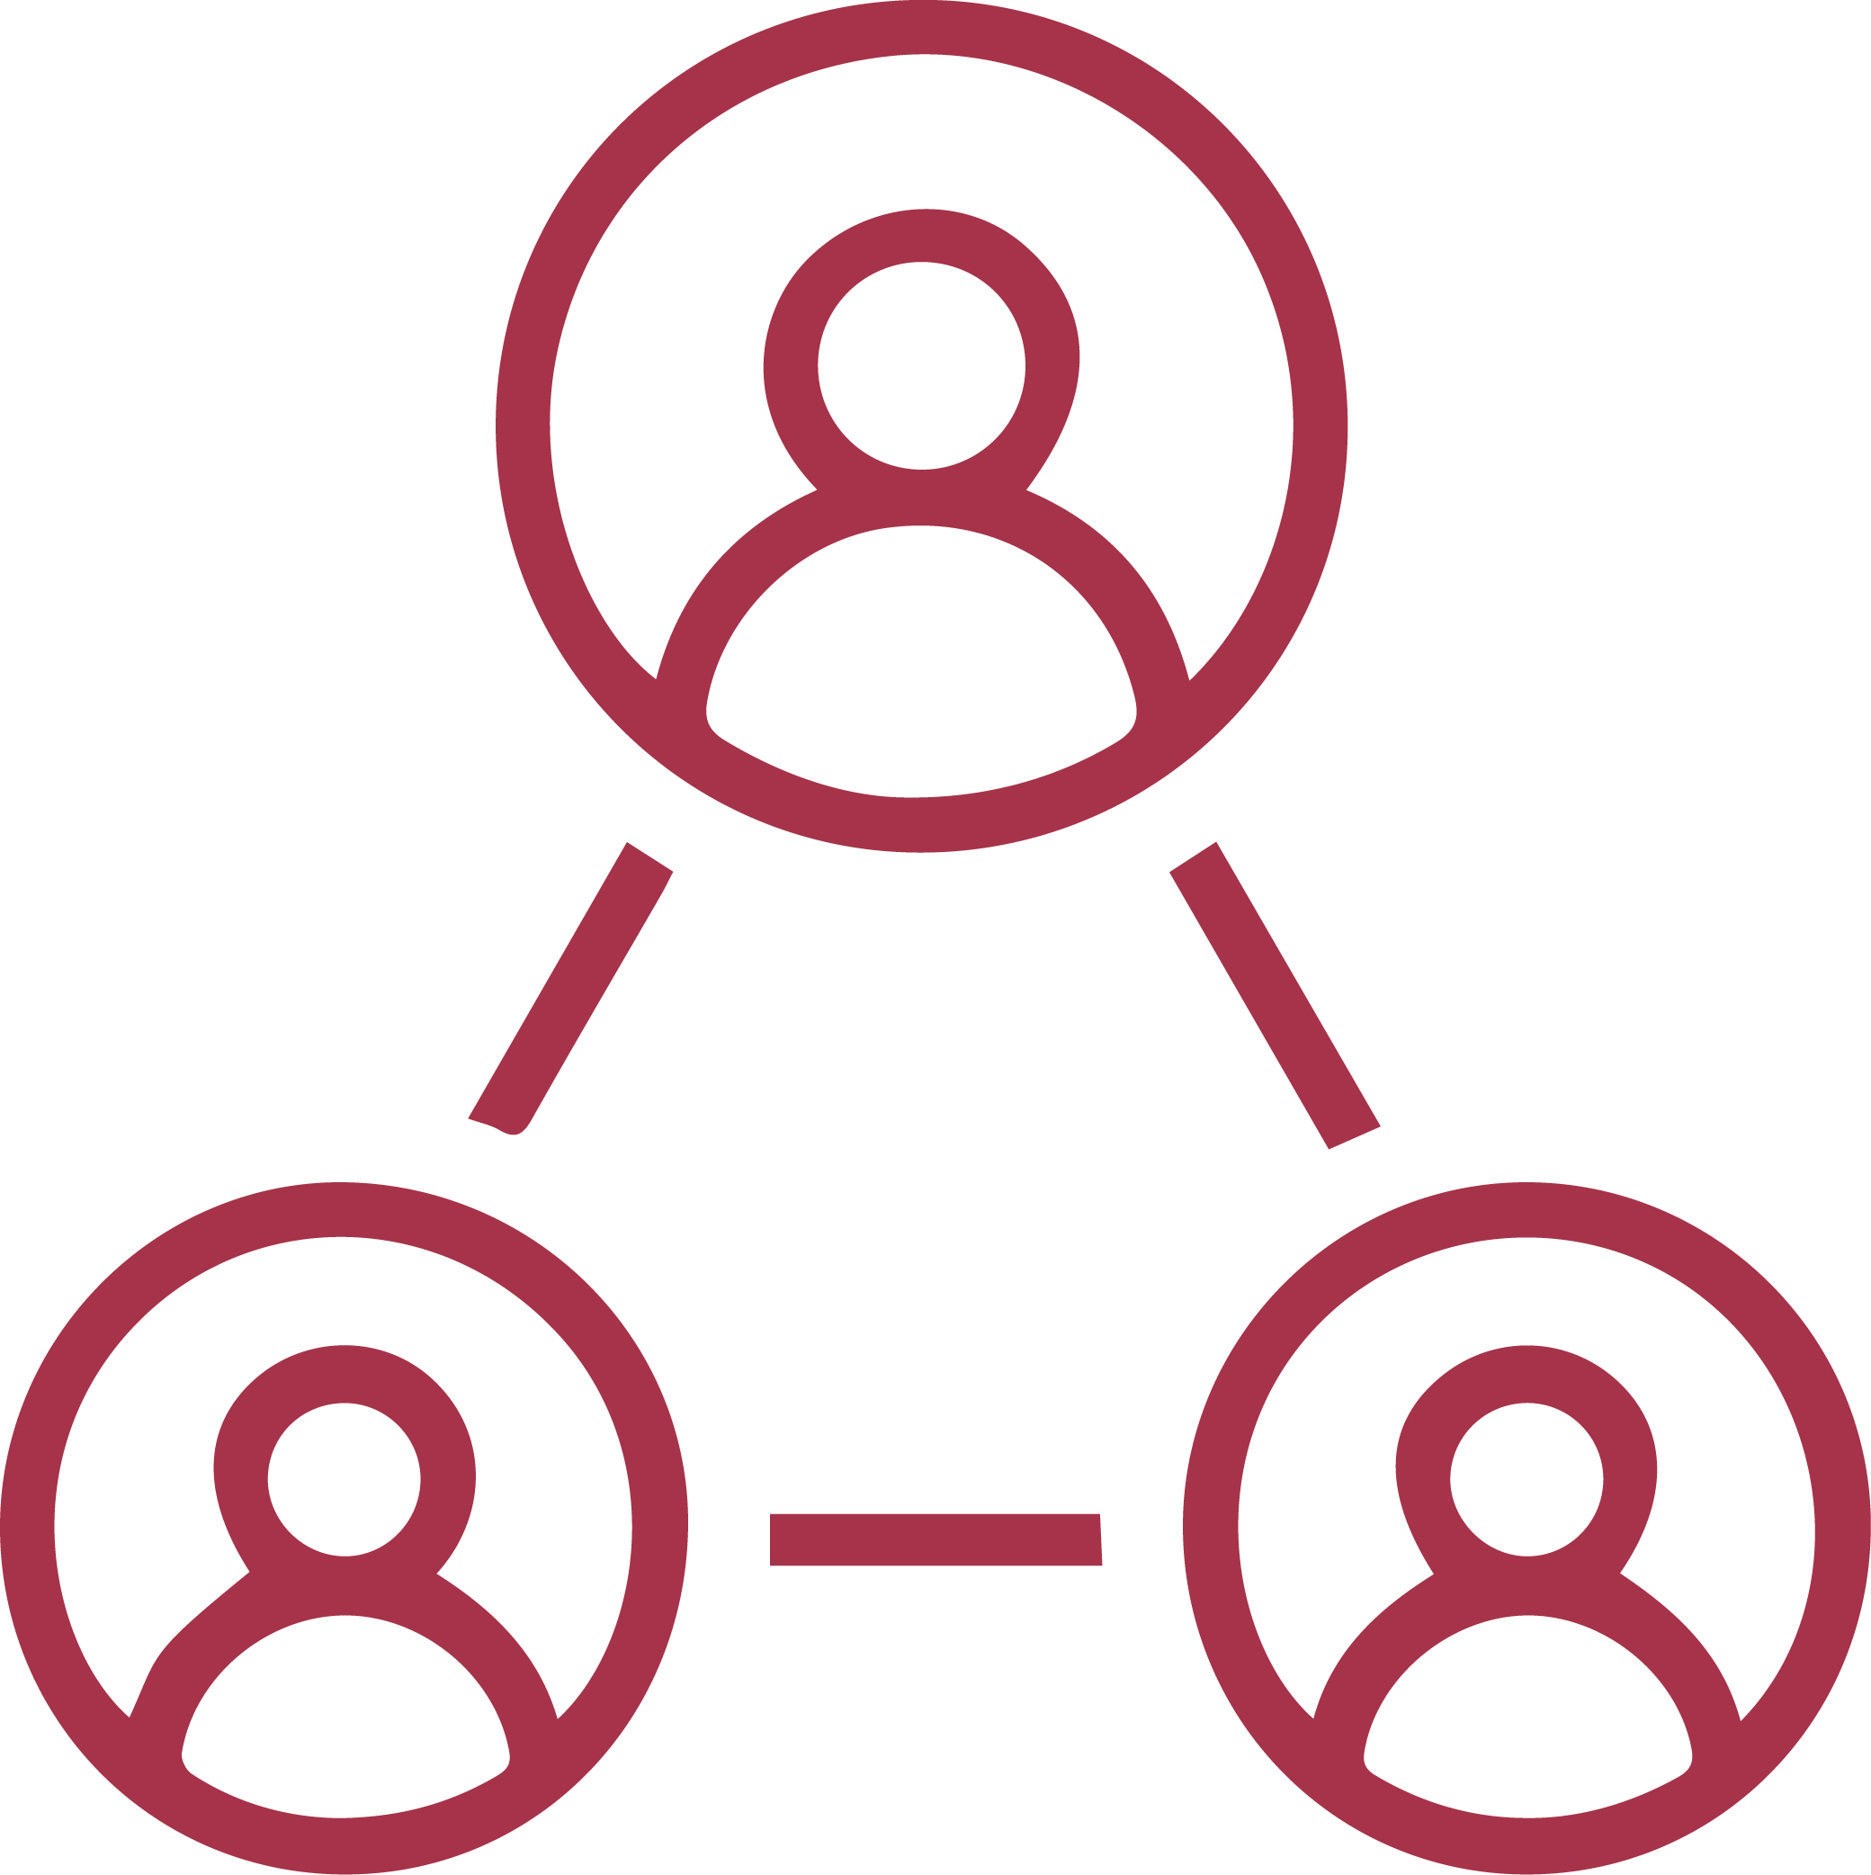
leap-hub.ac.uk
leap-dh-hub@bristol.ac.uk
What is the LEAP Digital Health Hub?​
@LEAP_hub
Sign up to the Hub’s mailing list
leap-dh-hub
Collaborative research funding in 4 key themes:
Care outside of the hospital
Service and resource planning
Frailty, fall prediction and fall prevention
Smartphone and wearable technologies
Addressing unmet health and social care needs across South West England and Wales
Connecting industry, academics, and
health and social care providers
Ways to get involved
Increasing regional digital health capability through opportunities for training, research, and innovation
Programme of short courses designed for professionals across the digital health community
Funded fellowships, internships, networking and development opportunities

Slide 7
1.a., 1.b., 1.c.
Icebreaker
(10 min)

Slide 8
1.a., 1.b., 1.c.
Why are you interested in AI?
(10 min)

Slide 9
2.a., 2.b., 2.c.
Demystifying
AI
(20 min)

Slide 10
Open question:
Where do you use AI?
(5 min)

Slide 11
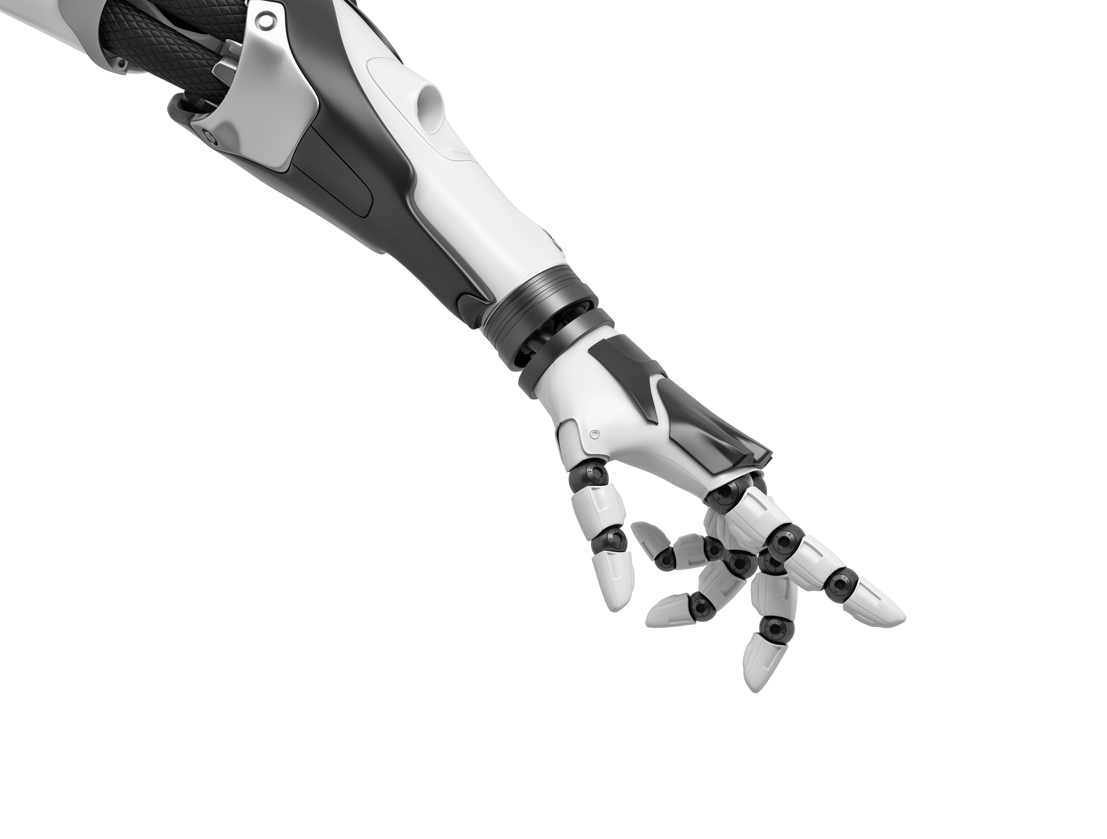
AI example: Search algorithms
Decisions based on scores
(or costs)
Good
(avoids human winning)
BAD
(AI loses)

Slide 12
AI example: Knowledge base
Knowledge Base
Inference Engine
Other examples
Prior
knowledge
Belongs to
Patient description:
Is 30 years old
Has symptom Fever
Has symptom Fatigue
Does not have Dry Cough
...
Disease
Coronavirus
Covid-19
Belongs to
Can generate
Fever
Fatigue
Dry cough
Past experiences or data examples
Belongs to
Actions
Suggestions
New knowledge
Symptom

Slide 13
AI brief history

Slide 14
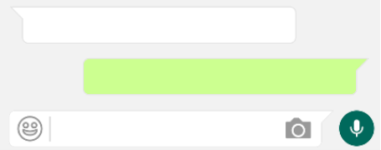
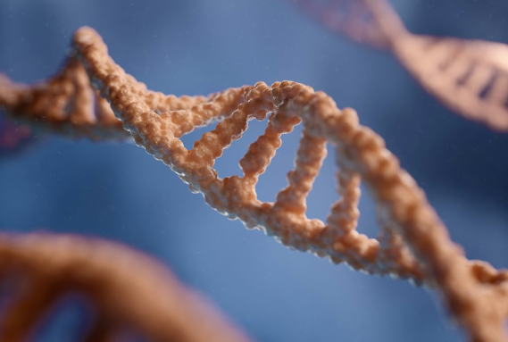
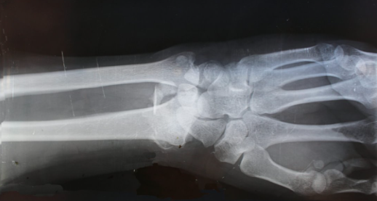
AI and Machine Learning
Artificial Intelligence (AI)
Less data
requirements
Machine Learning (ML)
Deep Learning
More data
Notes:
AI: Multiagent systems, Internet of Things, simulation, digital twins, planning
ML: Human activity recognition, localisation, robotics and automation, predictive maintenance
DL: Personalised medicine, drug discovery and development, medical imaging and diagnostics, chatbots

Slide 15
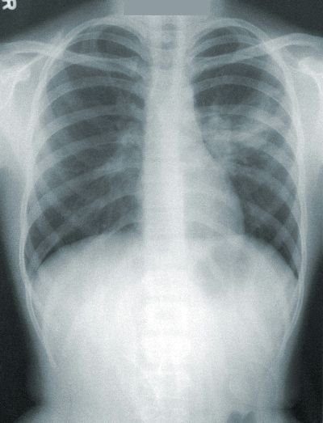
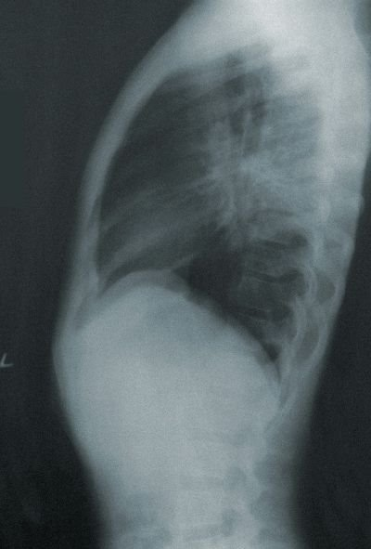
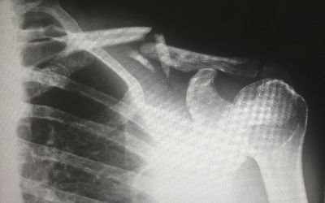
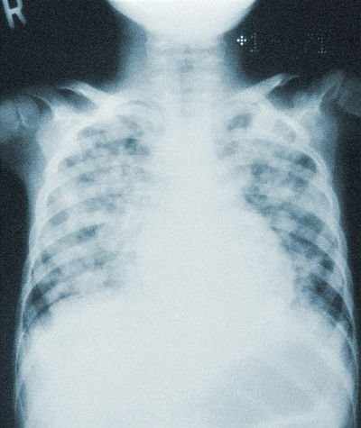
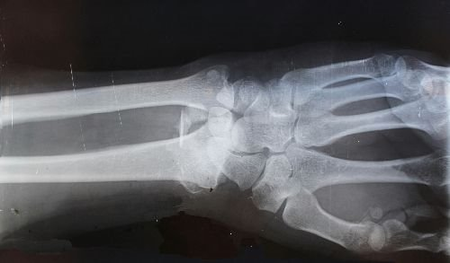
Machine Learning Example
Unlabelled data
Annotators
Labelled data
Classification
Detection
Segmentation
Regression
Exploratory
Clustering
Dimensionality Reduction
Expert
Fracture
Groups
Crowd
Pneumonia
Notes:
Unsupervised Anomaly detection

Slide 16
Applications of AI in Healthcare
Medical Diagnosis
Virtual Nursing
Assistance
Fraud Detection
Cancer Research
Drug Development
Cybersecurity
A.I. for Healthcare
Rare Disease
Diagnostics & Treatment
AI Robot-Assisted
Surgery
Dosage Error
Reduction
Personalised
Healthcare Plans
Health Monitoring
& Wearables
Personalised
Medicine

Slide 17
Example of use of AI
Health data
Pre-disease
Undetectable
Moderate /
Reversible
Severe /
Irreversible
Disability /
Death
Predisposition?
Epistemic?
Shift from symptom management
to remission and cure
Notes:
Data privacy
Ethical use of collected data
Lack of data standardisation
Scarcity and quality of annotations

Slide 18
The limitations of AI
Some AI tools are designed to generate realistic text, but not true knowledge.
The credibility of the sources may be difficult to assess.

Slide 19
Continuous improvement of AI
I tried with Google but did not work.
ChatGPT identifies that it is not a real syndrome.
Only because it agrees with us does not mean that ChatGPT is right.

Slide 20
Continuous improvement of AI

Slide 21
Group discussion:
Where else would you use AI?
(8 min)

Slide 22
2.a., 2.b., 2.c.
AI ethics and regulations
(20 min)

Slide 23
Open question:
What are your concerns about AI?
(5 min)

Slide 24
Healthcare regulations affecting AI
Market regulations:
EU AI Act
EU Digital Services Act
EU Digital Markets Act
EU Cyber Resilience Act
Biopharma regulations:
European Health Data Space
General Pharmaceutical Legislation
Clinical Trial Regulations
Data regulations:
GDPR (General Data Protection Regulation)
Data Act
Data Governance Act

Slide 25
AI ethics and regulations
Five key principles for regulatory use of AI for medical products
1
Safety, security and robustness
2
Transparency and explainability
3
Fairness
4
Accountability and governance
5
Contestabilityand redress
Policy paper. Impact of AI on the regulation of medical products. Medicines & Healthcare products Regulatory Agency, GOV.UK (Apr. 2024)​

Slide 26
Robustness and fairness

Slide 27
Robustness and fairness
Train
Validate
Test
Deploy
Performance
Training
Validation
Test
Deployment t=1
Deployment t=N
...
Requires constant monitoring
Notes:
active learning, semi-supevised learning, weak labels, one-shot learning
Constant monitoring of
Model performance
Data distribution

Slide 28
Transparency and explainability
Transparent
Pneumonia
Pneumonia
Transparent
Black box
Post-hoc explainability
method
Identify dataset biases, or model problems
Model complexity vs transparency vs performance
Notes:
Dataset biases can be detected with transparency and explainability
Trade-off between predictive performance and model complexity
Model complexity is a common source of lack of transparency

Slide 29
Safety and security
Federated learning
Synthetic data
Foundation models
Differential privacy
Synthetic data
Requirements:
Standardisation
Infrastructure
Notes:
Computational infrastructure necessary
Standardisation of the data

Slide 30
Group discussion:
What are your concerns about AI in the context of healthcare?
(8 min)

Slide 31
2.a., 2.b., 2.c.
Possible content for a course
(20 min)

Slide 32
The NHS AI Lab (now NHS England)
Understand AI
Learn about AI and its potential to transform health and care.
Develop AI
Find resources to help you design and build AI solutions that meet the requirements of the NHS and social care.
Adopt AI
Understand best practice in commissioning AI and get inspired by learning how organisations overcome challenges they faced adopting AI.
https://transform.england.nhs.uk/ai-lab/explore-all-resources/

Slide 33
The NHS AI Lab programmes
The AI in Health and Care Award
Using AI to improve back office efficiency, smartphone self-testing, AI detection for breast cancer...
AI regulation and AI ethics
Governing the use of data for AI, Striving for health equity, Building confidence in clinical use of AI
AI imaging
AI Diagnostic Fund, AI Deployment Platform, National COVID-19 Chest Imaging Database
AI funding streams
UKRI, Cancer Research UK, European Research Council, Horizon Europe...
AI Skunkworks projects
Short-term projects to investigate the use of AI for improving efficiency and accuracy in health and care
The NHS AI Lab roadmap
Current opportunities, coming soon and on the horizon
https://transform.england.nhs.uk/ai-lab/

Slide 34
Possible topics about AI
Theory
History
Methods
Problems/tasks
Demystification
Assessing capabilities
Regulations
Ethical implications
Explainability
Fairness and biases
Practice
Real world applications
Existing AI tools
Identification of opportunities
Malpractices using AI
Building your own AI
Health
Existing AI tools for healthcare professionals
Implications of adopting AI in healthcare
Communication with different stakeholders
Possible areas for AI in healthcare

Slide 35
3.a., 3.b., 3.c.
What did
you learn?
(10 min)

Slide 36
3.a., 3.b., 3.c.
What did
you miss?
(10 min)

Slide 37
3.a., 3.b., 3.c.
Feedback
(10 min)

