Slide 1
Artificial Intelligence in Healthcare:
Opportunities, Challenges,
and Critical Perspectives
Presenter: Dr Miquel Perelló Nieto
10 March 2025

Slide 2
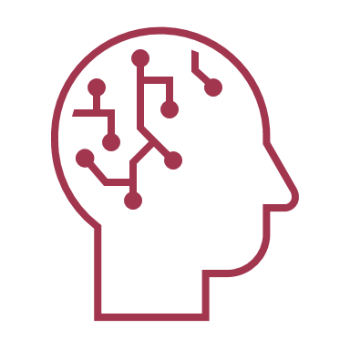
About me Dr Miquel Perelló Nieto
Research experience
Research Interests
Machine Learning
Uncertainty quantification
Optimal decision making
Real-world applications
Healthcare

Slide 3
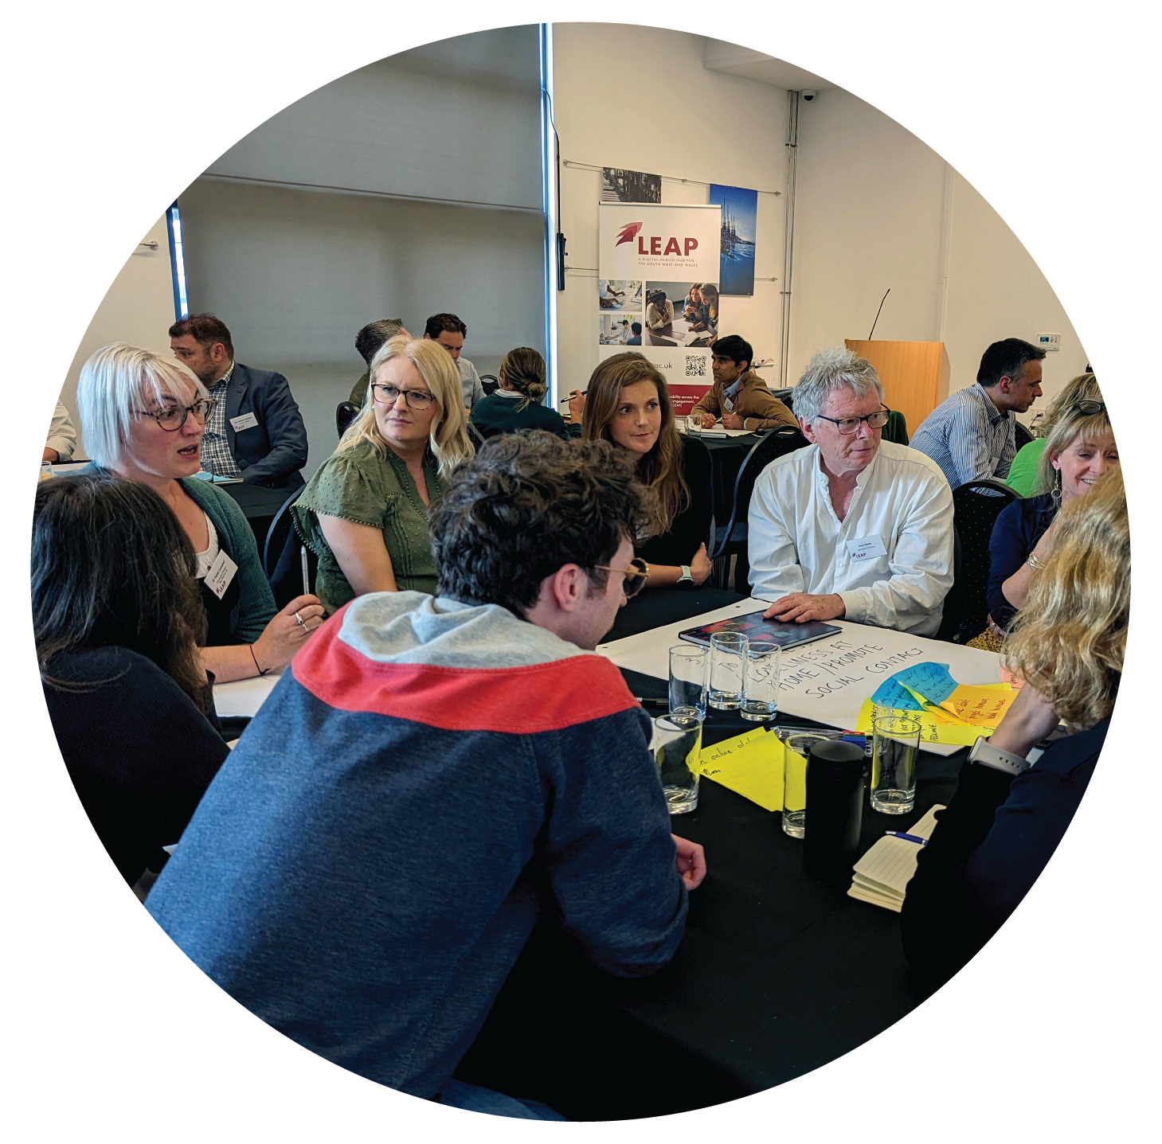
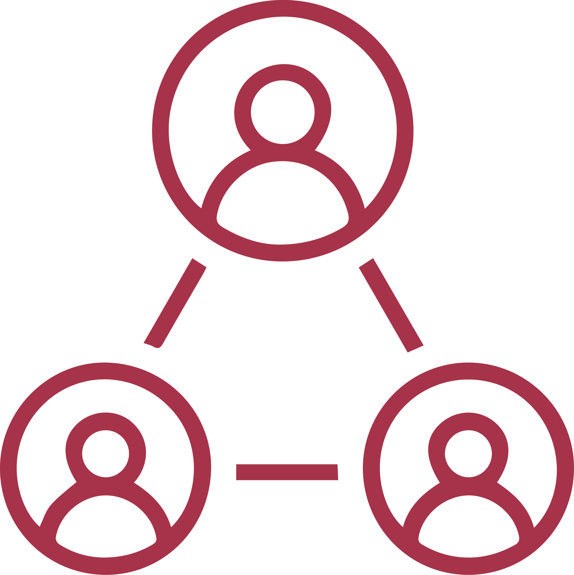
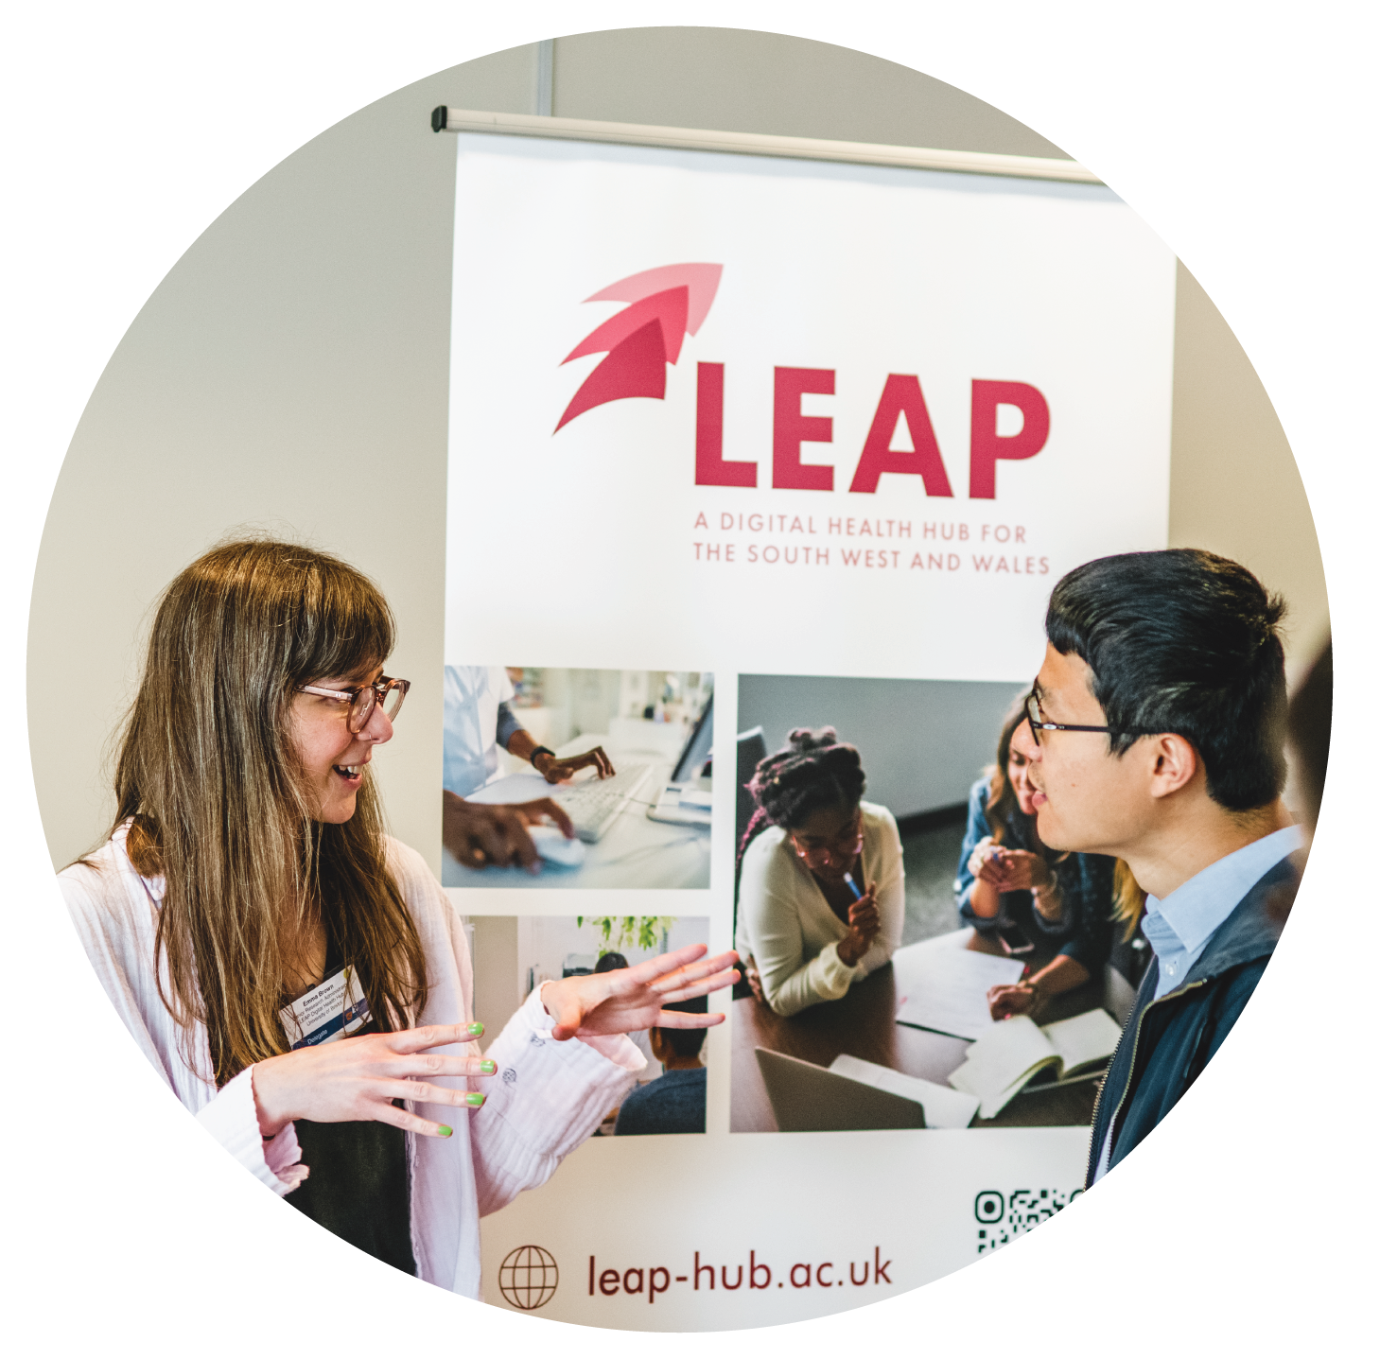
leap-hub.ac.uk
leap-dh-hub@bristol.ac.uk
What is the LEAP Digital Health Hub?​
@LEAP_hub
Sign up to the Hub’s mailing list
leap-dh-hub
Collaborative research funding in 4 key themes:
Care outside of the hospital
Service and resource planning
Frailty, fall prediction and fall prevention
Smartphone and wearable technologies
Addressing unmet health and social care needs across South West England and Wales
Connecting industry, academics, and
health and social care providers
Ways to get involved
Increasing regional digital health capability through opportunities for training, research, and innovation
Programme of short courses designed for professionals across the digital health community
Funded fellowships, internships, networking and development opportunities

Slide 4
AI initiatives in the NHS
Understand AI
Learn about AI and its potential to transform health and care.
Develop AI
Find resources to help you design and build AI solutions that meet the requirements of the NHS and social care.
Adopt AI
Understand best practice in commissioning AI and get inspired by learning how organisations overcome challenges they faced adopting AI.
https://transform.england.nhs.uk/ai-lab/explore-all-resources/

Slide 5
Agenda
What is AI?
AI in healthcare
Demistifying AI
Ethics and Regulations
Conclusion

Slide 6
1. What is AI?
Examples
AI vs Machine Learning

Slide 7
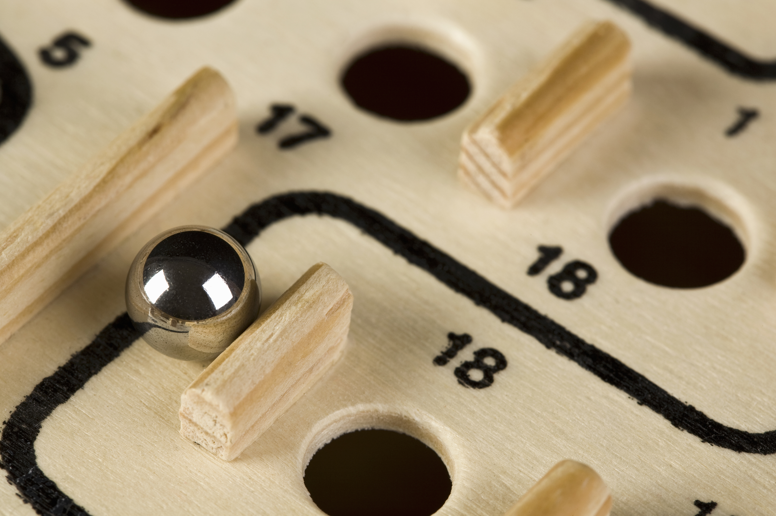
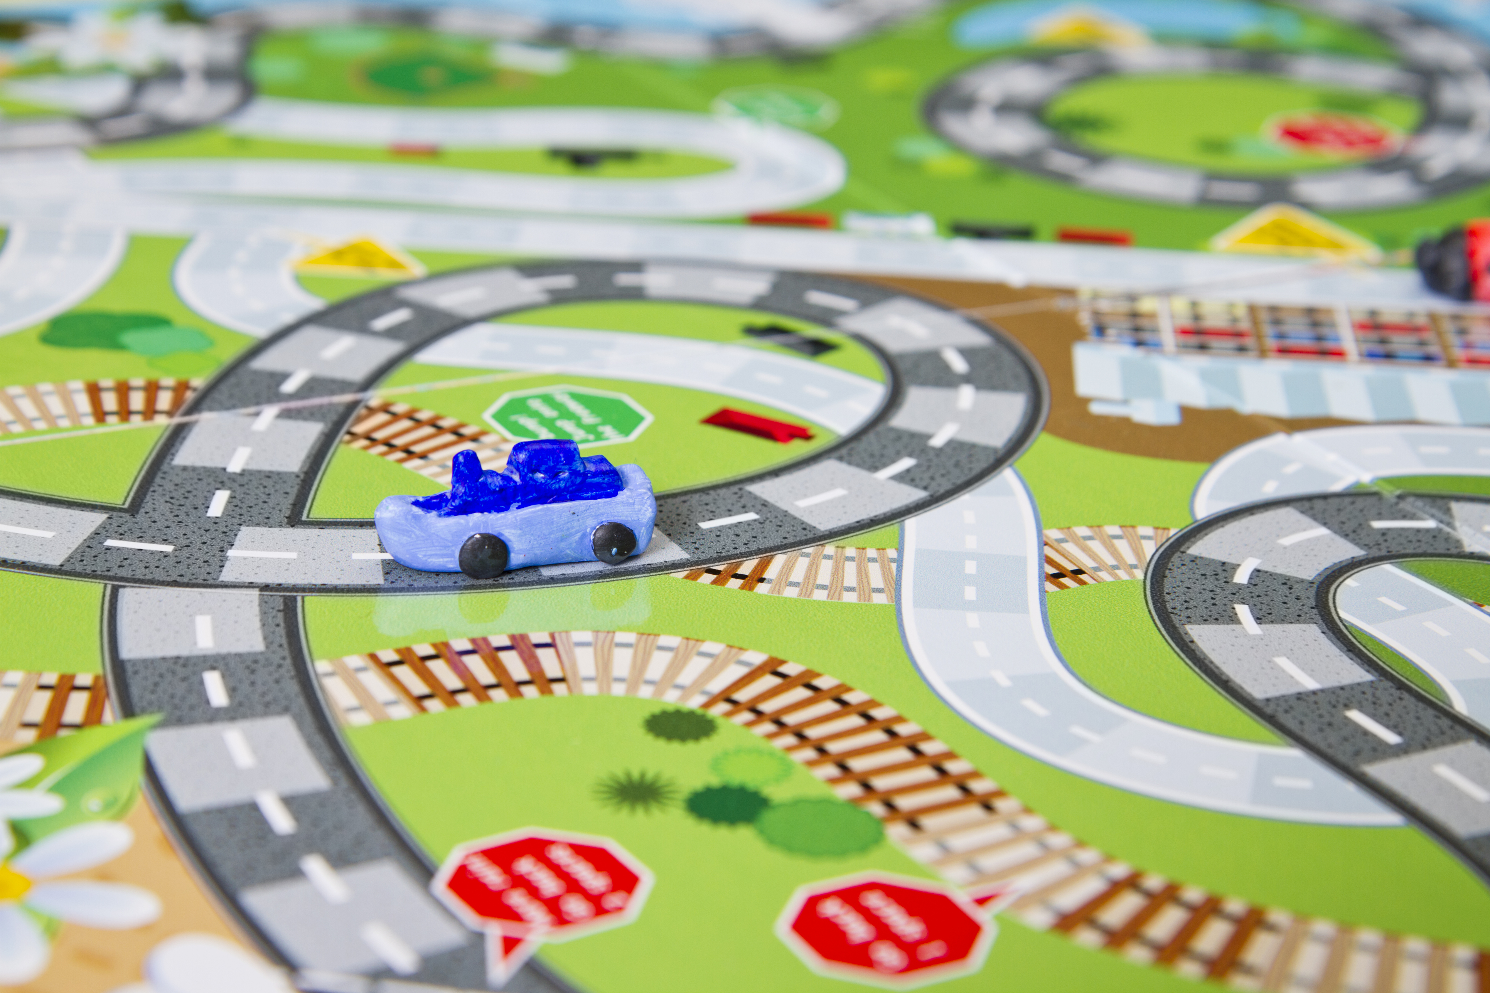
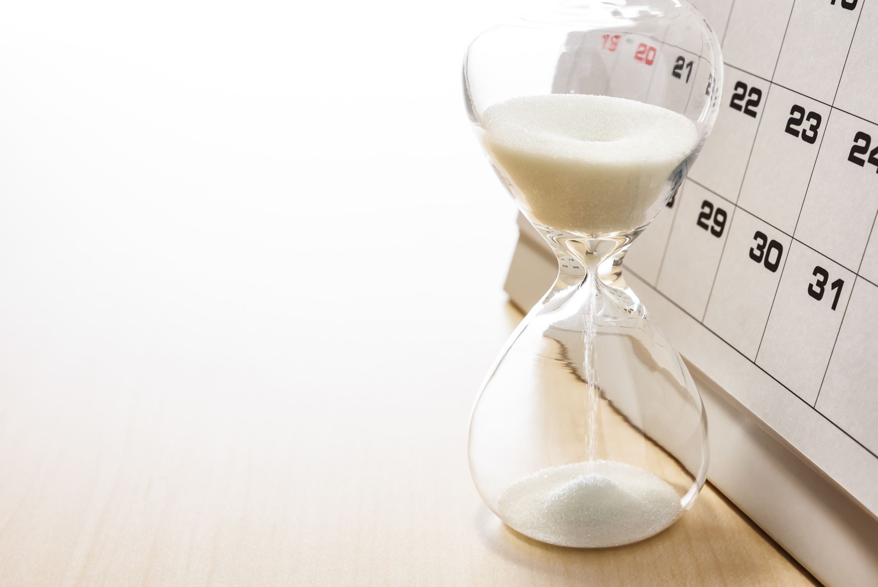
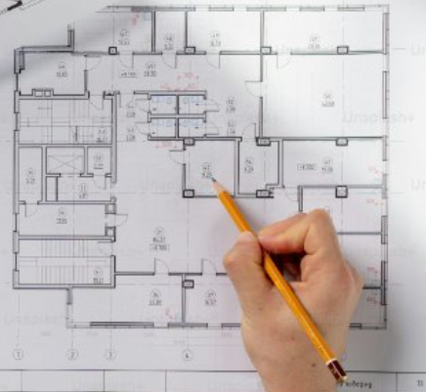
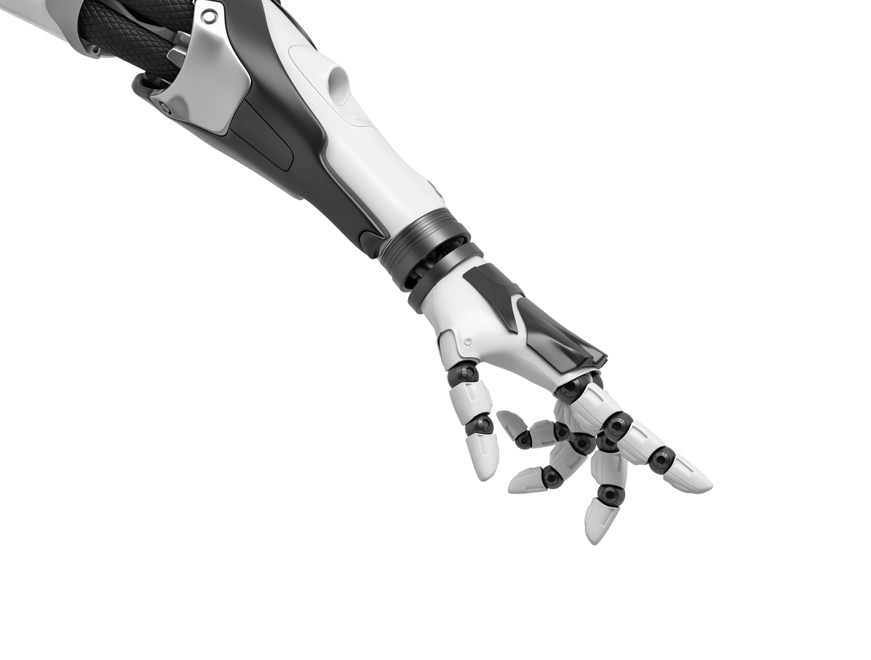
AI example: Search algorithms
Decisions based on scores
(or costs)
Good move
(avoids human winning)
BAD move
(AI loses)

Slide 8
AI example: Knowledge base
Knowledge Base
Inference Engine
Prior
knowledge
Belongs to
Patient description:
Is 30 years old
Has symptom Fever
Has symptom Fatigue
Does not have Dry Cough
...
Disease
Coronavirus
Covid-19
Belongs to
Can generate
Fever
Fatigue
Dry cough
Past experiences or data examples
Belongs to
Actions
Suggestions
New knowledge
Symptom

Slide 9
AI examples
Information retrieval
Recomender systems
Google searches
Online articles
Restaurants
Travel agencies
Similar to information retrieval but with personal profile
Movie recommendations
Music recommendations
Online shoping

Slide 10
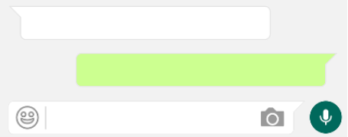
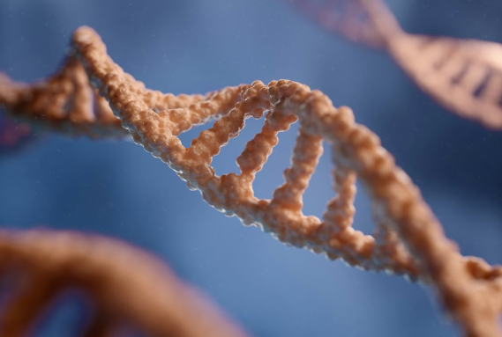
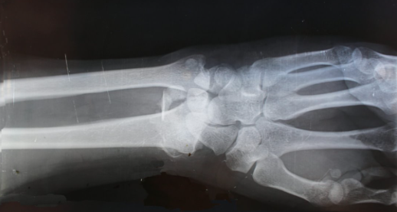
AI and Machine Learning
Artificial Intelligence (AI)
Less data
requirements
Machine Learning (ML)
Deep Learning
More data
Notes:
AI: Multiagent systems, Internet of Things, simulation, digital twins, planning
ML: Human activity recognition, localisation, robotics and automation, predictive maintenance
DL: Personalised medicine, drug discovery and development, medical imaging and diagnostics, chatbots

Slide 11
2. AI in Healthcare
Applications
Examples

Slide 12
Applications of AI in Healthcare
Medical Diagnosis
Virtual Nursing
Assistance
Fraud Detection
Cancer Research
Drug Development
Cybersecurity
A.I. for Healthcare
Rare Disease
Diagnostics & Treatment
AI Robot-Assisted
Surgery
Dosage Error
Reduction
Personalised
Healthcare Plans
Health Monitoring
& Wearables
Personalised
Medicine

Slide 13
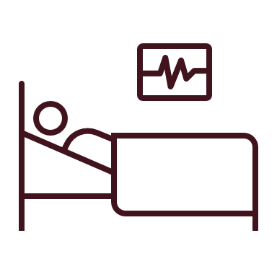
Early diagnosis
Health data
Pre-disease
Undetectable
Moderate /
Reversible
Severe /
Irreversible
Disability /
Death
Predisposition?
Epistemic?
Shift from symptom management
to remission and cure
Notes:
Data privacy
Ethical use of collected data
Lack of data standardisation
Scarcity and quality of annotations

Slide 14
2. AI in Healthcare
Applications
Examples

Slide 15
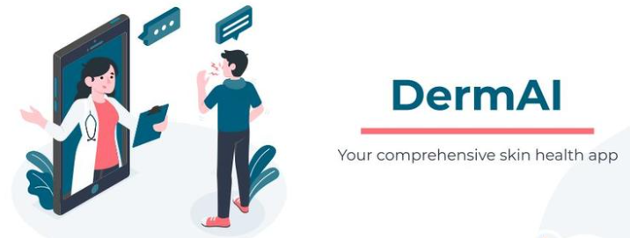
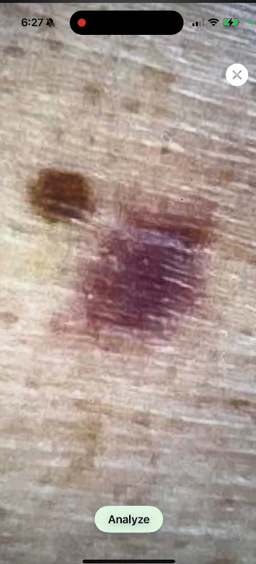
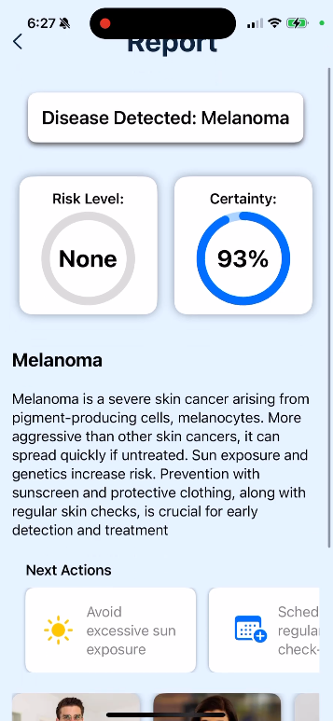
DermAI: AI-Powered Skin Cancer Detection
Diagnosis of non-melanoma and melanoma skin cancers and other skin conditions.
Tailored reports including risk levels, recommended specialists, research findings, actionable next steps.
AI chatbot functionality for real-time natural language interactions.

Slide 16
Haut.AI: AI Skin Analysis
Algorithm trained on over 3 million facial images of multiple skin types and tones, with more than 150 facial biomarkers and 15 skin health metrics.

Slide 17
AI scribes
Along side your Electronic Health Record (EHR), while you hold consutations with your patients
Listens and transcribes
Summarisation
Task creation
Drafts notes, letters and clinical codes
Some have a chatbot
Lots of different tools:
Tortus: Self-registered as a class 1 medical device
Heidi
Anima:
Kiwipen
Antikit AI: Chatbot for GPS, uses the British Medical Association and the NHS guidance

Slide 18
Data privacy and security
NHS Compliant, GDPR Compliant, HIPAA Compliant, ISO 27001 Accredited...
Data security
Not about the AI aspect

Slide 19
The limitations of AI
Some AI tools are designed to generate realistic text, but not true facts.
The credibility of the sources may be difficult to assess.
Google has fixed the issue.

Slide 20
Continuous improvement of AI
I tried with Google but did not work.
ChatGPT identifies that it is not a real syndrome.
New online articles discussed the previous mistake.

Slide 21
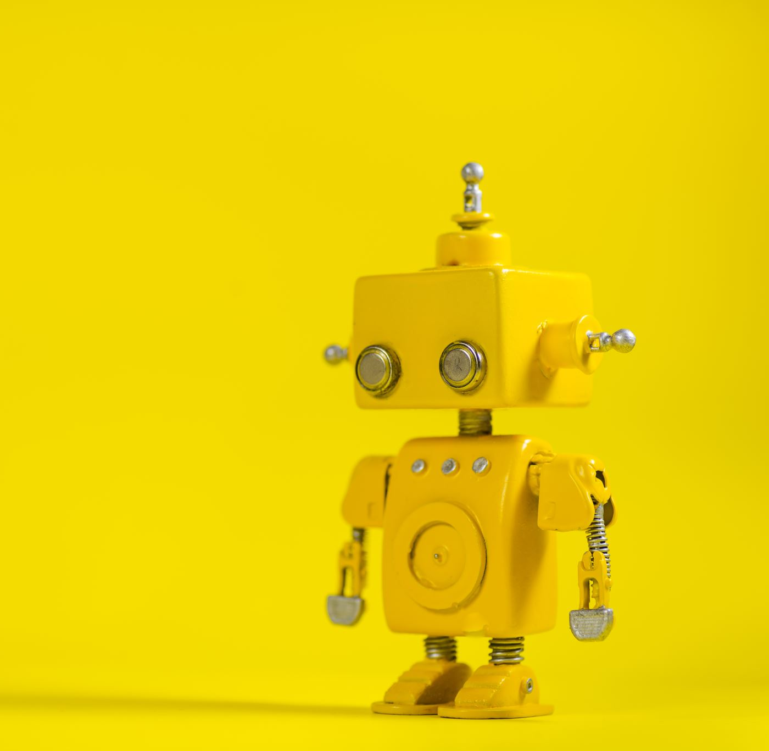
3. Demystifying AI
Common ML Pipeline
Radiology
Scribes

Slide 22
3. Demystifying AI
These eyes can't see,
they are batteries
Common ML Pipeline
Radiology
Scribes
These hands can't grasp,
they are levers of a lighter

Slide 23
Common Machine Learning lifecycle
Data collection
Data preprocessing
Feature engineering
Model selection
Model training
Model evaluation
Model deployment
Monitoring and maintenance

Slide 24
Data Preprocessing. Tabular
Quantitative
Qualitative
ID | Age | Sex | Weight | Height
1 | 26 | 0 | 65.2 | 155
2 |  | 2 | 78.5 | 178
3 | 18 | 1 | 58.1
4 | 67 | 0 | 70.7 | 170
5 | 50 |  |  | 175
ID | Age | Sex | Weight | Height
6 | young | male | normal | short
7 | baby | female | underweight | small
8 | adult | female |  | tall
9 | teenager |  | normal | short
10 | senior | male | overweight
Data is commonly converted into numeric data.
Careful consideration for missing values.

Slide 25
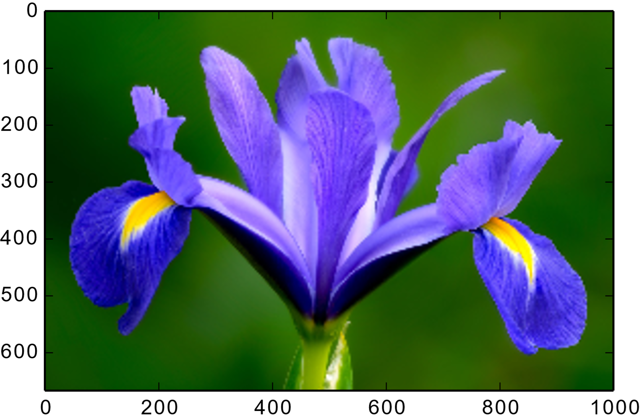
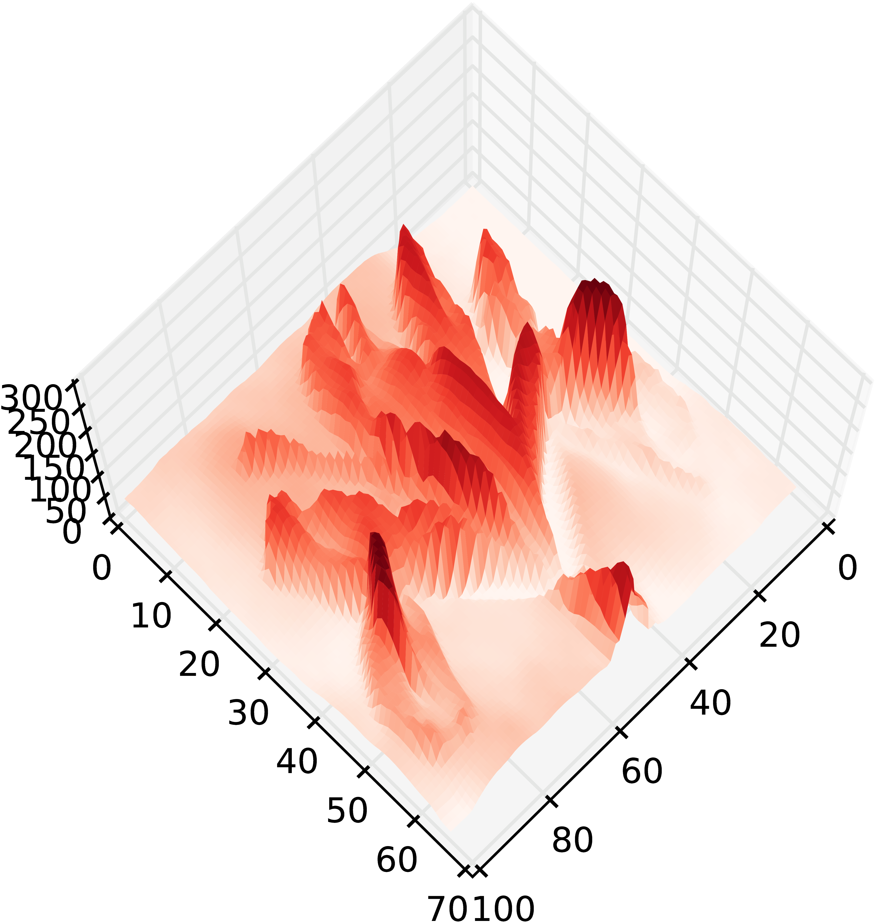
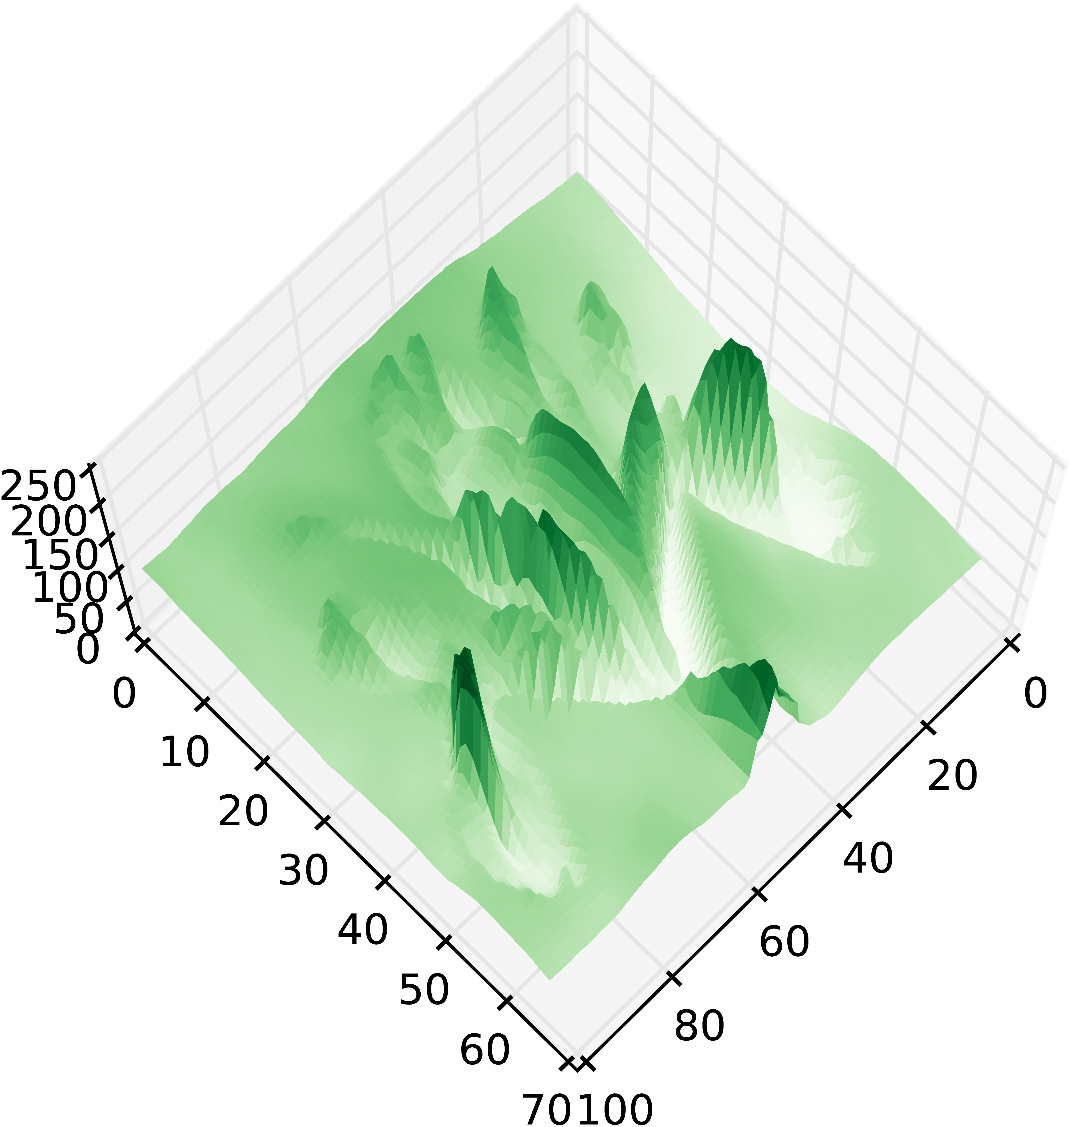
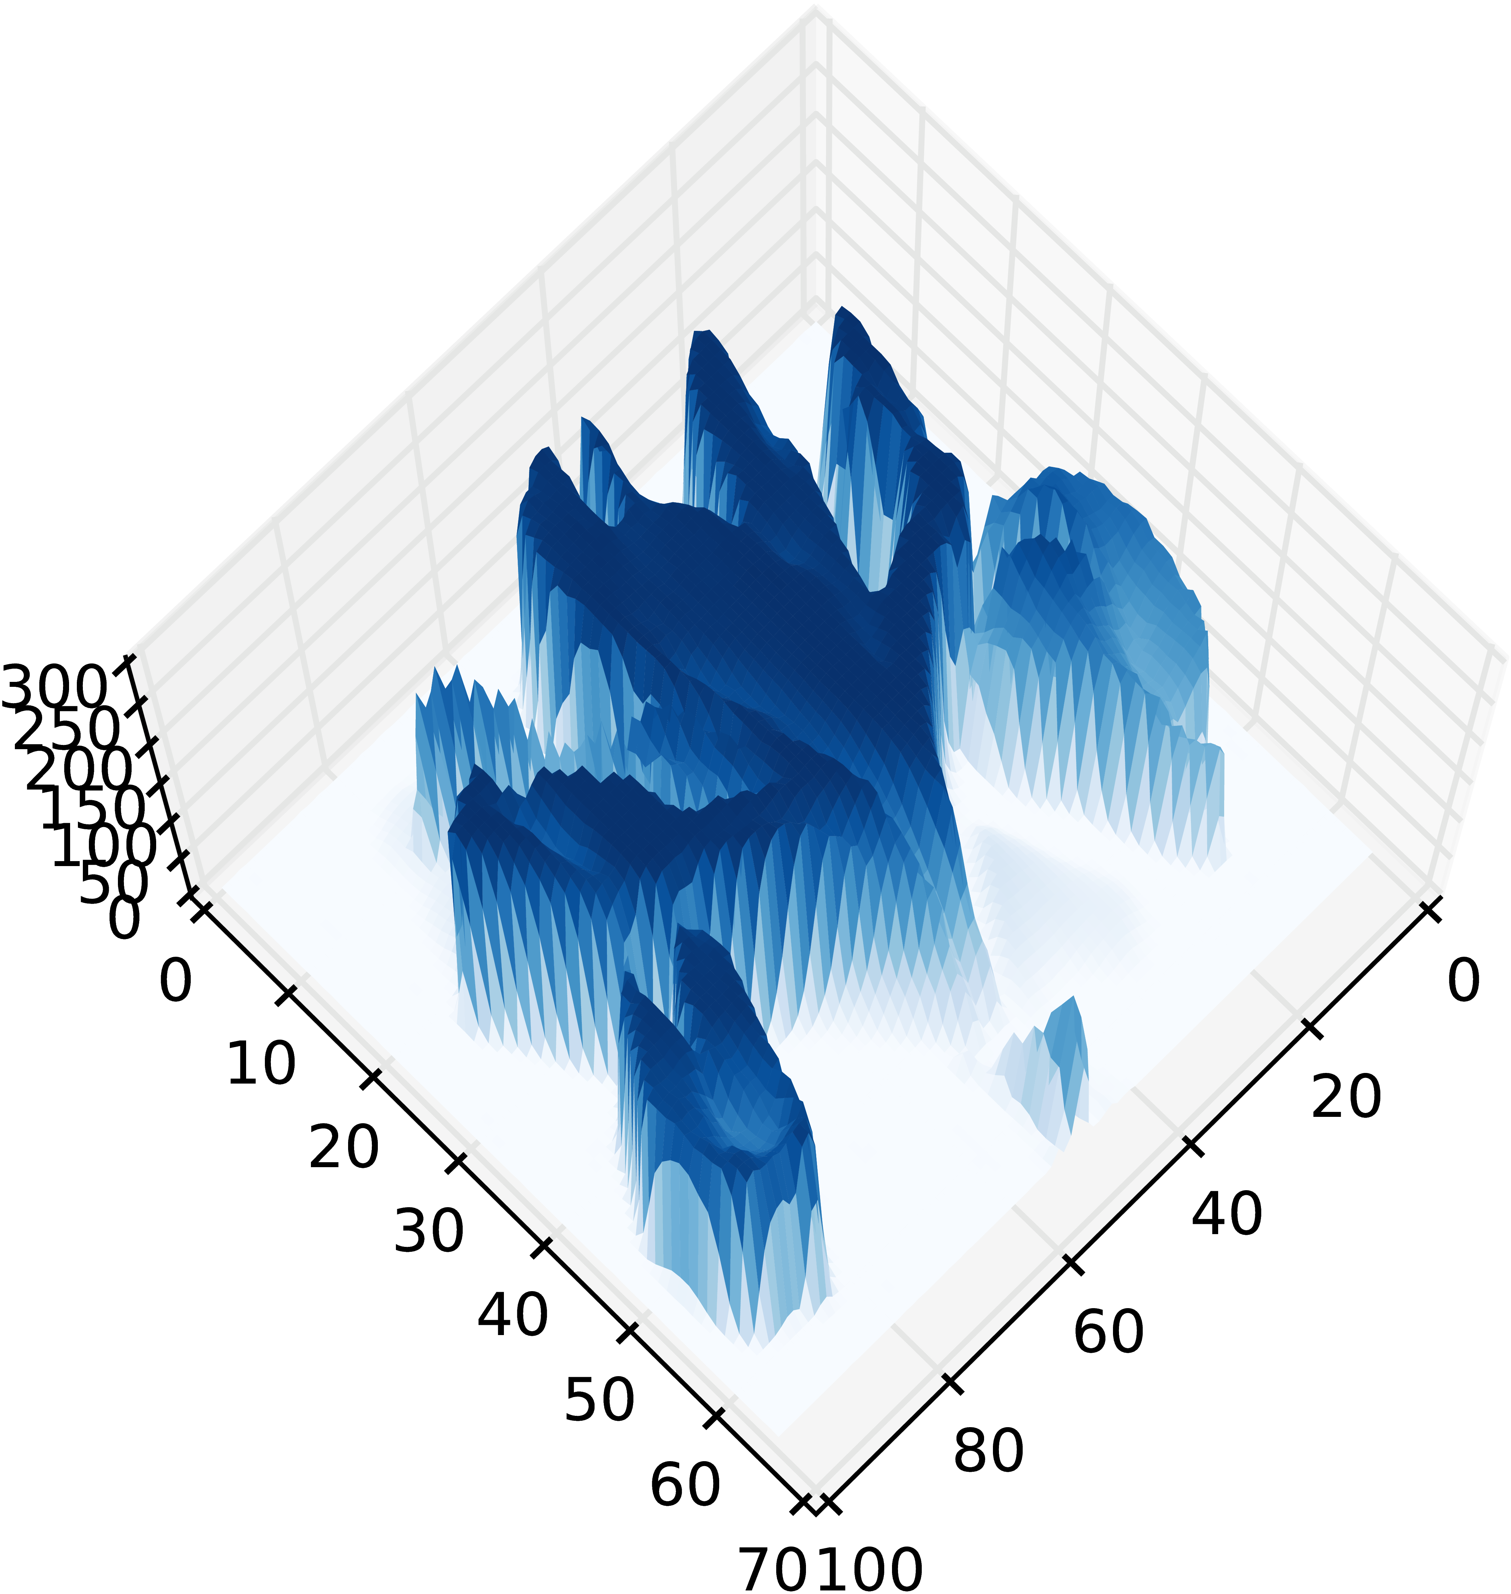
Data Preprocessing. Images

Slide 26
Data Preprocessing. Text
"Text can be encoded in numeric form in multiple ways, a simple example is in the form of bag of words"
This representation loses the order information.
There are more complex approaches not covered here.
Words | Text | Can | Be | encoded | in | a | numeric | form | Multiple | Ways | Simple | ...
Repetitions | 1 | 1 | 1 | 1 | 3 | 1 | 1 | 2 | 1 | 1 | 1

Slide 27
3. Demystifying AI
Common Pipeline
Radiology
Scribes

Slide 28
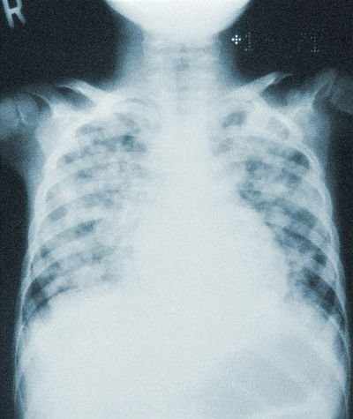
Radiology and image classification
The COVID-19 pandemic required a large amount of chest image analysis.
AI could help speed up the process.
But how could AI make a diagnosis?

Slide 29
Feature engineering
Haar filters and Viola-Jones face detection (Haar, A., Viola, P., and Jones, M.)
How to create filters for every object?
Convolve the filter
?
Images by Soumyanilcsc - Own work, CC BY-SA 4.0, https://commons.wikimedia.org/w/index.php?curid=37353327 and https://commons.wikimedia.org/w/index.php?curid=37353395

Slide 30
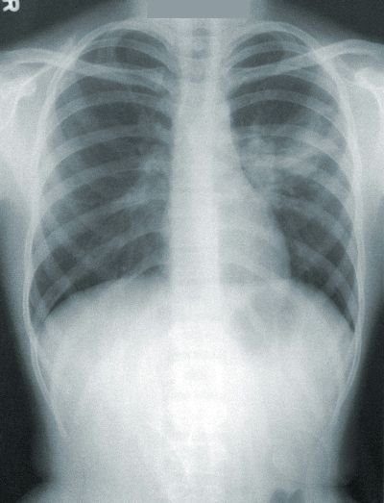
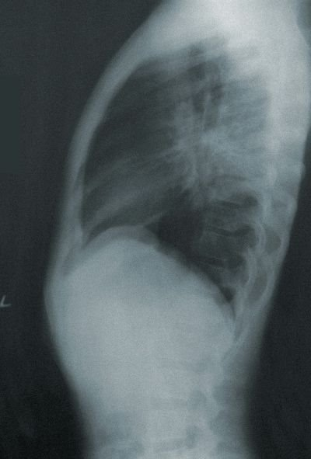
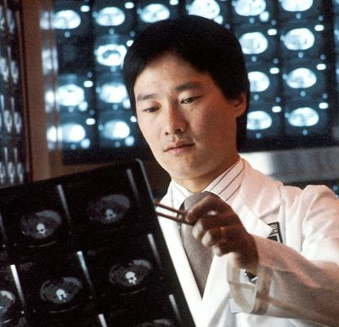
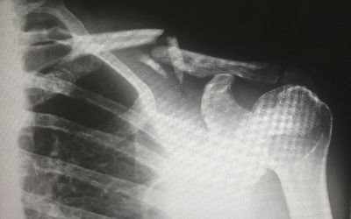
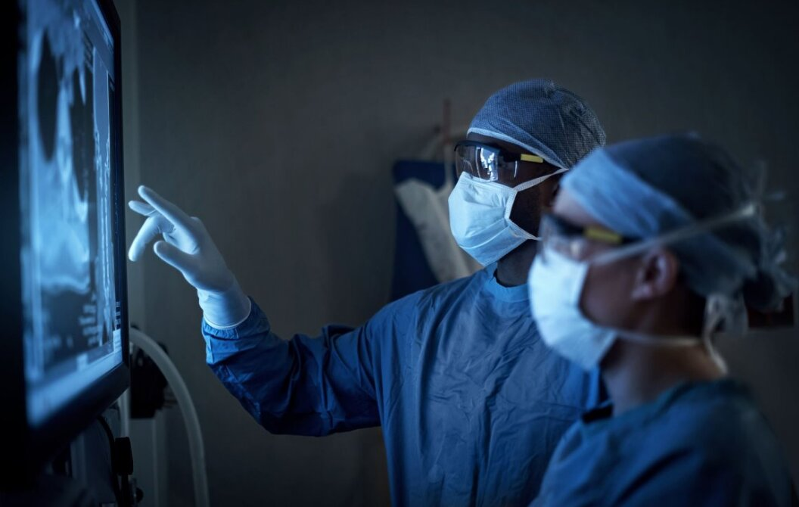
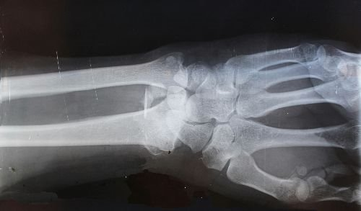
Annotations for Machine Learning
Unlabelled data
Annotators
Labelled data
Classification
Detection
Segmentation
Other tasks
Regression
Exploratory
Clustering
Dimensionality Reduction
Expert
Fracture
Groups
Crowd
Pneumonia
Notes:
Unsupervised Anomaly detection

Slide 31
Artificial Neurons
Simplified schema of a biological neuron
Neuron from the SNARC (Stochastic Neural Analog Reinforcement Calculator) designed by Marvin Lee Minsky ~ 1951
Mathematical simplification of a neuron as a weighted sum
2. Neuronal action potential ("spike")
Originally Neuron.jpg taken from the US Federal (public domain) ( Nerve Tissue, retrieved March 2007), redrawn by User:Dhp1080 in Illustrator. Source: “Anatomy and Physiology” by the US National Cancer Institute’s Surveillance, Epidemiology and End Results (SEER) Program.
2. By Nir.nossenson - Own work, CC BY-SA 4.0, https://commons.wikimedia.org/w/index.php?curid=48019779

Slide 32
Cat's visual cortex (1962)
Hubel, D. and Wiesel, T. (1962). Receptive fields, binocular interaction and func- tional architecture in the cat’s visual cortex. The Journal of physiology, pages 106–154.

Slide 33
Artificial Neural Networks
Drawing of neurons by Santiago Ramón y Cajal (around 1890s)
Neocognitron schematic diagram illustrating the interconections between multiple layers [Fukushima, 1980]

Slide 34
Learned filters

Slide 35
More complex features

Slide 36
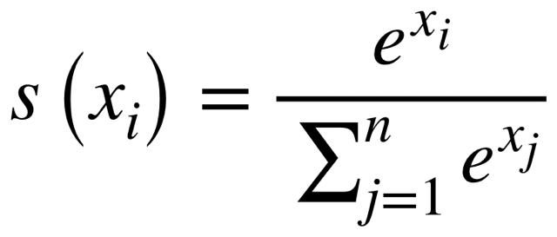
Final prediction
Airplane
Automobile
Bird
Cat
Deer
Dog
Frog
Horse
Ship
Truck
Airplane
Automobile
Bird
Cat
Deer
Dog
Frog
Horse
Ship
Truck
SoftMax

Slide 37
Deep Neural Network
VGG-16: 16 layers
GoogleNet: 22 layers DNN [Szegedy et al., 2014]
ResNet: 34 layers
ResNet-50: 50 layers
...

Slide 38
What different layers represent

Slide 39
Radiology and other image predictions
Plenty of AI methods for image analysis
Each with its own drawbacks
AI should support experts
Constant monitoring is necessary
Provide explanations under request
Blood dell counter YoLo v7, MIT license, https://github.com/mmasdar/Blood-Cell-Counter-YoLo-v7

Slide 40
3. Demystifying AI
Common Pipeline
Radiology
Scribes

Slide 41
Scribes
Voice to text in real time
Summarisation of the text
Use of additional text information (e.g., EHR)
Help writing a reference letter
Sometimes Chat functionalities
Most parts probably done with Large Language Models with prompt engineering

Slide 42
Large Language Models (Chat GPT)
Generative: Designed to generate the next "word".
Pre-trained: Pre-trained with bast amounts of text.
Transformer: A Transformer architecture to iteratively assign importance to the "words" in the text.

Slide 43
Data Preprocessing. Text
"Text can be encoded in numeric form in multiple ways, a simple example is in the form of bag of words"
N-gram: sequences of n adjacent symbols (words).
Words | Text | Can | Be | encoded | in | a | numeric | form | Multiple | Ways | Simple | ...
Repetitions | 1 | 1 | 1 | 1 | 3 | 1 | 1 | 2 | 1 | 1 | 1
1-gram | Rep.
text | 1
can | 1
be | 1
encoded | 1
in | 3
... | ...
2-gram | Rep.
Text can | 1
Can be | 1
Be encoded | 1
Encoded in | 1
In numeric | 1
... | ...
3-gram | Rep.
Text can be | 1
Can be encoded | 1
Be encoded in | 1
Encoded in numeric | 1
In numeric form | 1
... | ...
Can we predict the new word in the sentence
A simple …
And the next one?
In ...

Slide 44
Learning the meaning of words
Training the model to predict the new word with limited information forces the model to learn a representation of the meaning of words
king – man + woman ~= queen
sushi – japan + germany ~= bratwurst

Slide 45
Text generation
The huge amount of training has a multitude of context
Prompts provide a context to "reduce the search area"
In any particular context the text generation will be different
It does not need to find exact matches, as it has learned the "meaning" of words
What it generates looks like natural language, but it is debatable if there is any type of thought process

Slide 46
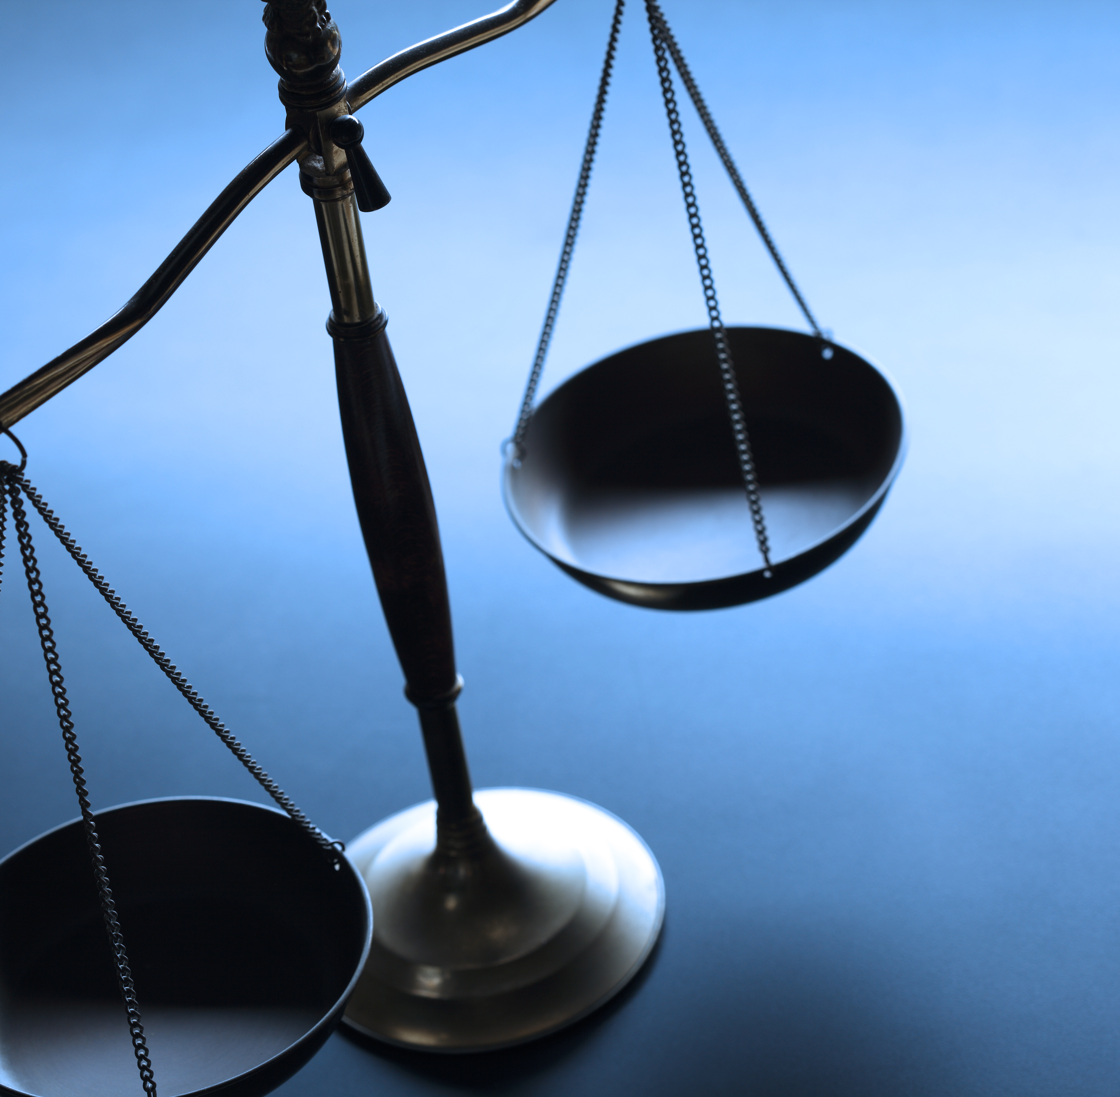
4. Ethics and Regulations
Regulations
Privacy
Explainability
Fairness
Accountability
Contestability

Slide 47
Healthcare regulations affecting AI
Market regulations:
EU AI Act
EU Digital Services Act
EU Digital Markets Act
EU Cyber Resilience Act
Biopharma regulations:
European Health Data Space
General Pharmaceutical Legislation
Clinical Trial Regulations
Data regulations:
GDPR (General Data Protection Regulation)
Data Act
Data Governance Act

Slide 48
AI ethics and regulations
Five key principles for regulatory use of AI for medical products
1
Safety, security and robustness
2
Transparency and explainability
3
Fairness
4
Accountability and governance
5
Contestabilityand redress
Policy paper. Impact of AI on the regulation of medical products. Medicines & Healthcare products Regulatory Agency, GOV.UK (Apr. 2024)​

Slide 49
4. Ethics and Regulations
Regulations
Privacy
Explainability
Fairness
Accountability
Contestability

Slide 50
Safety and security
Federated learning
Synthetic data
Foundation models
Differential privacy
Synthetic data
Requirements:
Standardisation
Infrastructure
Notes:
Computational infrastructure necessary
Standardisation of the data

Slide 51
4. Ethics and Regulations
Regulations
Privacy
Explainability
Fairness
Accountability
Contestability

Slide 52
Transparency and explainability
Transparent
Pneumonia
Pneumonia
Transparent
Black box
Post-hoc explainability
method
Identify dataset biases, or model problems
Model complexity vs transparency vs performance
Notes:
Dataset biases can be detected with transparency and explainability
Trade-off between predictive performance and model complexity
Model complexity is a common source of lack of transparency

Slide 53
4. Ethics and Regulations
Regulations
Privacy
Explainability
Fairness
Accountability
Contestability

Slide 54
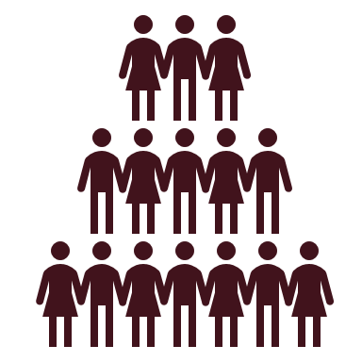
Fairness and robustness
Train
Validate
Test
Deploy
Performance
Training
Validation
Test
Deployment t=1
Deployment t=N
...
Requires constant monitoring
Notes:
active learning, semi-supevised learning, weak labels, one-shot learning
Constant monitoring of
Model performance
Data distribution

Slide 55
Fairness

Slide 56
The survivorship bias

Slide 57
The Simpson's paradox
Kievit Rogier , Frankenhuis Willem E., Waldorp Lourens , Borsboom Denny, Simpson's paradox in psychological science: a practical guide, Frontiers in Psychology, 2013

Slide 58
4. Ethics and Regulations
Regulations
Privacy
Explainability
Fairness
Accountability
Contestability

Slide 59
Accountability and Governance
Effective oversight of the use of AI.
Clear lines of accountability across the AI life cycle.
Trustworthiness auditing

Slide 60
4. Ethics and Regulations
Regulations
Privacy
Explainability
Fairness
Accountability
Contestability

Slide 61
Contestability and redress
A person affected by the outcomes or a decision from an AI should be able to contest the AI.
How to rectify and address any harm resulting from an AI decision

Slide 62
5. Conclusion

Slide 63
Conclusion
It is not easy to validate an AI technology for critical applications.
A governmental organization should investigate the transparency and understanding of such technologies.
The data used for training may have unexpected consequences (e.g., bias, discrimination).

Slide 64
Q&A and Discussion
Artificial Intelligence in Healthcare:
Opportunities, Challenges,
and Critical Perspectives
Presenter:
Dr Miquel Perelló Nieto

