Slide 1
Digital Health Research Group School of Engineering Mathematics and Technology
Data Science Lab Away Day
Presenter:
Dr. Miquel Perello Nieto, Senior Research Associate
Monday 23 June 2025

Slide 2
Digital Health Research Group: A multidisciplinary team with more than 100 academics
Research
SPHERE
TORUS
LEAP Digital Health Hub
Skills & Knowledge
CDT in Digital Health and Care
MSc in Digital Health and Care
Networking
Digital Health Seminar Series
Festival of Digital Health
Health Science
Computer Science
Engineering
charities
NHS
Universities
public
industry

Slide 3
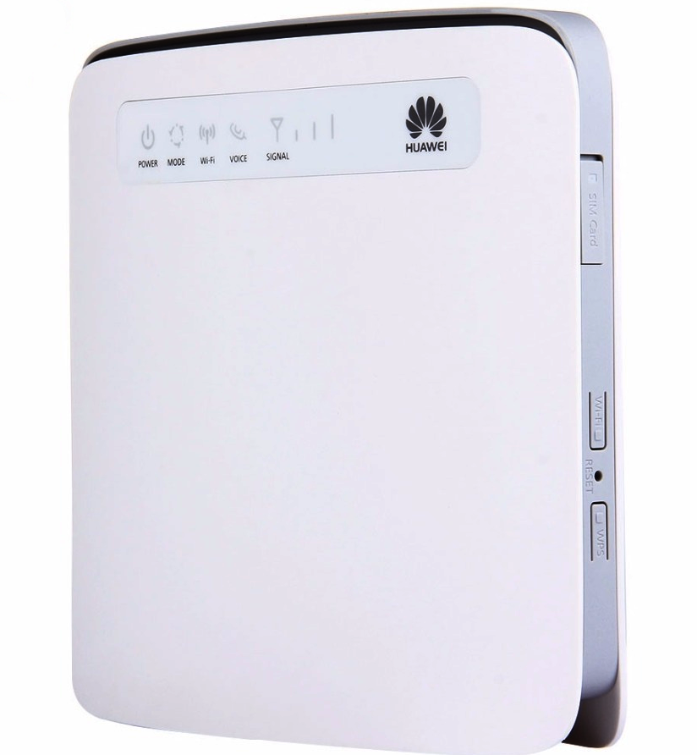
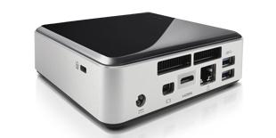
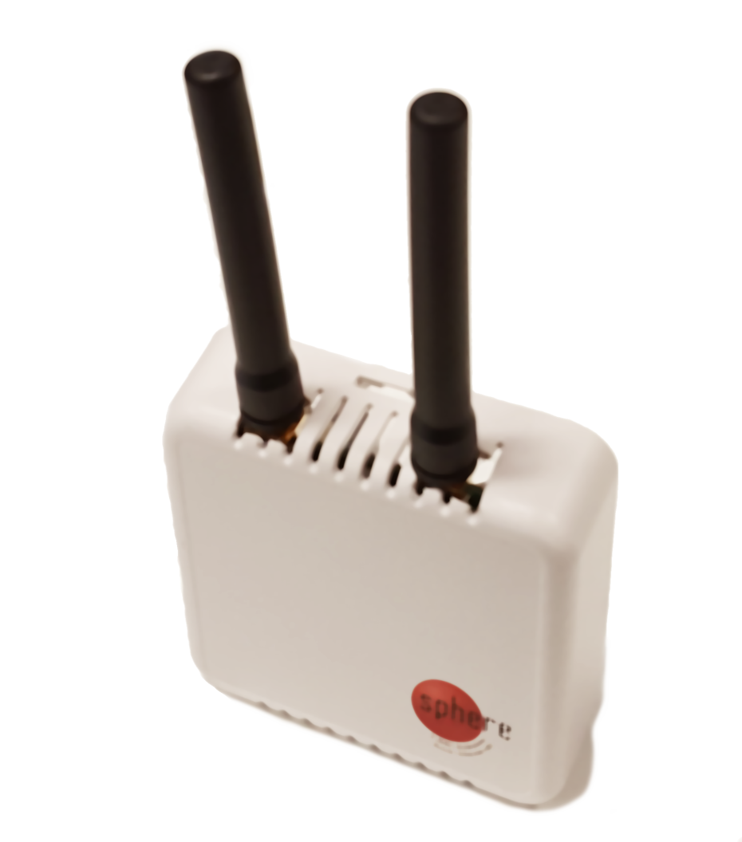
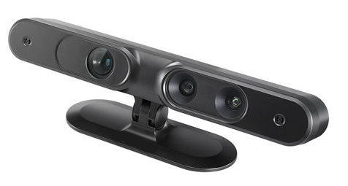
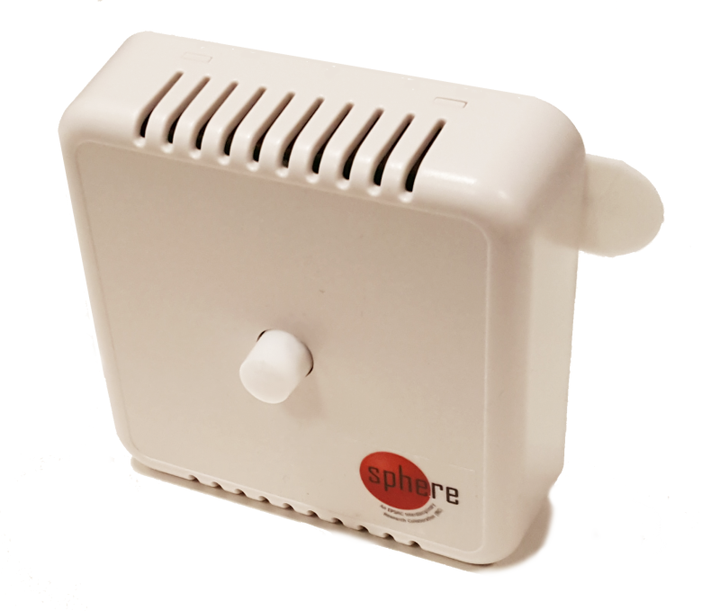
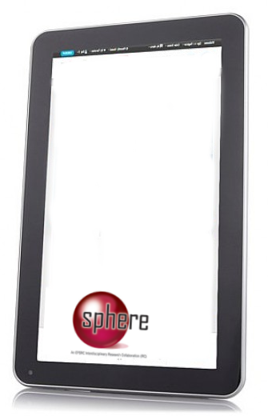
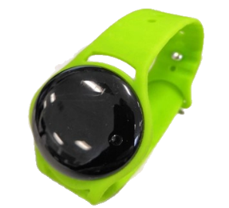
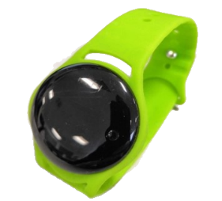
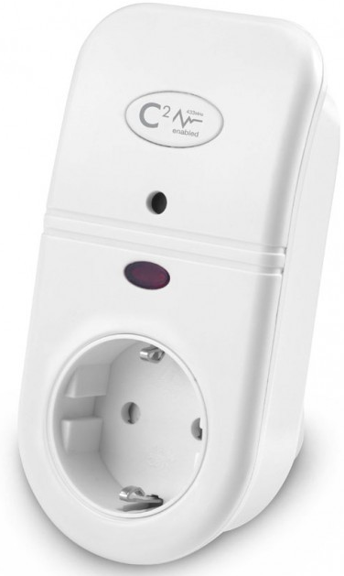
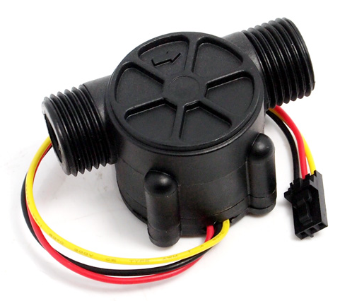
SPHERE Sensor Platform for Healthcare in a Residential Environment
Flagship project for the Digital Health
£25M of funding since 2013 from EPSRC, MRC and H2020
CUBOiD, PD Sensors, OPERA, EurValve, HEmiSPHERE, SPHERE-Cared
Design and deployment of custom IoT technologies in over 100 local homes
Collaborations between researchers, clinicians and the public
Research in wearable sensors, low power communication networks, computer vision systems and machine learning
~100 Bristol area

Slide 4
TORUS Transforming the Objective Real-world measurement of Symptoms
A novel platform of sensing technologies for patients’ own homes, to monitor Parkinson’s disease progression
£6.17M of funding from EPSRC (2023-2028)
39 staff members in Bristol and Newcastle
6 Work packages:
A Wearable for Data Fusion
Video Sensing for Data Fusion
Data Fusion and Distributed Machine Learning
System Integration, Security, Testing and Trial Support
PPIE, Codesign, Ethics and Acceptability
Into the Real World
The continuation of the SPHERE project

Slide 5
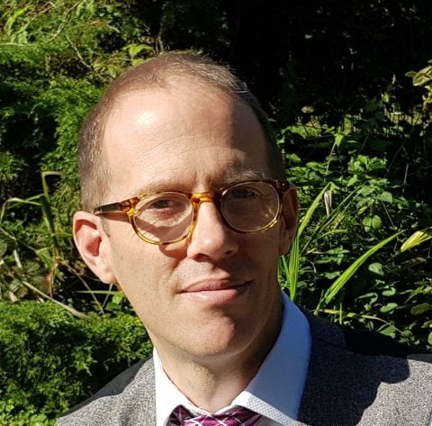
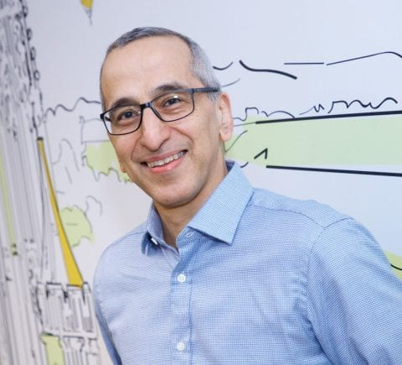
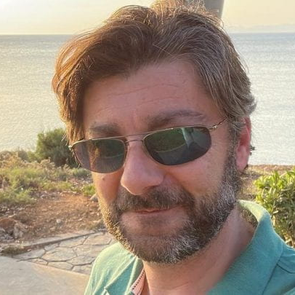
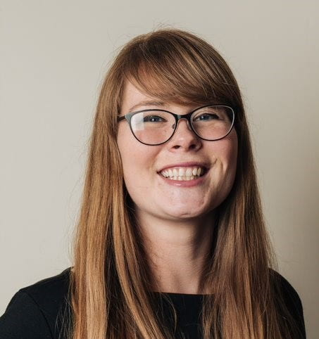
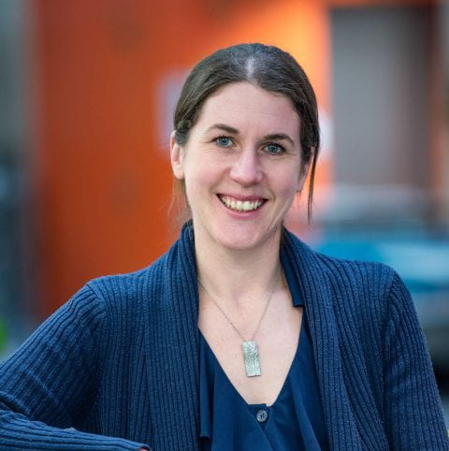
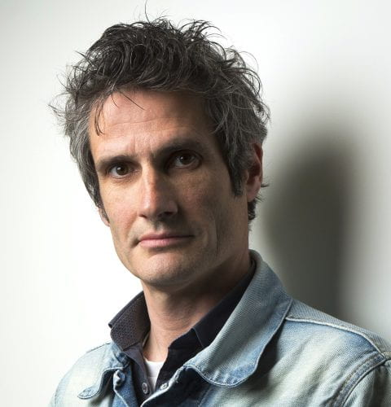
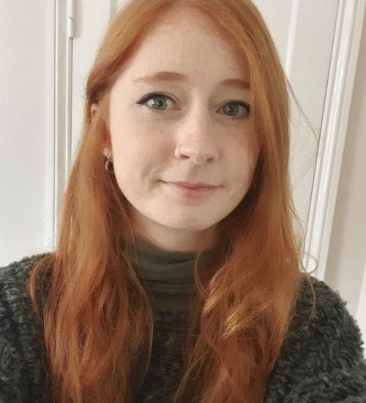
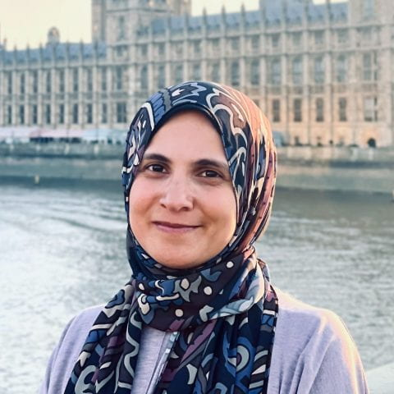
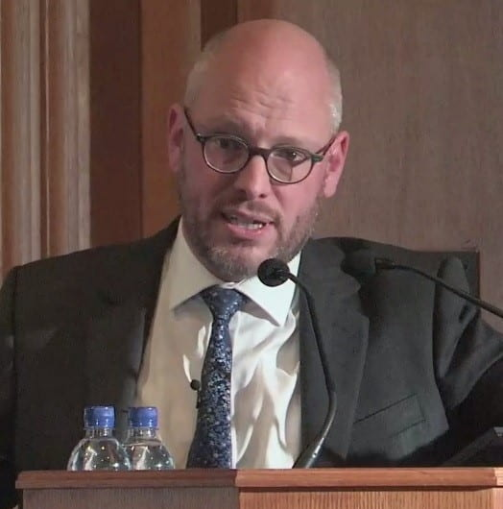
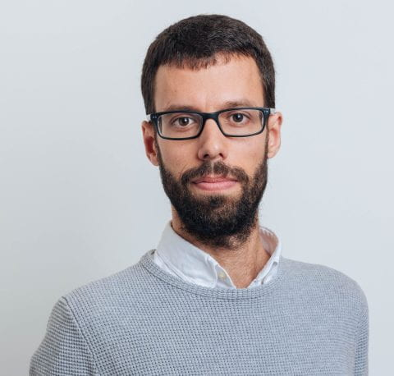
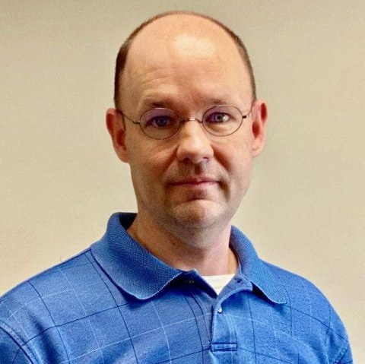
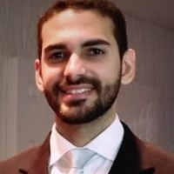
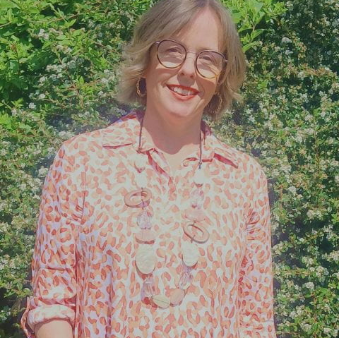
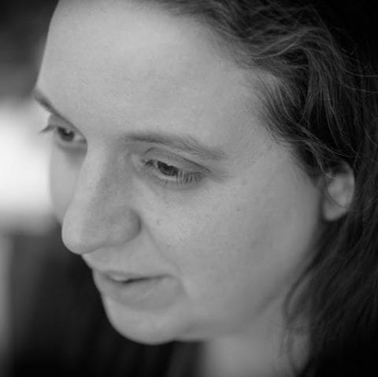
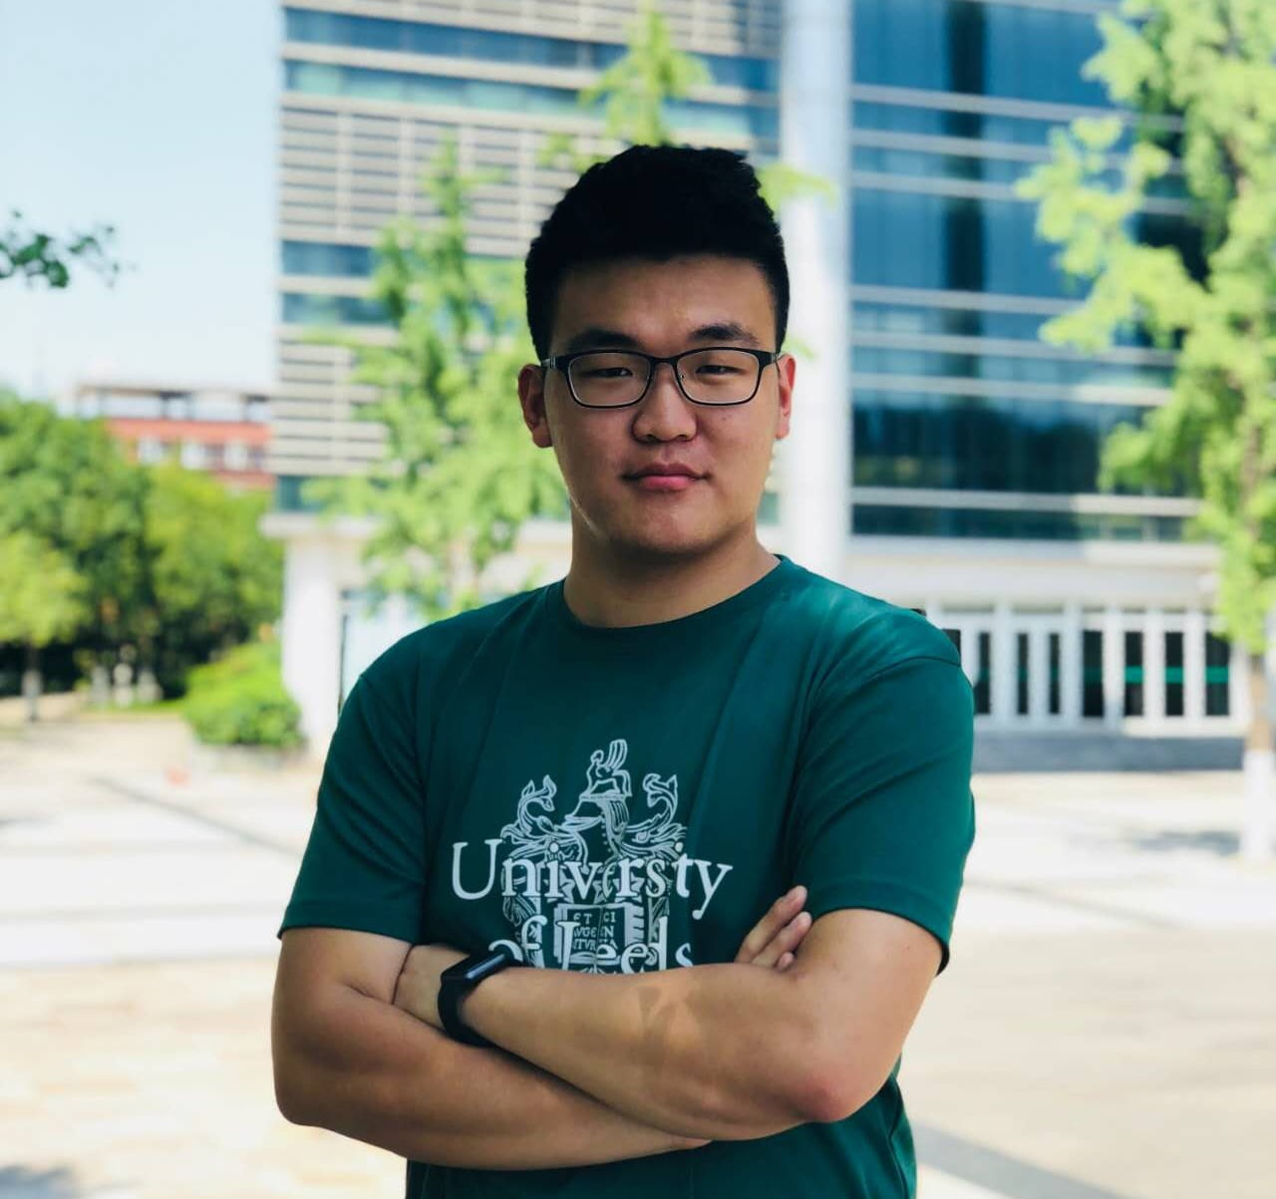
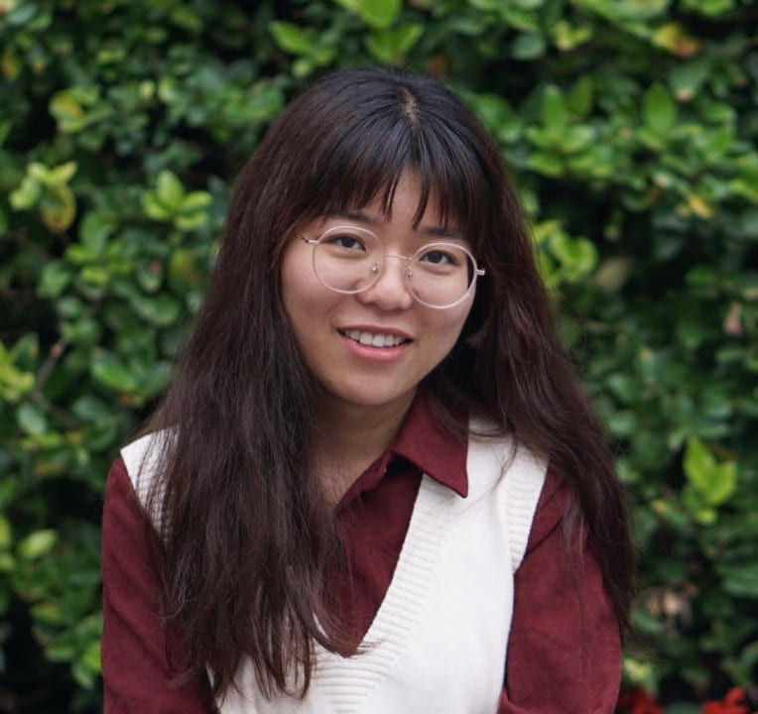
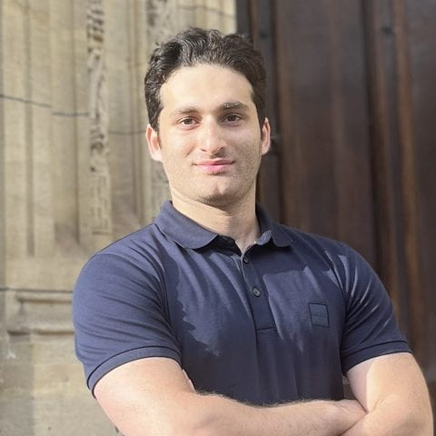
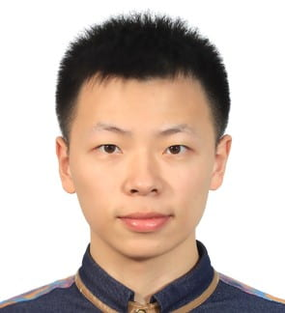
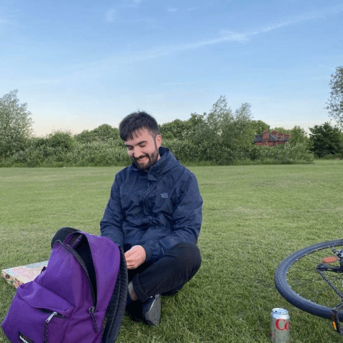
TORUS Team at the University of Bristol
Ian Craddock
Director
Majid Mirmehdi
George Oikonomou
Aisling O’Kane
Cathy Morgan
Kenton O’Hara
Mae Hazell
Co-Investigators
Project Staff
Zahraa Abdallah
George Oikonomou
Raul Santos Rodriguez
James Pope
Telmo de Menezes e Silva Filho
Lindsay Bishop
Researchers
Em Tonkin
Shuhao Dong
Jingjing Liu
Elaine Czech
Amirhossein Dadashzadeh
Guanxiong
Sun
Oscar Illingworth

Slide 6
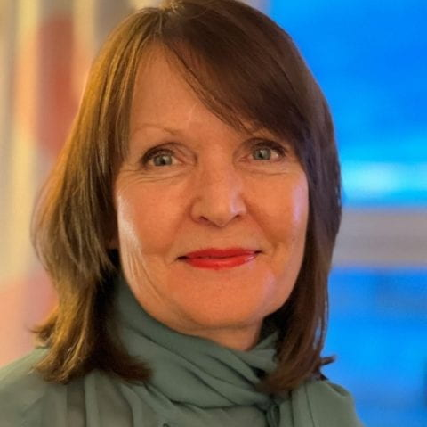
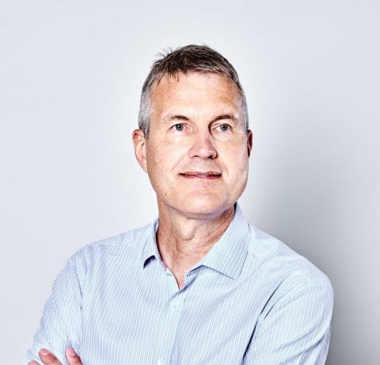
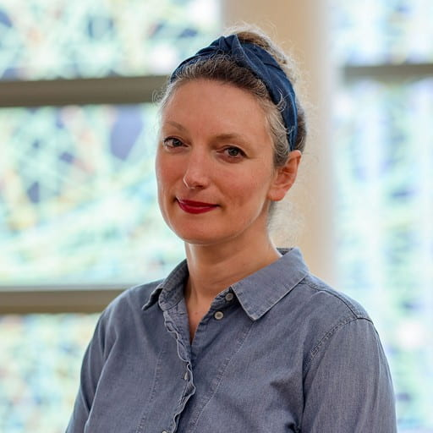
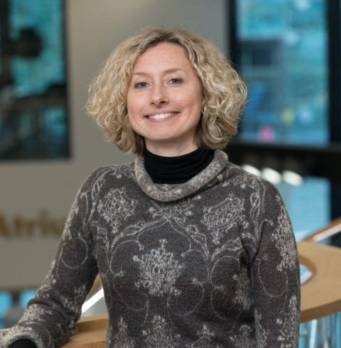
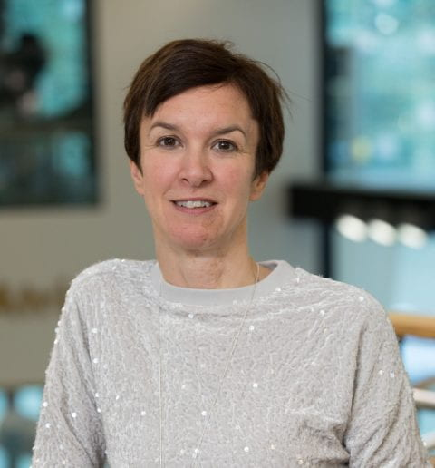
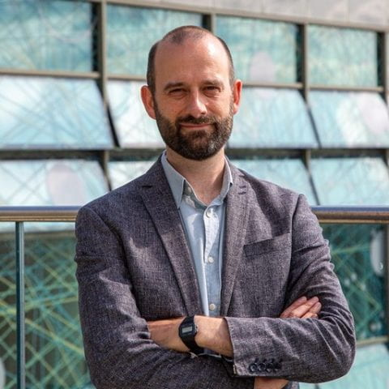
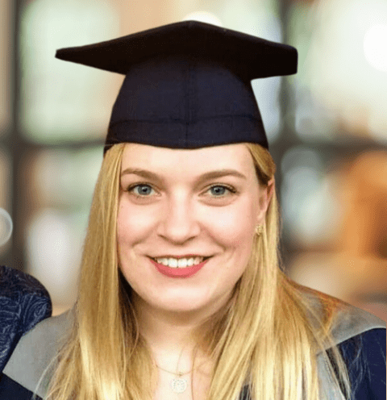
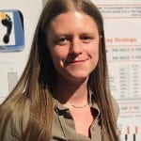
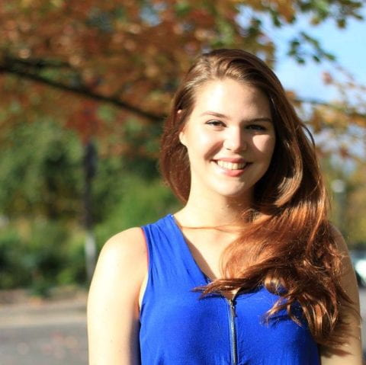
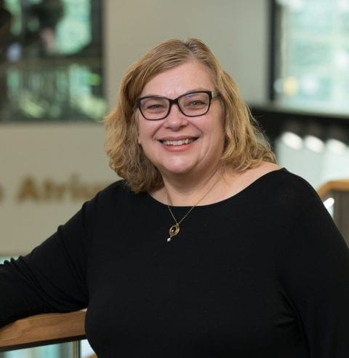
TORUS Team at Newcastle University
Lynn Rochester
Co-Director
Paul Watson
Abi Durrant
Silvia Del Din
Alison Yarnall
David Kirk
Co-Investigators
Lenia Margariti
Kirsty Scott
Lisa Alcock
Chloe Hinchliffe
Ann Gibson
Project Staff
Researchers

Slide 7
TORUS Highlighted research
Duan, S., Dadashzadeh, A., Whone, A. L. & Mirmehdi, M. Trajectory-guided Motion Perception for Facial Expression Quality Assessment in Neurological Disorders. (2025). 19th International Conference on Automatic Face and Gesture Recognition (FG). Institute of Electrical and Electronics Engineers (IEEE), (International Conference on Automatic Face and Gesture Recognition).
Elaine Czech, Ewan Soubutts, Ian J Craddock, Aisling Ann O'Kane. Understanding the Multimodal Voice Assistant as an Informal and Social Care Support Tool in the UK. (2025). ACM Conversational User Interfaces Conference.

Slide 8
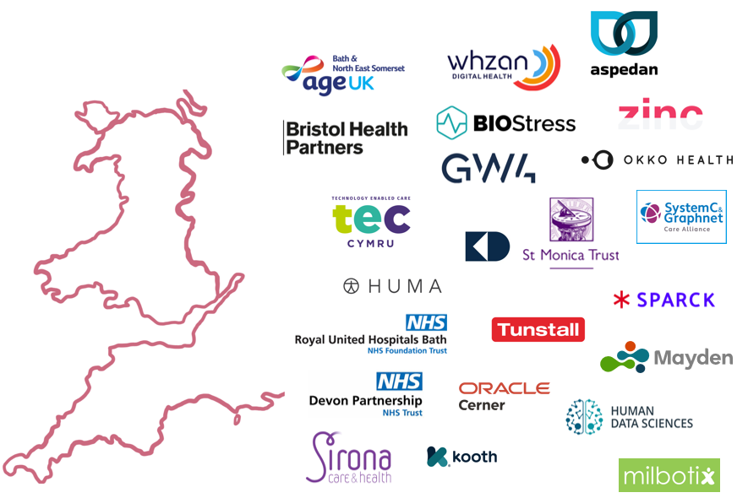
LEAP Digital Health Hub Leadership Engagement Acceleration & Partnership
Hub for the South West of England and Wales
5 regional universities and HDR UK
Led by the University of Bristol
Network of 200+ organisations
£4M of funding from EPSRC (2023-2026)
£1M of research funding allocated
Portfolio of 10 collaborative research projects in 4 key themes:
Care outside of the hospital
Service and resource planning
Frailty, fall prediction and fall prevention
Smartphone and wearable technologies

Slide 9
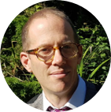
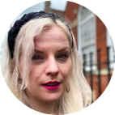
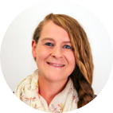
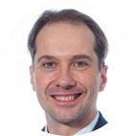
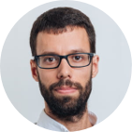
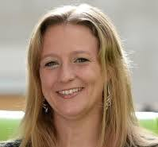
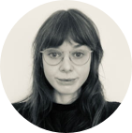
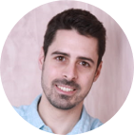
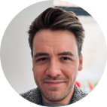
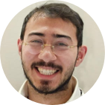
LEAP Team in the University of Bristol
Ian Craddock
Hub Director
Hanna Isotalus
Deputy Director
Rachel Prior
Hub Manager
Karen Dawe
Skills and Knowledge Deputy Director
Andrew Dowsey
Fellowship Programme Director
Raul Santos Rodriguez
Capability Programme Director
Kirsten Cater
Co-I
Laura Yiqing Wang
Online Coordinator
Emma Brown
Hub Administrator
Miquel Perello Nieto
Matthew Wragg
Nawid Keshtmand
Emily Nielsen
Researchers in Residence

Slide 10
LEAP Team in other organizations
Richard Luxton
Lead for UWE Bristol
David A. Ellis
Lead for University of Bath
Daniel Gartner
Lead for Cardiff University
Martin
Pitt
Lead for University of Exeter
Christopher Yau
Lead for HDR UK
Christos Vasilakis
Fellowships Programme Co-Director
Krasimira Tsaneva-Atanasova
Co-I
Antonia
Dingle
Skills and Knowledge Programme Representative
Andy Gibson
Co-I
Maneesh Kumar
Co-I
Rosie Wakeham
Skills and Knowledge Programme Representative
Janice Kiely
Co-I
Paul Harper
Co-I

Slide 11
LEAP Highlighted research
Tong Computer Interface for Widening Computer Access ( Withey, D., et al., UWE)
Novel Wearable-based Stress Detection Using Earables and Smartwatches (Clarke, C., et al., Bath)
Synthetic Data Generation for Privacy-Preserving Prediction Modelling in Critical Care ( McWilliams, C., et al., Bristol)
Predicting Falls Using Routinely Collected Primary Care Data in Heart Failure Population (Owusu, B., et al., Exeter)
(1)
(2)

Slide 12
CDT in Digital Health and Care Centre for Doctoral Training
£6.6M of funding from EPSRC (2019-2027)
5 cohorts (~10 students per year, total 50)
Research interests include:
Precision Digital Health & Self-Management
AI & Machine Learning for Prediction & Diagnosis
Mental Health & Behaviour Change Technologies
Health Robotics & Simulation
Wearables & Digital Biomarkers
Human-Centred Design & Inclusive Technologies
Global & Public Health Innovation
Notes:
Precision Digital Health & Self-Management e.g. Digital tools for managing cystic fibrosis, diabetes, atopic dermatitis, and ADHD
AI & Machine Learning for Prediction & Diagnosis e.g. Predictive models for sepsis, depression, COPD; explainable AI for antibiotic prescribing and cancer treatment
Mental Health & Behaviour Change Technologies e.g. Mood tracking, sleep interventions, self-harm support tools, digital epidemiology of mental wellbeing
Health Robotics & Simulation e.g. Haptic simulators for surgery, soft robots for therapy, swarm robotics in healthcare
Wearables & Digital Biomarkers e.g. Wearable sensors for Parkinson’s monitoring, seizure prediction, and temperature tracking in oncology and fertility
Human-Centred Design & Inclusive Technologies e.g. Co-designed apps with young people and neurodiverse users, WHO app for skin disease diagnosis in Kenya
Global & Public Health Innovation e.g. Mobile tech for diabetes care in Nigeria, AI platforms for health education, social media behaviour in population studies

Slide 13
CDT Management Team
Ian Craddock
Previous Director
Amberly Brigden
Director
Hanna Isotalus
Deputy
Director
Lucy Yardley
Research Programme Lead
Robert Piechocki
Research Programme Lead
Oscar Cordero Llana
Training Programme Lead
Raul Santos Rodriguez
Training Programme Lead
George Oikonomou
Technician Task Manager
Tom Verheyden
CDT Manager
Jon Bird
Amberly Bridgen
Erin Dooley
Hanna Kristiina Isotalus
Aisling O’Kane
Research and Teaching Staff

Slide 14
CDT Students by cohort
2023
Anika Pinto
Sarah Koerner
Hans Johnson
Tefkros Chimonas
Emily Quilter
Jerusaa Vasikaran
Ryan Beck
Monib Sediqi
Angela Pateman
Weiyi Li
2022
Qiushuo Cheng
‌Abiola Saka
Amanda Sissons
Cicely Mathews
Fin Schofield
Dina Molnar
Abdelrahman Otify
Sarah Wilkie-Ryan
Verónica Blanco Gutiérrez‌
Yujie Dai
Yelu Gu
Ellen Weir
2021
… and 20 more from 2019-2020
Marah Alassaf
Timeyin Arueyingho
Sydney Charitos
Eszter Vigh
Daniel Joinson
Gavryel Martis
Sammy Shorthouse

Slide 15
CDT Highlighted research
Quilter, Emily & Butlin, Cynthia & Carrion, Carme & Ruiz-Postigo, Jose-Antonio. The WHO Skin NTD mobile application – a paradigm shift in leprosy diagnosis through Artificial Intelligence?. Leprosy Review. (2024).
Arueyingho O, Aprioku J, Marshall P, O'Kane A. Insights Into Sociodemographic Influences on Type 2 Diabetes Care and Opportunities for Digital Health Promotion in Port Harcourt, Nigeria: Quantitative Study. JMIR Diabetes. (2024).
Wijewardhane, N., Denniss, A.R., Uppington, M. et al. Long-term imaging and spatio-temporal control of living cells using targeted light based on closed-loop feedback. J Micro-Bio Robot. (2024).
Deighan, M.T., Simpson, D., Brigden, A. et al. Perspectives of healthcare professionals on the use of immersive virtual reality in teenage and young adult oncology: a qualitative interview study. BMC Digit Health 2, 22 (2024).
Notes:
Quilter, Emily & Butlin, Cynthia & Carrion, Carme & Ruiz-Postigo, Jose-Antonio. (2024). The WHO Skin NTD mobile application – a paradigm shift in leprosy diagnosis through Artificial Intelligence?. Leprosy Review. 95. 1-3. 10.47276/lr.95.2.2024030.
Digital tools for managing cystic fibrosis, diabetes, atopic dermatitis, and ADHD
Predictive models for sepsis, depression, COPD; explainable AI for antibiotic prescribing and cancer treatment
Mood tracking, sleep interventions, self-harm support tools, digital epidemiology of mental wellbeing
Haptic simulators for surgery, soft robots for therapy, swarm robotics in healthcare
Wearable sensors for Parkinson’s monitoring, seizure prediction, and temperature tracking in oncology and fertility
Co-designed apps with young people and neurodiverse users, WHO app for skin disease (leprosy) diagnosis in Kenya
Mobile tech for diabetes care in Nigeria, AI platforms for health education, social media behaviour in population studies

Slide 16
Digital Health Seminar Series
For more information visit: bristol.ac.uk/dh-seminars
Miquel
Perello Nieto
Matthew
Wragg
Emily
Nielsen
Sarah
Koerner
Nawid
Keshtmand
Emma
Brown
Tuesdays
14:00 – 15:00
Bi-weekly
Developing international interdisciplinary connections between academics, healthcare professionals, and industry. ​
Seminar Room 1,
AIMS Conference Centre
Notes:
Develop international interdisciplinary connections between academics, industry and healthcare professionals.
Strengthen a wider Digital Health Research group:
SEMT, SCS, Bris. Med. S. and more

Slide 18
Digital Health Research Group School of Engineering Mathematics and Technology
Data Science Lab Away Day
Presenter:
Dr. Miquel Perello Nieto, Senior Research Associate
Monday 23 June 2025

