Slide 1
Interpreting Artificial Intelligence
Solutions for Healthcare
Organizers:
Dr Miquel Perelló Nieto & Dr Nawid Keshtmand
4 July 2025

Slide 2
About Dr Miquel Perelló Nieto
Research experience
Research Interests
Machine Learning
Uncertainty quantification
Optimal decision making
Real-world applications
Healthcare

Slide 3
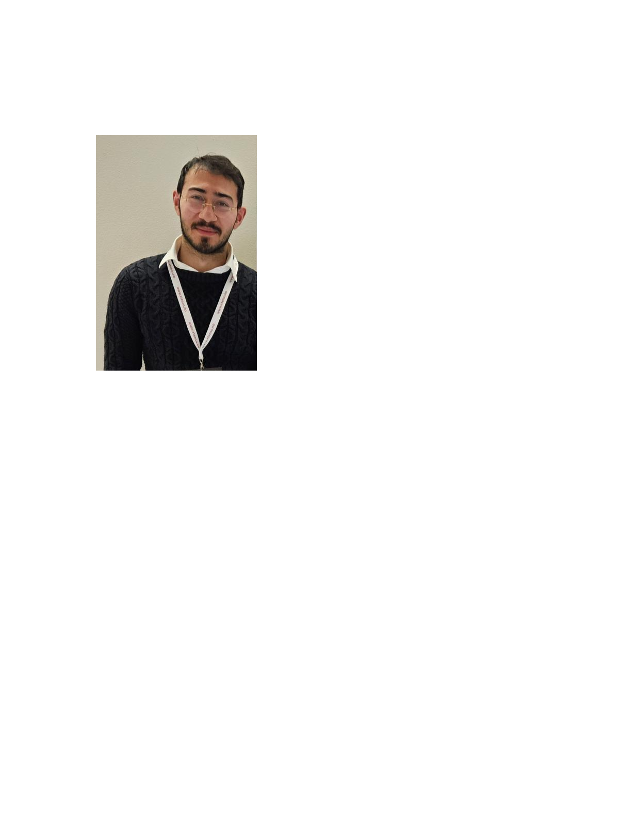
About Dr Nawid Keshtmand
Research experience
Research Interests
Machine Learning
Out-of-Distribution data
Self-supervised learning
Healthcare
Climate

Slide 4
LEAP Digital Health Hub Leadership Engagement Acceleration & Partnership
Hub for the South West of England and Wales
5 regional universities and HDR UK
Led by the University of Bristol
Network of 200+ organisations
£4M of funding from EPSRC (2023-2026)
£1M of research funding allocated
Portfolio of 10 collaborative research projects in 4 key themes:
Care outside of the hospital
Service and resource planning
Frailty, fall prediction and fall prevention
Smartphone and wearable technologies

Slide 5
Agenda
10:00
What is AI?
AI in healthcare
Demistifying AI
Ethics and Regulations
Explainability
10:45
Break
10:55
6. Large Language Models
7. Discussion
11:30

Slide 7
1. What is AI?
Examples
AI vs Machine Learning

Slide 8
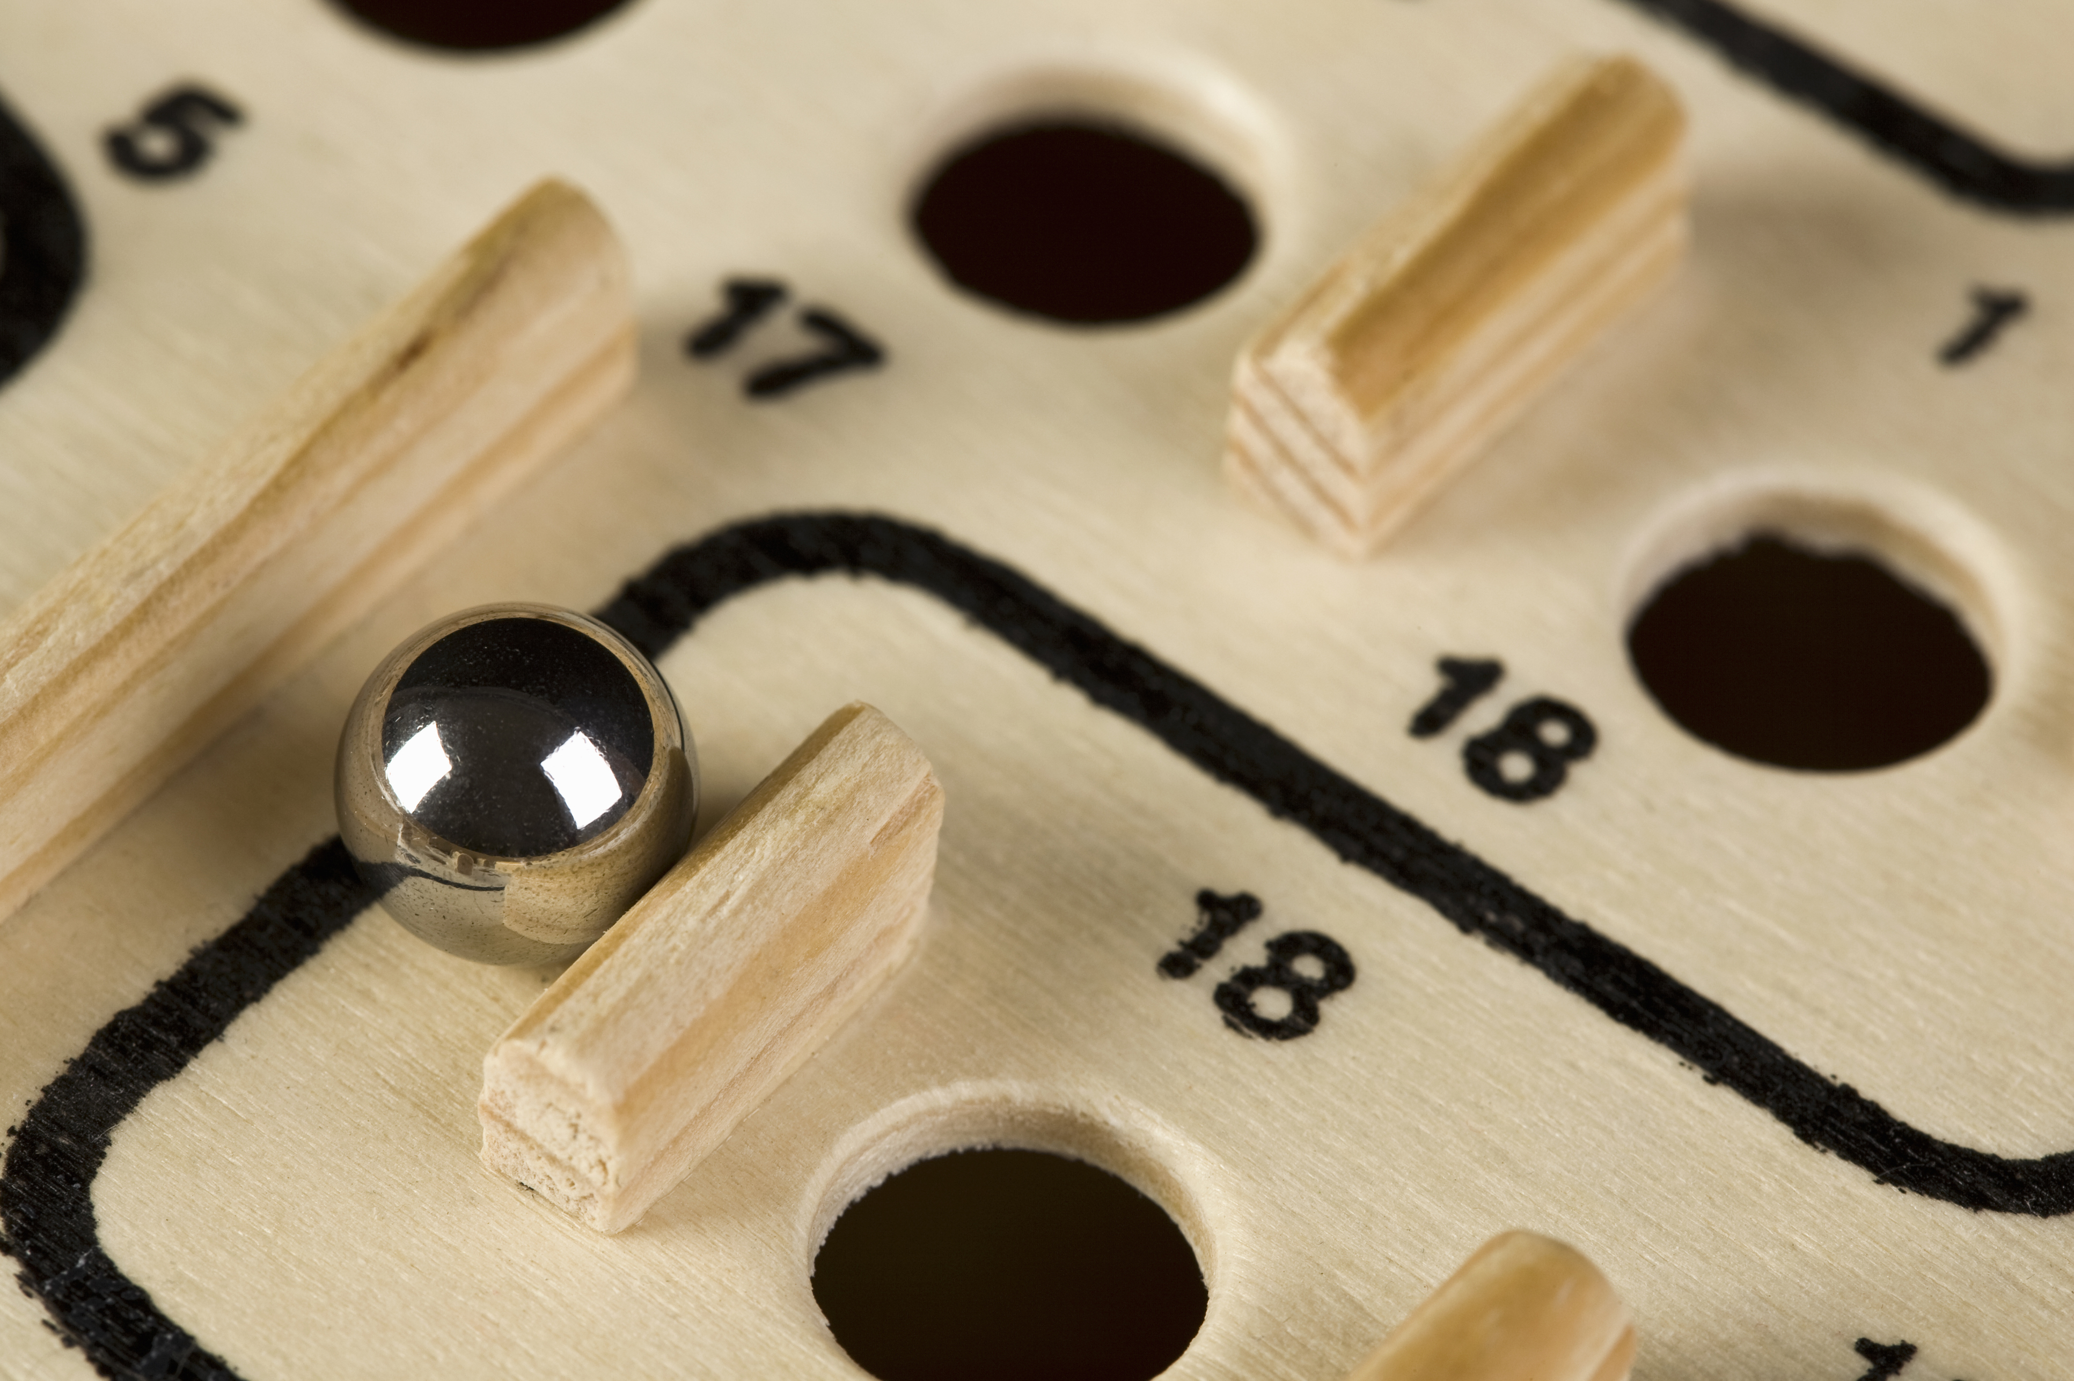
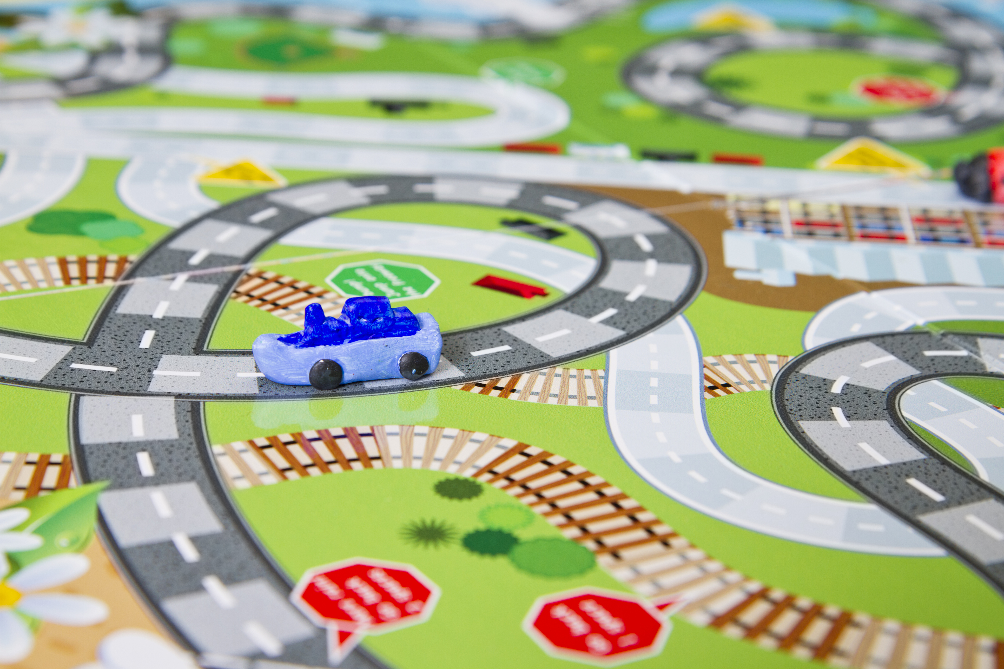
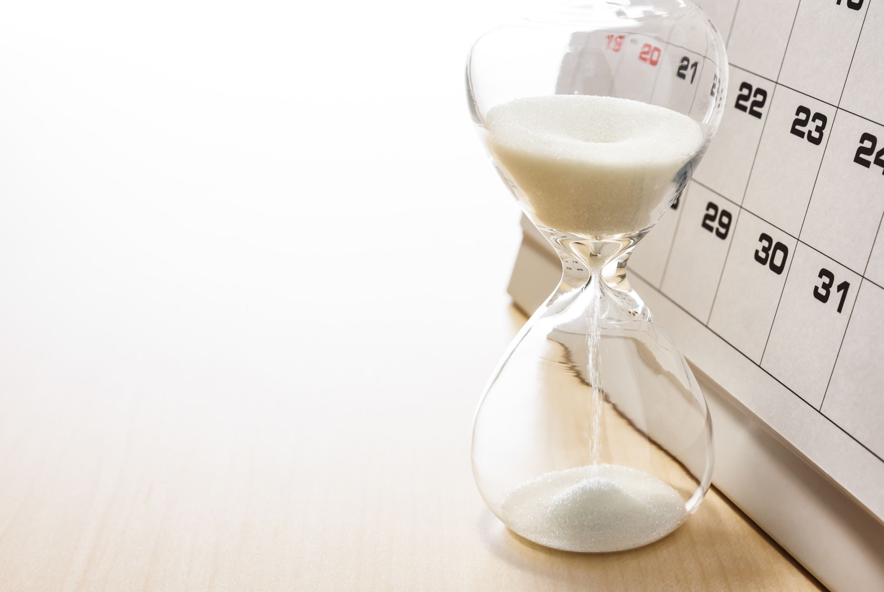
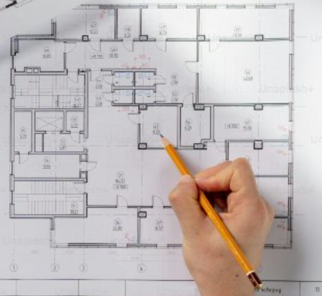
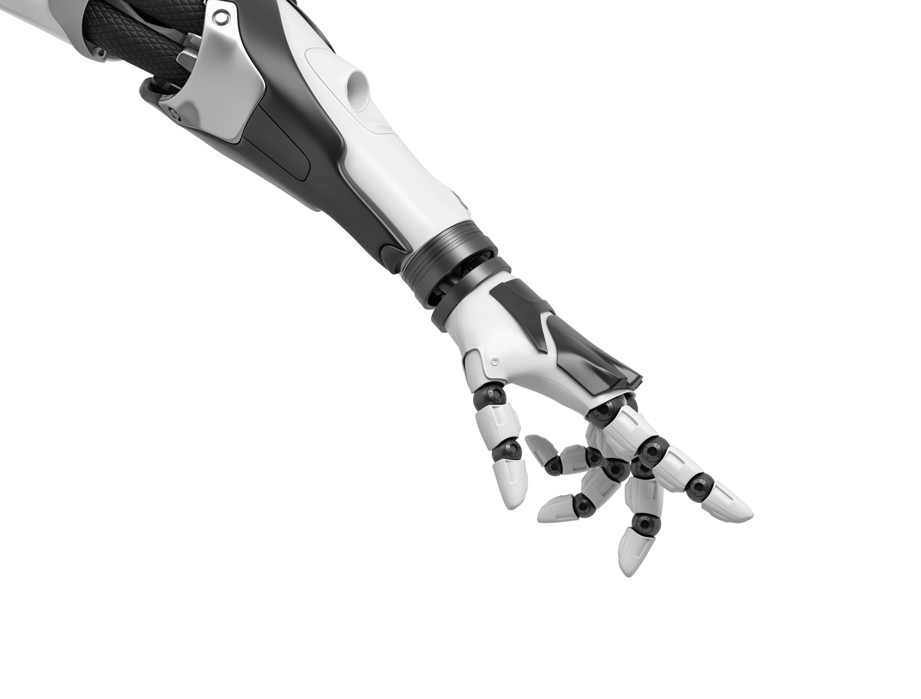
AI example: Search algorithms
Decisions based on scores
(or costs)
Good move
(avoids human winning)
BAD move
(AI loses)

Slide 9
AI example: Knowledge base
Knowledge Base
Inference Engine
Prior
knowledge
Belongs to
Patient description:
Is 30 years old
Has symptom Fever
Has symptom Fatigue
Does not have Dry Cough
...
Disease
Coronavirus
Covid-19
Belongs to
Can generate
Fever
Fatigue
Dry cough
Past experiences or data examples
Belongs to
Actions
Suggestions
New knowledge
Symptom

Slide 10
AI examples
Information retrieval
Recomender systems
Google searches
Online articles
Restaurants
Travel agencies
Similar to information retrieval but with personal profile
Movie recommendations
Music recommendations
Online shopping

Slide 11
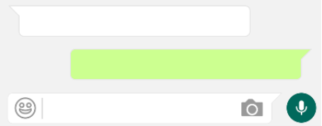
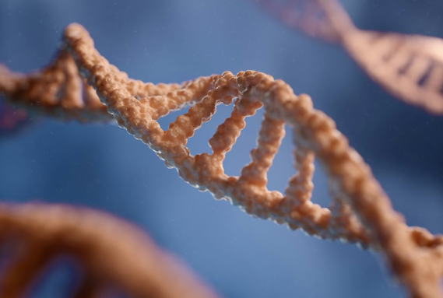
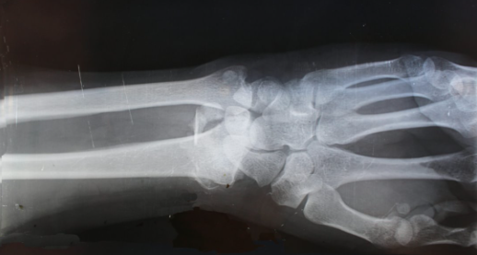
AI and Machine Learning
Artificial Intelligence (AI)
Less data
requirements
Machine Learning (ML)
Deep Learning
More data
Notes:
AI: Multiagent systems, Internet of Things, simulation, digital twins, planning
ML: Human activity recognition, localisation, robotics and automation, predictive maintenance
DL: Personalised medicine, drug discovery and development, medical imaging and diagnostics, chatbots

Slide 12
2. AI in Healthcare
Applications
Examples

Slide 13
Applications of AI in Healthcare
Medical Diagnosis
Virtual Nursing
Assistance
Fraud Detection
Cancer Research
Drug Development
Cybersecurity
A.I. for Healthcare
Rare Disease
Diagnostics & Treatment
AI Robot-Assisted
Surgery
Dosage Error
Reduction
Personalised
Healthcare Plans
Health Monitoring
& Wearables
Personalised
Medicine

Slide 14
Early diagnosis
Health data
Pre-disease
Undetectable
Moderate /
Reversible
Severe /
Irreversible
Disability /
Death
Predisposition?
Epistemic?
Shift from symptom management
to remission and cure
Notes:
Data privacy
Ethical use of collected data
Lack of data standardisation
Scarcity and quality of annotations

Slide 15
2. AI in Healthcare
Applications
Examples

Slide 16
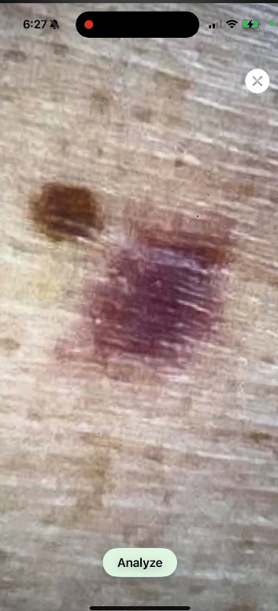
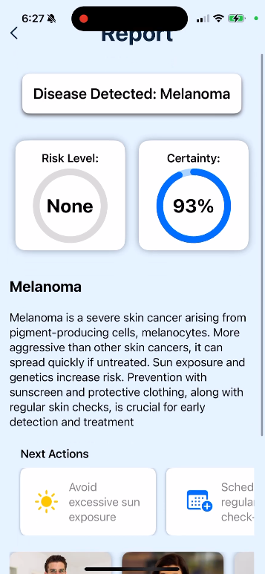
DermAI: AI-Powered Skin Cancer Detection
Diagnosis of non-melanoma and melanoma skin cancers and other skin conditions.
Tailored reports including risk levels, recommended specialists, research findings, actionable next steps.
AI chatbot functionality for real-time natural language interactions.

Slide 17
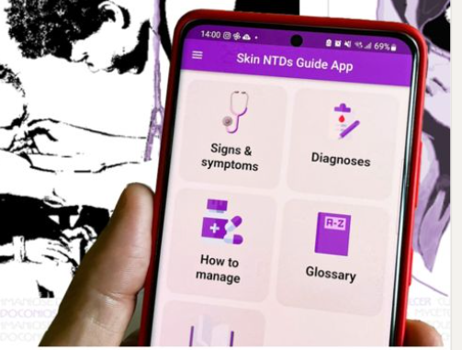
WHO Skin NTD (Neglected Tropical Diseases) mobile application
App development "No Leprosy Remains"
Used in clinical workflows in 35 FHWs and 5 Kenyan counties
Computer vision to classify photos of skin lessions with special focus on leprosy and other NTDs
Emily E. V. Quilter, Cynthia Ruth Butlin, Carme Carrion, Jose-Antonio Ruiz-Postigo; The WHO Skin NTD mobile application – a paradigm shift in leprosy diagnosis through Artificial Intelligence?; Leprosy Review; 2024; 95; 2; e2024030; DOI: 10.47276/lr.95.2.2024030

Slide 18
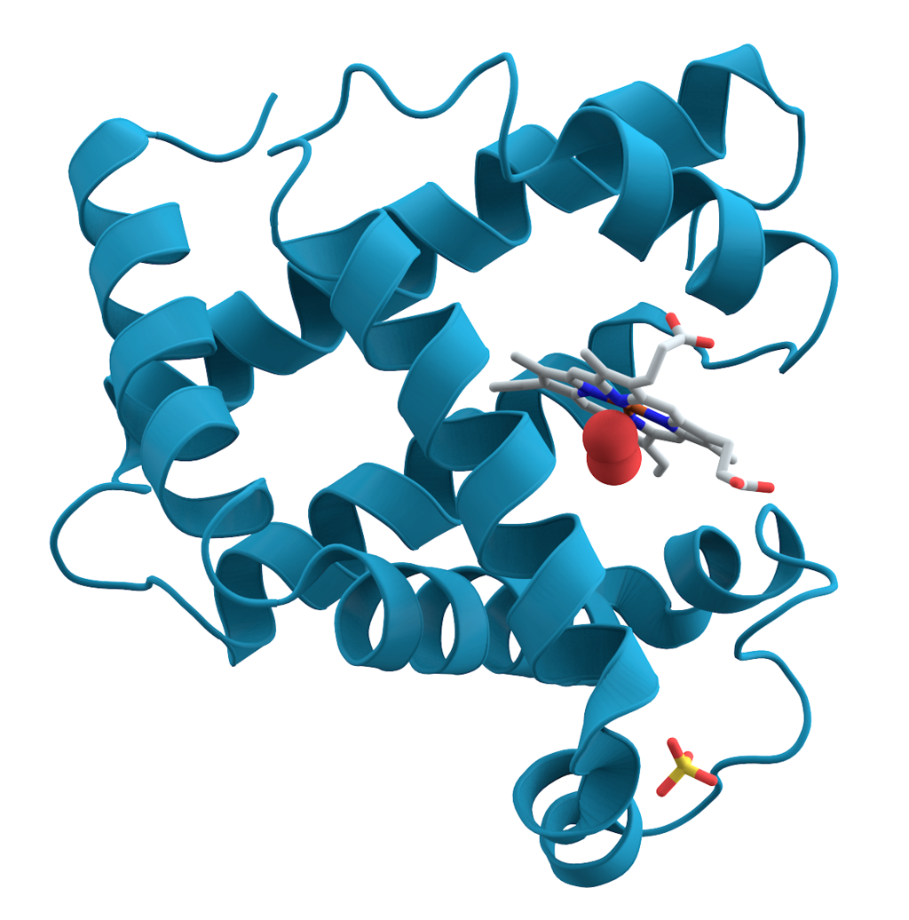
Protein structure prediction
Predicting the 3D structure of a protein based on its amino acid sequence
One of the most important open research problem for more than 50 years
AlphaFold: a neural network evaluated in the 14th Critical Assessment of protein Structure Prediction
We now have 98.5% of the human proteome 3D structures
36% of it with very high accuracy
22% with high accuracy
Jumper, J., Evans, R., Pritzel, A. et al. Highly accurate protein structure prediction with AlphaFold. Nature 596, 583–589 (2021). https://doi.org/10.1038/s41586-021-03819-2

Slide 19
3. Demystifying AI
These eyes can't see,
they are batteries
ML Pipeline
Radiology
Scribes
Pitfalls
These hands can't grasp,
they are levers from a lighter

Slide 20
3. Demystifying AI
ML Pipeline
Radiology
Scribes
Pitfalls

Slide 21
Machine Learning lifecycle
Data collection
Data preprocessing
Feature engineering
Model selection
Model training
Model evaluation
Model deployment
Monitoring and maintenance

Slide 22
Data Preprocessing. Tabular
Quantitative
Qualitative
ID | Age | Sex | Weight | Height
1 | 26 | 0 | 65.2 | 155
2 |  | 2 | 78.5 | 178
3 | 18 | 1 | 58.1
4 | 67 | 0 | 70.7 | 170
5 | 50 |  |  | 175
ID | Age | Sex | Weight | Height
6 | young | male | normal | short
7 | baby | female | underweight | small
8 | adult | female |  | tall
9 | teenager |  | normal | short
10 | senior | male | overweight
Data is commonly converted into numeric data.
Careful consideration for missing values.

Slide 23
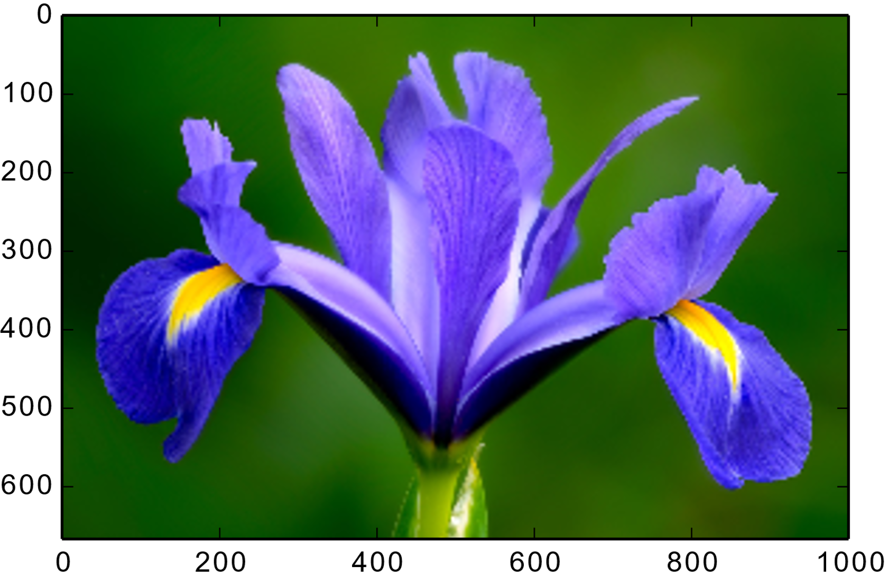
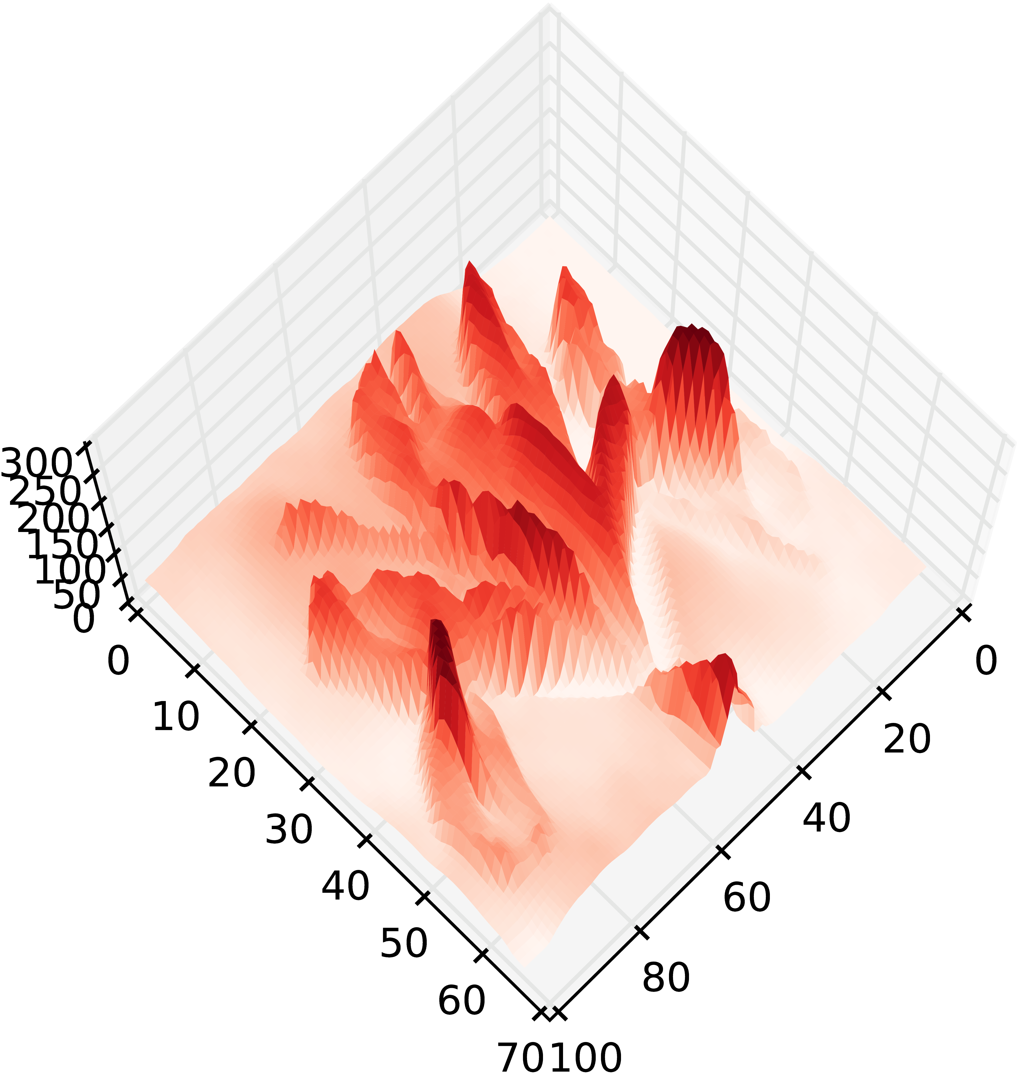
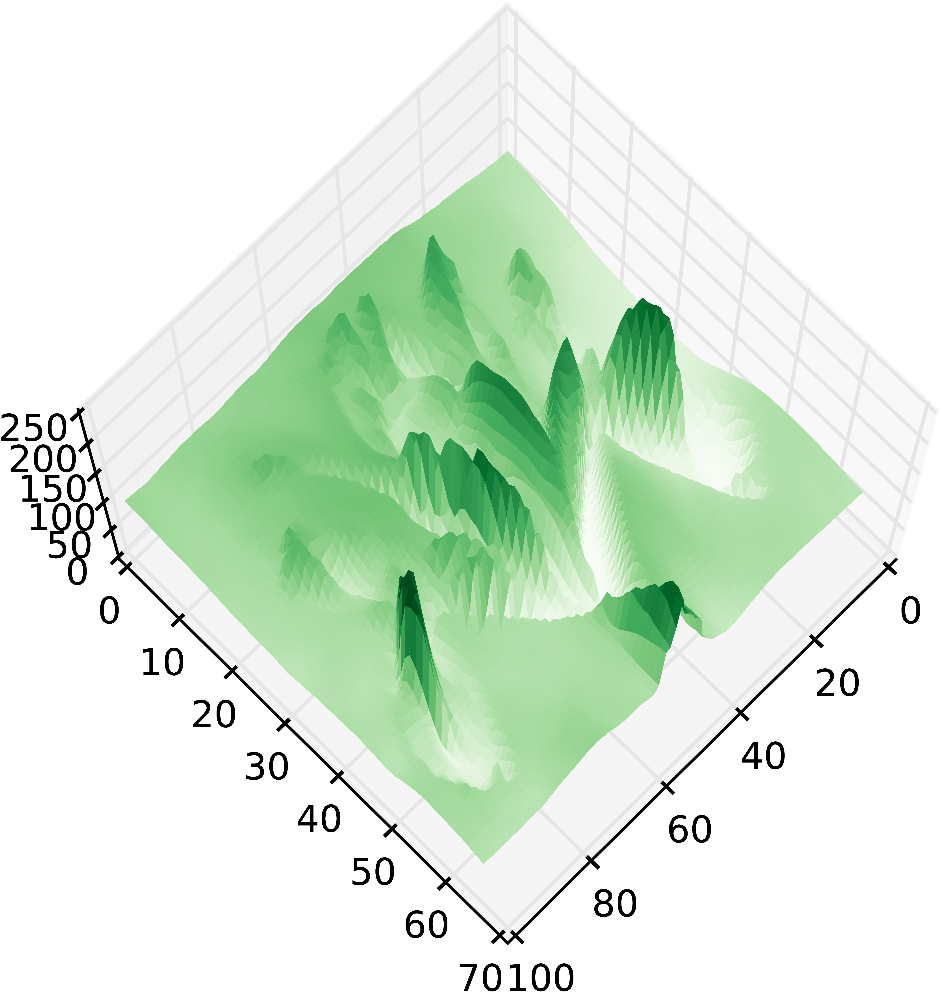
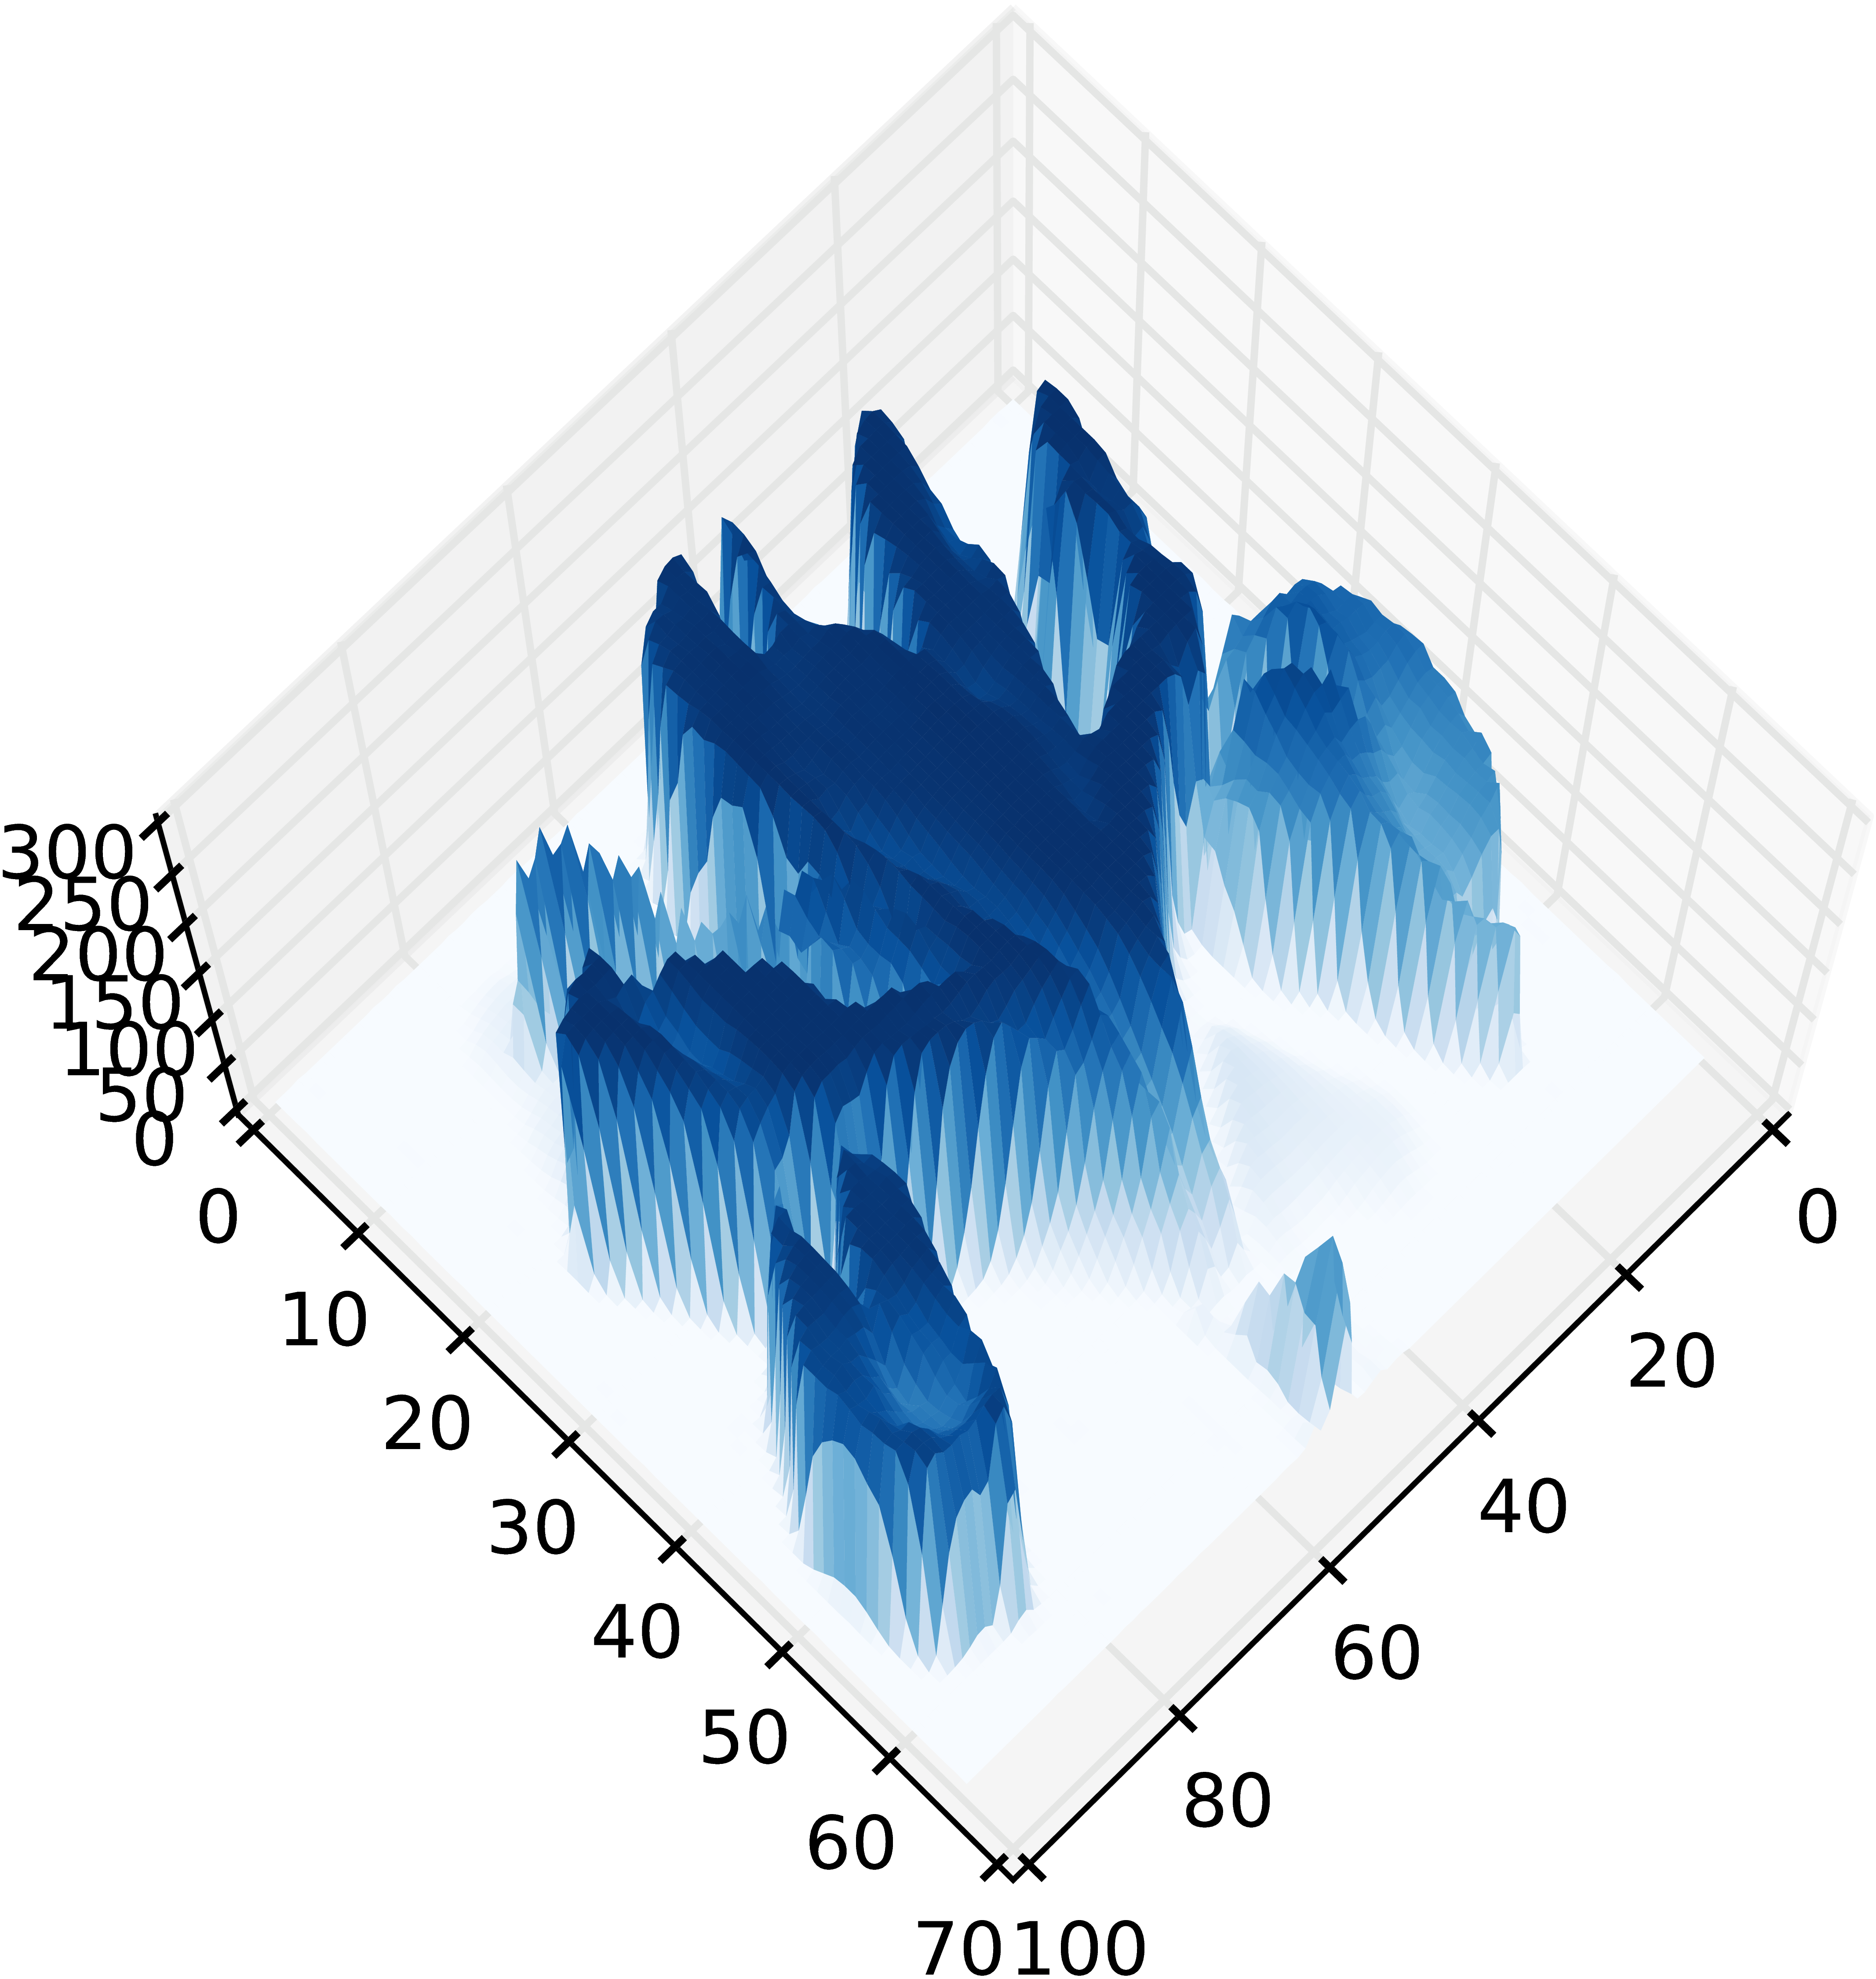
Data Preprocessing. Images
Grayscale
Colour
Original
image
Computer representation

Slide 24
Data Preprocessing. Text
"Text can be encoded in numeric form in multiple ways, a simple example is in the form of bag of words"
This representation loses the order information.
There are more complex approaches not covered here.
Words | Text | Can | Be | encoded | in | a | numeric | form | Multiple | Ways | Simple | ...
Repetitions | 1 | 1 | 1 | 1 | 3 | 1 | 1 | 2 | 1 | 1 | 1

Slide 25
Data Preprocessing. Text
"Text can be encoded in numeric form in multiple ways, a simple example is in the form of bag of words"
N-gram: sequences of n adjacent symbols (words).
Words | Text | Can | Be | encoded | in | a | numeric | form | Multiple | Ways | Simple | ...
Repetitions | 1 | 1 | 1 | 1 | 3 | 1 | 1 | 2 | 1 | 1 | 1
1-gram | Rep.
text | 1
can | 1
be | 1
encoded | 1
in | 3
... | ...
2-gram | Rep.
Text can | 1
Can be | 1
Be encoded | 1
Encoded in | 1
In numeric | 1
... | ...
3-gram | Rep.
Text can be | 1
Can be encoded | 1
Be encoded in | 1
Encoded in numeric | 1
In numeric form | 1
... | ...
Can we predict the new word in the sentence
A simple …
And the next one?
In ...

Slide 26
3. Demystifying AI
ML Pipeline
Radiology
Scribes
Pitfalls

Slide 27
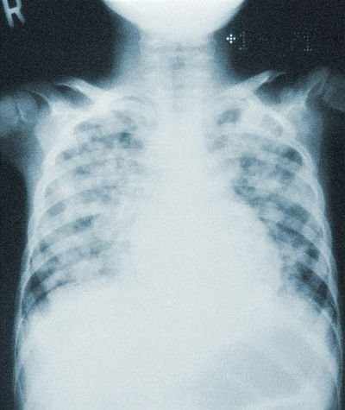
Radiology and image classification
The COVID-19 pandemic required a large amount of chest image analysis.
AI could help speed up the process.
But how could AI make a diagnosis?

Slide 28
Feature engineering
Haar filters and Viola-Jones face detection (Haar, A., Viola, P., and Jones, M.)
How to create filters for every object?
Convolve the filter
?
Images by Soumyanilcsc - Own work, CC BY-SA 4.0, https://commons.wikimedia.org/w/index.php?curid=37353327 and https://commons.wikimedia.org/w/index.php?curid=37353395

Slide 29
Automatic detection of Feature descriptors
Automatic detection of feature descriptors of an image (or sub-image)
SIFT (Scale-Invariant Feature Transform)
Features of interest are robust to image translation, scaling, and rotation, and partially invariant to illumination changes, and local geometric distortion
Other methods:
SURF (Speeded Up Robust Features)
GLOH (Gradient Location and Orientation Histogram)
HOG (Histogram of Oriented Gradients)

Slide 30
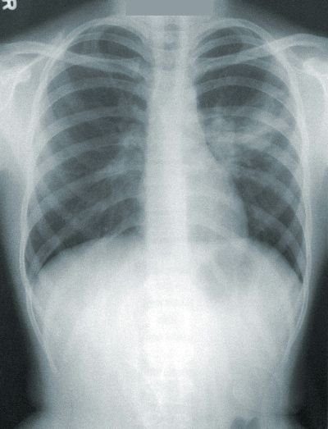
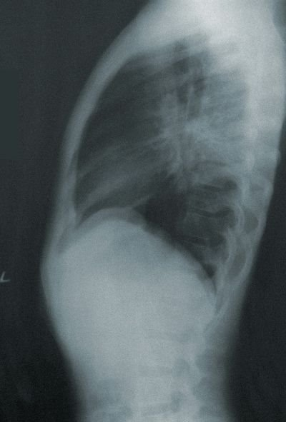
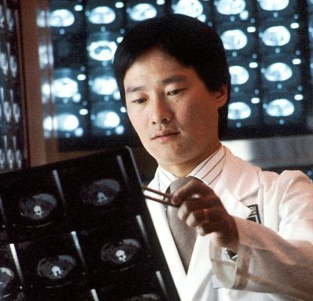
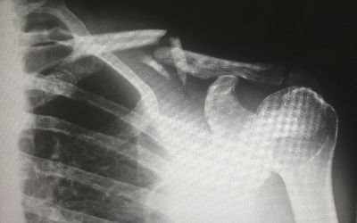
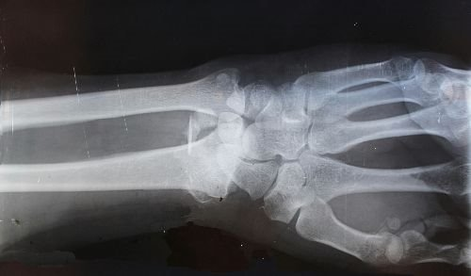
Annotations for Machine Learning
Unlabelled data
Annotators
Labelled data
Classification
Detection
Segmentation
Other tasks
Regression
Exploratory
Clustering
Dimensionality Reduction
Expert
Fracture
Groups
Crowd
Pneumonia
Notes:
Unsupervised Anomaly detection

Slide 31
Neurons: bilogical vs artificial
Simplified schema of a biological neuron
Logistic activation function
Mathematical simplification of a neuron as a weighted sum
2. Neuronal action potential ("spike")
Rectified linear unit
Originally Neuron.jpg taken from the US Federal (public domain) ( Nerve Tissue, retrieved March 2007), redrawn by User:Dhp1080 in Illustrator. Source: “Anatomy and Physiology” by the US National Cancer Institute’s Surveillance, Epidemiology and End Results (SEER) Program.
2. By Nir.nossenson - Own work, CC BY-SA 4.0, https://commons.wikimedia.org/w/index.php?curid=48019779

Slide 32
Neural Networks
Drawing of neurons by Santiago Ramón y Cajal (around 1890s)
Neocognitron schematic diagram illustrating the interconections between multiple layers [Fukushima, 1980]

Slide 33
Learning procedure: Backpropagation
Toy example of the learning process to classify between white and black samples.
Example of how a prediction error during training propagates a loss that changes the strengths of the weights on a multilayer artificial neural network

Slide 34
Learned filters

Slide 35
More complex features

Slide 36
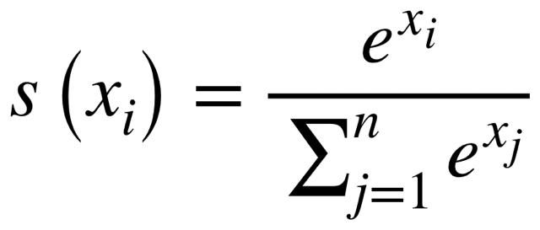
Final prediction
Airplane
Automobile
Bird
Cat
Deer
Dog
Frog
Horse
Ship
Truck
Airplane
Automobile
Bird
Cat
Deer
Dog
Frog
Horse
Ship
Truck
SoftMax

Slide 37
Deep Neural Network
VGG-16: 16 layers
GoogleNet: 22 layers DNN [Szegedy et al., 2014]
ResNet: 34 layers
ResNet-50: 50 layers
...

Slide 38
What different layers represent

Slide 39
YouTube: DeepDream through all the layers of GoogleNet

Slide 40
Radiology and other image analysis
Plenty of AI methods for image analysis
Each with its own drawbacks
AI should support experts
Constant monitoring is necessary
Provide explanations under request
Blood dell counter YoLo v7, MIT license, https://github.com/mmasdar/Blood-Cell-Counter-YoLo-v7

Slide 41
3. Demystifying AI
ML Pipeline
Radiology
Scribes
Pitfalls

Slide 42
AI scribes
Along side your Electronic Health Record (EHR), while you hold consutations with your patients
Listens and transcribes
Summarisation
Task creation
Drafts notes, letters and clinical codes
Some have a chatbot
Lots of different tools:
Tortus: Self-registered as a class 1 medical device
Heidi
Anima:
Kiwipen
Antikit AI: Chatbot for GPS, uses the British Medical Association and the NHS guidance

Slide 43
Scribes
Voice to text in real time
Summarisation of the text
Use of additional text information (e.g., EHR)
Help writing a reference letter
Sometimes Chat functionalities
Most parts probably done with Large Language Models with prompt engineering

Slide 44
Large Language Models (Chat GPT)
Generative: Designed to generate the next "word".
Pre-trained: Pre-trained with bast amounts of text.
Transformer: A Transformer architecture to iteratively assign importance to the "words" in the text.

Slide 45
Learning the meaning of words
Training the model to predict the new word with limited information forces the model to learn a representation of the meaning of words
king – man + woman ~= queen
sushi – japan + germany ~= bratwurst

Slide 46
Text generation
The huge amount of training has a multitude of context
Prompts provide a context to "reduce the search area"
In any particular context the text generation will be different
It does not need to find exact matches, as it has learned the "meaning" of words
What it generates looks like natural language, but it is debatable if there is any type of thought process

Slide 47
3. Demystifying AI
ML Pipeline
Radiology
Scribes
Pitfalls

Slide 48
Generalization error
A complex model can overfit the training data
The model could memorise the available data
However, it may not generalize to the deployment population

Slide 49
Misinterpreting the model's output
How to interpret the model output?
Regression, class prediction, ranking, probabilities, sets
Example:
Calibrated probabilities approximate the proportion of correct predictions for each class
A weather forecast of 80% chance of rain, should be followed by rain 80% of the time.
It applies to multiclass problems (e.g., three medical outcomes):
A prediction of s=[0.1, 0.2, 0.7], should be followed by
10% from the first class, 20% from the second class, and 70% from the third class
Notes:
As human beings we make decisions everyday, sometimes explicitly and sometimes implicitly. In any case, we live our lives under relative constraints that give rise to rational decision making—neutralizing inevitable losses by gaining something we treasure more. Machine learning takes rational decision making to a whole new level. Rigorous mathematical models empower machine learning algorithms to search for optimal solutions for problems under constraints, often way more complicated than any human mind can comprehend. Despite the enormous potential of success in real life, making critical decisions with machine learning algorithms comes with many great challenges. The most apparent one is transparency. No one should feel comfortable when decisions, especially critical ones, are made by and within a black box. Without transparency, we cannot speak for machine learning algorithms in justifying the decisions they deduce and their ultimate consequences on trust, fairness, privacy, and security

Slide 50
Bennefits of calibrated probabilities
A calibrated classifier correctly quantifies the level of uncertainty or confidence associated with its predictions (Important: assuming independent and identically distributed random variables (i.i.d.))
Cost Matrix | Predicted True | P. False
Actual True | -1£ | 20£
Actual False | 5£ | 0£
Population proportion
40%
60%
Changes on costs
Changes on class proportions
Cost Matrix | Predicted True | P. False
Actual True | 0£ | 10£
Actual False | 9£ | -3£
Abstain
2£
-1£
Population proportion
50%
50%

Slide 51
Can my model abstain?
Imagine a simple classification task (e.g. height and weight by country)
Most classification models assume the same distribution during deployment
We may need models that have the option of abstaining if the query is too different
Perello-Nieto, Miquel, et al. "Background Check: A general technique to build more reliable and versatile classifiers." 2016 IEEE 16th International Conference on Data Mining (ICDM). IEEE, 2016.

Slide 52
The survivorship bias
Hypothetical damage patter on a WW2 bomber.
Potential areas to reinforce with additional armour covering the holes...
… the planes that didn't return probably got holes in more crucial areas.
Bullet holes observed from returning flights.
Are we using data from the patients that need the help?

Slide 53
The Simpson's paradox
Kievit Rogier , Frankenhuis Willem E., Waldorp Lourens , Borsboom Denny, Simpson's paradox in psychological science: a practical guide, Frontiers in Psychology, 2013

Slide 54
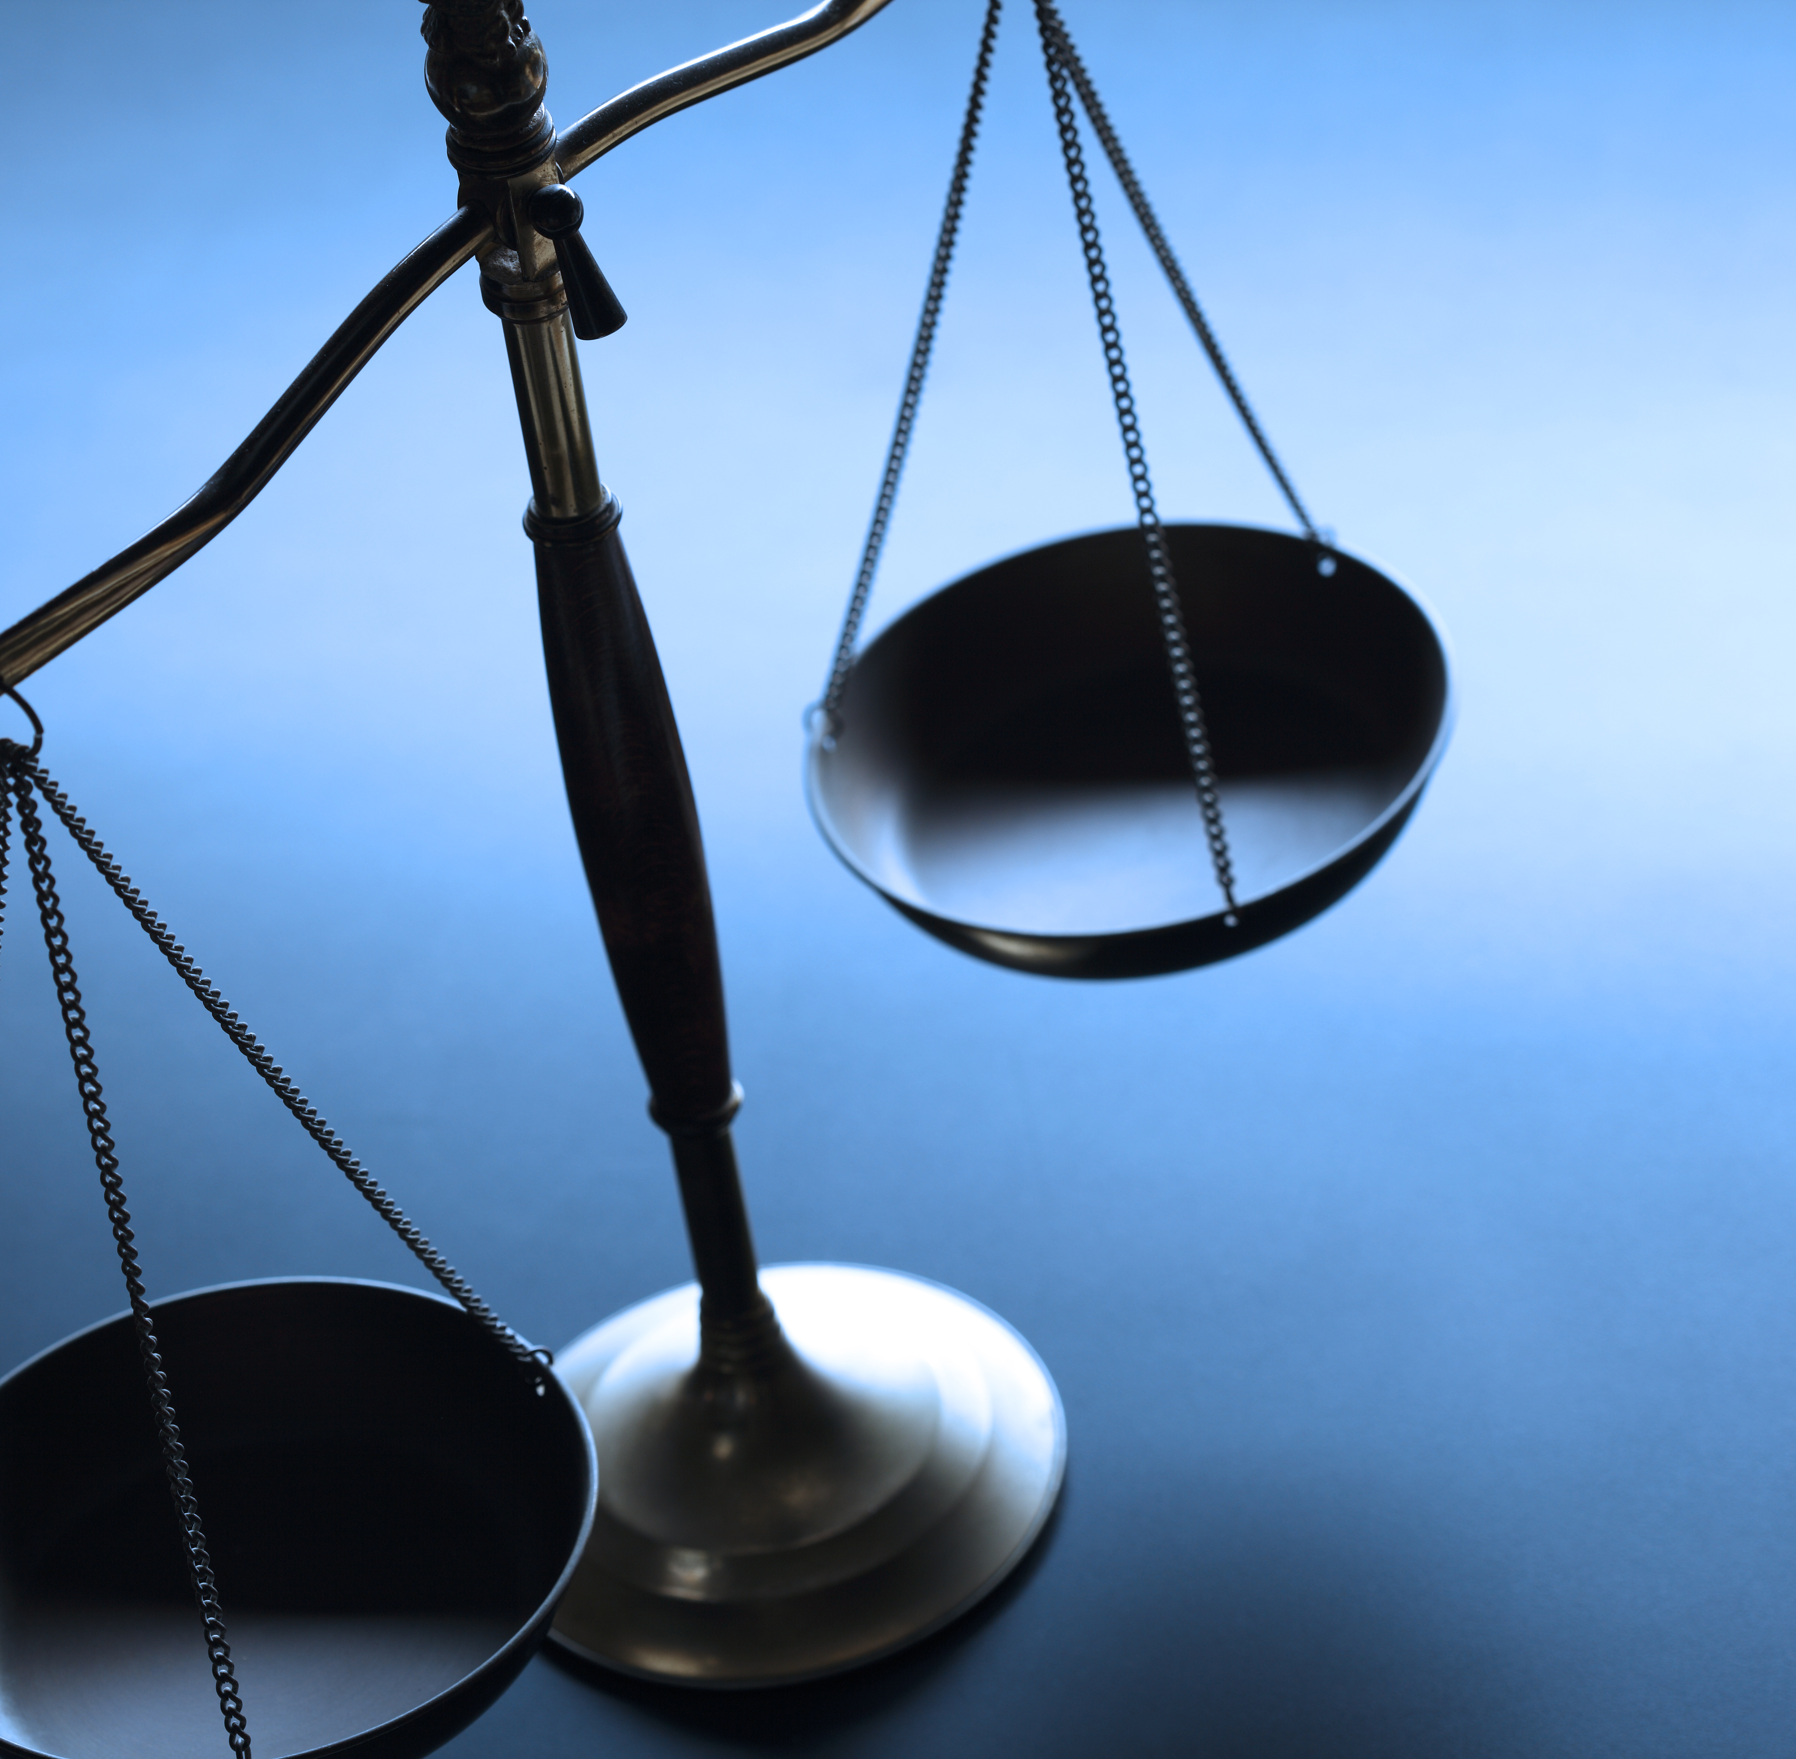
4. Ethics and Regulations
Regulations
Privacy
Explainability
Fairness
Accountability
Contestability

Slide 55
Healthcare regulations affecting AI
Market regulations:
EU AI Act
EU Digital Services Act
EU Digital Markets Act
EU Cyber Resilience Act
Biopharma regulations:
European Health Data Space
General Pharmaceutical Legislation
Clinical Trial Regulations
Data regulations:
GDPR (General Data Protection Regulation)
Data Act
Data Governance Act

Slide 56
AI ethics and regulations
Five key principles for regulatory use of AI for medical products
1
Safety, security and robustness
2
Transparency and explainability
3
Fairness
4
Accountability and governance
5
Contestabilityand redress
Policy paper. Impact of AI on the regulation of medical products. Medicines & Healthcare products Regulatory Agency, GOV.UK (Apr. 2024)​

Slide 57
4. Ethics and Regulations
Regulations
Privacy
Explainability
Fairness
Accountability
Contestability

Slide 58
Safety and security
Federated learning
Synthetic data
Foundation models
Differential privacy
Synthetic data
Requirements:
Standardisation
Infrastructure
Notes:
Computational infrastructure necessary
Standardisation of the data

Slide 59
4. Ethics and Regulations
Regulations
Privacy
Explainability
Fairness
Accountability
Contestability

Slide 60
Transparency and explainability
Transparent
Pneumonia
Pneumonia
Transparent
Black box
Post-hoc explainability
method
Identify dataset biases, or model problems
Model complexity vs transparency vs performance
Notes:
Dataset biases can be detected with transparency and explainability
Trade-off between predictive performance and model complexity
Model complexity is a common source of lack of transparency

Slide 61
4. Ethics and Regulations
Regulations
Privacy
Explainability
Fairness
Accountability
Contestability

Slide 62
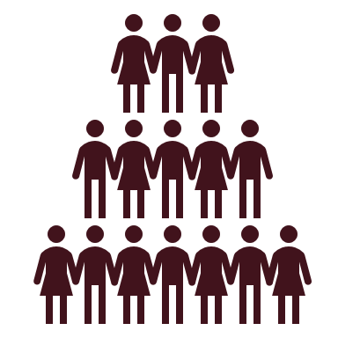
Fairness and robustness
Train
Validate
Test
Deploy
Performance
Training
Validation
Test
Deployment t=1
Deployment t=N
...
Requires constant monitoring
Notes:
active learning, semi-supevised learning, weak labels, one-shot learning
Constant monitoring of
Model performance
Data distribution

Slide 63
Fairness

Slide 64
4. Ethics and Regulations
Regulations
Privacy
Explainability
Fairness
Accountability
Contestability

Slide 65
Accountability and Governance
Effective oversight of the use of AI.
Clear lines of accountability across the AI life cycle.
Trustworthiness auditing

Slide 66
4. Ethics and Regulations
Regulations
Privacy
Explainability
Fairness
Accountability
Contestability

Slide 67
Contestability and redress
A person affected by the outcomes or a decision from an AI should be able to contest the AI.
How to rectify and address any harm resulting from an AI decision

Slide 68
5. Explainability
Global vs local
Model-based
Surrogate model
Feature-based
Example-based

Slide 69
Explainable to whom?
Different stakeholders, different explanations:
Patient (end-user):
confidence, clarity, fairness, contestability...
Doctor (domain expert):
support decision-making, trust, understanding, justification...
Developer / Scientists:
diagnosis, errors, design, model...
Researchers / Ethicists:
Fairness, biases, generalizability...
Executives:
Risk assessment, impact, investment, reputation, legal risks...

Slide 70
5. Explainability
Global vs local
Model-based
Surrogate model
Feature-based
Example-based

Slide 71
Global vs local explanations
Global
Local
Explain the overall behaviour of a model
Examples:
Overall feature importance
Overall performance of the model
Explain individual predictions
Examples:
Feature attribution
Exemplars and prototypes
Counterfactual explanations
Model

Slide 72
5. Explainability
Global vs local
Model-based
Surrogate model
Feature-based
Example-based

Slide 73
Transparent models
Decision Tree
Linear/Logistic Regression
n = 180
thalassemia
≤ 6
> 6
n = 112
n = 68
fluoroscopy
chest pain
= 0
> 0
≤ 3
> 3
n = 33
healthy
sex
healthy
disease
female
male
healthy
disease

Slide 74
5. Explainability
Global vs local
Model-based
Surrogate model
Feature-based
Example-based

Slide 75
Surrogate model
Given a pre-trained black-box model
Train a transparent model to simulate the black-box model
Input Data
Transparent
Black Box
Training
Training
Output
Data
Black-box
predictions
Transparent
predictions

Slide 76
5. Explainability
Global vs local
Model-based
Surrogate model
Feature-based
Example-based

Slide 77
PFI (Permutation Feature Importance)
Originally introduced for Random Forests, and made model agnostic in 2019 with the name Model Reliance.
It requires a scoring metric to evaluate the model's performance.
One feature to be assessed is selected and its values are randomly permuted.
The performance of the model is compared between the original and the permuted dataset.

Slide 78
LIME (Local Interpretable Model-Agnostic Explanations)
Aims at producing locally consistent explanations
Learns a model around the input and its prediction by the base model
Uses a representation that is understood by humans:
For text: presence/absence of words
For images: presence/absence of superpixels (contiguous patch of similar pixels)
For tabular data: weighted combination of columns
Notes:
Transparency—“Know How”

Slide 79
LIME (Local Interpretable Model-Agnostic Explanations)
Notes:
Transparency—“Know How”

Slide 80
LIME (Local Interpretable Model-Agnostic Explanations)
Notes:
Transparency—“Know How”

Slide 81
LIME (Local Interpretable Model-Agnostic Explanations)
z'
0 | 0 | 0 | 1 | …. | 0 | 0
x
x'
2
z
w
1
3
4
5
6
8
9
7

Slide 82
SHAP (SHapley Additive exPlanations)
Using Nobel-winning results from Game Theory, SHAP unifies previously proposed methods
Including LIME
Treats input features as players forming coalitions to better explain the base model’s prediction for x
Shapley regression values consists on retraining the model on all feature subsets and assessing how the model output changes with and without the feature being evaluated.
Dataset with feature i
Dataset without feature i
f'
f

Slide 83
SHAP
Feature values of the inspected sample
Model output for the inspected sample
SHAP values of all the input features will always sum up to the difference between baseline model output and the model output for the prediction being explained
For classification, baseline is the class proportion
For regression, baseline is the average y
Expected model output without information

Slide 84
5. Explainability
Global vs local
Model-based
Surrogate model
Feature-based
Example-based

Slide 85
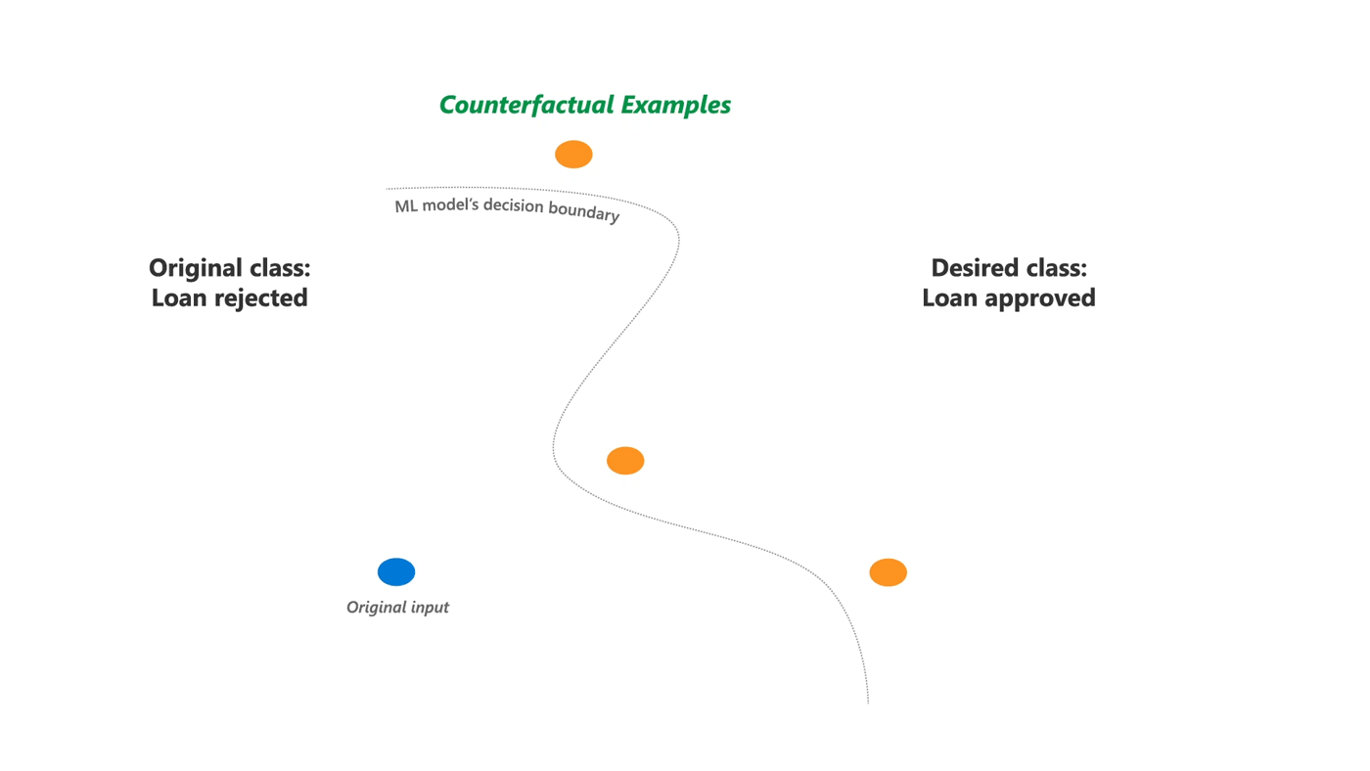
Counterfactual Explanations
A counterfactual explanation for a specific prediction describes the closest possible input that would result in a different prediction from the model.
Why they are important: They provide actionable insights, foster trust in AI systems, and help users understand the sensitive features influencing a decision.
Notes:
Encapsulates the thought experiment:
\textit{Y was my outcome, but if I had done $\delta$ then Y' would have occurred instead}.
Definition: A counterfactual explanation for a specific prediction describes the closest possible input (the "counterfactual") that would result in a different (usually desired) prediction from the model.
Intuition: Think of it as a "what if" scenario. "What if my credit score was 50 points higher?" or "What if my blood pressure was slightly lower?"
Why they are important: They provide actionable insights, foster trust in AI systems, and help users understand the sensitive features influencing a decision.

Slide 86
6. Large Language Models
Language Model
Large Reasoning Models

Slide 87
What Is a Language Model?
• An AI system designed to understand and generate human language
• Predicts what comes next in a sentence.
Predicts words within a sentence.
Notes:
At its core, a language model is an artificial intelligence system designed to understand and generate human language.
It learns the statistical relationships between words and phrases by analyzing vast amounts of text.
Its primary task is to predict the next word in a sequence, making the generated text coherent and grammatically correctm or predicting words
Think of it as an incredibly advanced auto-complete function.
https://jalammar.github.io/illustrated-bert/ (reference)

Slide 88
What makes them 'Large'?
The "Large" in LLM refers to several key aspects:
Vast Training Data
Billions of Parameters
Computational Power
Notes:
LLMs are trained on enormous datasets of text and code, often comprising trillions of words gathered from the internet, books, articles, and more. This extensive exposure allows them to learn a wide range of linguistic nuances, facts, and styles.
These models have an incredibly high number of "parameters" – variables that the model adjusts during training to learn patterns.
Modern LLMs can have hundreds of billions, even trillions, of these parameters, enabling them to capture complex relationships in language.
Training and running these models requires immense computational resources, including powerful GPUs and specialized AI hardware

Slide 89
What can they do ?
LLMs are versatile tools with many applications:
Text Generation
Translation
Code Generation & Debugging
Chat and Dialogue
Notes:
LLMs are versatile tools with many applications:
Text Generation: Crafting stories, poems, emails, marketing copy, scripts, and even entire articles.
Question Answering: Providing concise and relevant answers to complex questions by extracting information from their training data.
Summarization: Condensing long documents, articles, or conversations into key takeaways.
Translation: Accurately translating text between various human languages.
Code Generation & Debugging: Writing code snippets, converting code between languages, and identifying errors.
Creative Brainstorming: Generating ideas for names, concepts, designs, and more.
Chat and Dialogue: Engaging in natural, flowing conversations on a multitude of topics.
https://gdscpvgcoet.substack.com/p/the-rise-of-the-large-language-models (reference)

Slide 90
Different language models
OpenAI’s GPT series
Google’s Gemini
Anthtropic Claude
Meta’s LLaMA
Mistral
Notes:
Several prominent models developed by different organizations, each with unique strengths and applications.
OpenAI's GPT Series (e.g., GPT-4, GPT-4o):
Developer: OpenAI
Characteristics: Widely known for their strong general-purpose capabilities, excelling in creative writing, complex reasoning, coding, and multi-modal understanding (GPT-4o can handle text, image, and audio inputs). They are generally proprietary models, accessed via API or integrated products like ChatGPT.
Focus: Versatility, human-like text generation, and broad application across many tasks.
Google's Gemini Series:
Developer: Google DeepMind
Characteristics: Designed as natively multimodal, meaning they can process and understand different types of information (text, images, audio, video) from the ground up. They often excel in complex reasoning, coding, and long-context understanding.
Focus: Multimodality, deep reasoning, and integrating AI with Google's ecosystem (e.g., Google Search, Workspace).
Anthropic's Claude Series (e.g., Claude 3 Opus, Sonnet, Haiku):
Developer: Anthropic
Characteristics: Developed with a strong emphasis on safety, helpfulness, and harmlessness. They are known for their strong conversational abilities, ethical considerations, and performance in coding and complex analysis. Available through API.
Focus: Responsible AI, conversational fluency, and robustness for enterprise applications.
Meta's LLaMA Series (e.g., Llama 3):
Developer: Meta AI
Characteristics: These models are often released with open weights, making them accessible for researchers and developers to download, run locally, and fine-tune for specific applications. They offer competitive performance and foster innovation within the open-source community.
Focus: Open-source accessibility, efficiency, and community-driven development.
Mistral AI (e.g., Mistral 7B, Mixtral 8x7B):
Developer: Mistral AI
Characteristics: Known for developing highly efficient and powerful models, often with open weights, that can achieve strong performance with fewer parameters, making them more cost-effective to run. Mixtral uses a "Mixture of Experts" (MoE) architecture for efficiency.
Focus: Performance efficiency, open-source models, and innovation in model architecture.
Each of these models has its own strengths and is continuously being improved, leading to a diverse and dynamic landscape of AI capabilities.
https://www.techradar.com/computing/artificial-intelligence/best-llms

Slide 91
6. Large Language Models
Language Model
Large Reasoning Models

Slide 92
Large Reasoning Models – Chain of Thought Reasoning
Encourages models to 'think through the problem'.
Example: "Let’s think step by step..."
Helps solve math and logic problems.
Notes:
Chain of Thought Reasoning
This is an advanced technique that allows LLMs to break down complex problems into intermediate steps, similar to how a human might think through a problem. Instead of just giving a direct answer, the LLM generates a sequence of reasoning steps, which often leads to more accurate and robust solutions, especially for multi-step questions or logical puzzles.
Example: "If a train leaves station A at 10 AM going 60 mph, and another leaves station B (300 miles away) at 11 AM going 50 mph towards A, when do they meet?" An LLM with Chain of Thought might first calculate the distance covered by the first train before the second one starts, then the relative speed, and finally the time to meet.
Used in GPT-4, Claude, PaLM.

Slide 93
Chain of thought reasoning - No prompting
No Prompting
Q: If there are 5 baskets and each basket has 6 apples, how many apples are there in total?
A:30
Notes:
The phrase "Let's think step by step." in the prompt triggers the model to produce intermediate reasoning steps.
Without it, the model tends to give the final answer directly.
This is the simplest form of zero-shot chain-of-thought prompting.

Slide 94
Chain of thought reasoning - Zero Shot
Q: If there are 5 baskets and each basket has 6 apples, how many apples are there in total? Let's think step by step.
A: Each basket has 6 apples. There are 5 baskets. So total apples = 5 × 6 = 30. The answer is 30.
Notes:
The phrase "Let's think step by step." in the prompt triggers the model to produce intermediate reasoning steps.
Without it, the model tends to give the final answer directly.
This is the simplest form of zero-shot chain-of-thought prompting.

Slide 95
Chain of thought reasoning - Few Shot
Q1: If a classroom has 6 rows with 7 chairs in each row, how many chairs are there?
A1: Let's think step by step. Each row has 7 chairs. There are 6 rows. So total chairs = 6 × 7 = 42. The answer is 42.
Q2: If there are 5 baskets and each basket has 6 apples, how many apples are there in total?
A2: Let's think step by step. Each basket has 6 apples. There are 5 baskets. So total apples = 5 × 6 = 30. The answer is 30.
Notes:
Why is few-shot CoT effective?
The model learns the format: question → step-by-step reasoning → final answer.
It imitates the pattern in the prompt.
Helps with complex tasks by encouraging explicit reasoning.

Slide 96
Large Reasoning Models – Retrieval Augmented Generation (RAG)
Issues with LLM are that information the model trained on was out of date and there is no source for the model
RAG involves using an LLM to get data from an external source.
Therefore, the source of the information is known and the information is up to date.

Slide 97
Large Reasoning Models –Retrieval Augmented Generation (RAG)
Notes:
Retrieval Augmented Generation (RAG)
While LLMs have vast knowledge from their training, that knowledge is static.
Therefore two issues with an LLM could be that the information is out-of-date, as well as there is no source to the data.
RAG combines the generative power of LLMs with real-time access to external, up-to-date information sources (like databases, documents, or the internet). When you ask a question:
The system first retrieves relevant information from an external source, this could be an external database such as a company database or other databasses such as the internet.
It uses the retrieved information and the prompt (which is fed into the LLM) to produce an answer.
Then, it uses that retrieved information to generate a more accurate, up-to-date, and grounded answer using the LLM. This helps reduce "hallucinations" (making up facts) and ensures answers are based on specific, verifiable data.
This therefore solves the issues as the information used can be up to date and we can obtain a source for the query.
1. Query Encoding
The input question or prompt is encoded into a vector (embedding) using a query encoder (often a transformer model like BERT).
2. Retrieval
The encoded query is used to search a retrieval corpus (e.g., Wikipedia, document database, private knowledge base) via a vector similarity search.
Typically, this uses dense retrievers like FAISS or sparse retrievers like BM25.
Top-k relevant documents/passages are retrieved.
3. Augmentation
These documents are then fed into a language model along with the original query.
The language model is prompted with the query and retrieved content to generate a grounded answer.
4. Generation
The generation model (e.g., a seq2seq model like T5, BART, or GPT) outputs a response conditioned on both the question and the retrieved documents.
https://gettectonic.com/retrieval-augmented-generation-techniques/ (source of image)

Slide 98
Data privacy and security
NHS Compliant, GDPR Compliant, HIPAA Compliant, ISO 27001 Accredited...
Data security
Not about the AI aspect

Slide 99
The limitations of AI
Some AI tools are designed to generate realistic text, but not true facts.
The credibility of the sources may be difficult to assess.
Google has fixed the issue.

Slide 100
Continuous improvement of AI
I tried with Google but did not work.
ChatGPT identifies that it is not a real syndrome.
New online articles discussed the previous mistake.

Slide 101
Q&A and Discussion
Interpreting Artificial Intelligence Solutions for Healthcare
Presenters:
Dr Miquel Perelló Nieto
Dr Nawid Keshtmand

Slide 103
Thank you!
Please take a moment to give us some feedback to help plan future events: https://forms.office.com/e/zvRxnXY5Hk

